Slide 1
High power thermal transient testing: challenges and chances
Dr. Gabor FARKAS
Development Engineering Manager
MAD MicReD
June 2012, Tokyo

Slide 2
Measurement of high current semiconductor devices

Slide 3
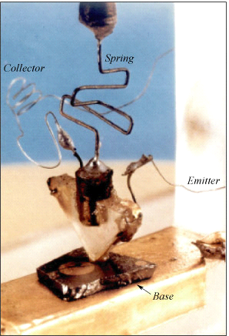
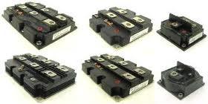
Measurement of transistors in general
We have a long history in measuring different transistor devices
  BJT-s, MOSFET-s, IGBT-s, HEMT-s
  can be tested
Tests may have different purposes:
  Junction temperature measurement
  Structural analysis
  Reliability analysis
  Thermal model generation
  Measurement of standard
  datasheet values
Our test methodology follows the
JEDEC 51-1 and the MIL-STD-750E series of standards
Notes:
I will say the same as on the slide

Slide 4
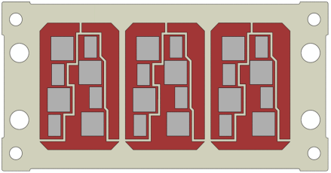
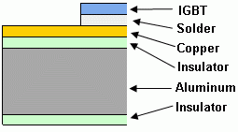
Helping Manufacturers:
Samsung - IGBT for Driving a Motor
High current full bridge for automotive
Power scalable in multiples of 250A/1.6 kW
Notes:
This was a study published with Samsung in Korea. We used our high power booster line to check the heat spreading in a High current full bridge for automotive industry. With the newest booster models we can produce multiples of 250A for testing IGBTs. This equipment also supports IGBT measurements in saturation with high constant V_{GE} voltage

Slide 5
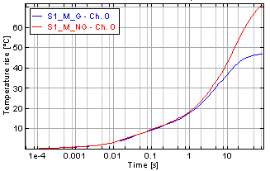
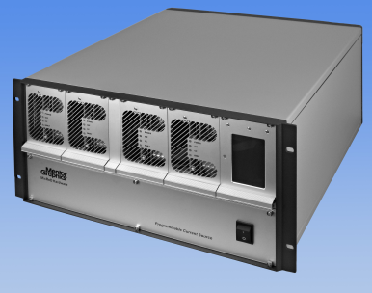
Helping Manufacturers:
Samsung - IGBT for Driving a Motor
Minimum Al
Average Al
Maximum Al
Cu
Insulator
Chip
DA
Notes:
We found that structure functions help identifying structural details in a qualitative and quantitative manner. Measuring thermal capacitance in the structure function we could easily find partial thermal resistance of chip, copper heat spreader, aluminum base etc. We could distinguish between good and faulty samples and we saw device breakdown in long time repeatability tests.

Slide 6
MIL-STD-750 compliant characterization
The MIL-STD-750 standard dates from the early 70-s and suggests different methodologies for different devices
It describes slightly different powering for BJTs, MOSFETs, IGBTs
The most commonly referenced methods are
  Method 3101 for diodes and other 2-pole devices
  Method 3131 for BJT-s (can be applied for the others, too)
  Method 3103 for IGBT-s
  Method 3161 for MOSFET-s heated on the R_{dson} channel resistance
T3Ster technology realizes all measurement techniques for all device categories.
Notes:
I will say the same as on the slide

Slide 7
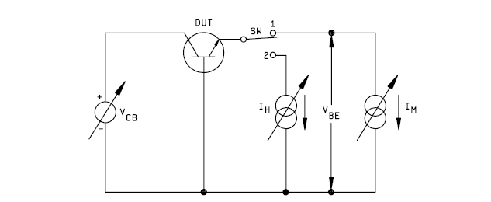
Method 3131:
High power applications
An additional power booster and a V_{CB} generator for
MIL-STD-750 standard characterization is required
Exists in booster
Additional high current voltage source
Notes:
A typical measurement upon standards is measuring power transistors as described in MIL-STD-750 standard. As we can see in the figure, the high emitter current flows further towards the collector, in such a way the VCB generator has to withstand high voltage AND high current, a really demanding task

Slide 8
A simple circuit transformation helps …
The transistor “does not know” how are currents and voltages ensured on the three pins …
Notes:
Rearranging the sources we need only ONE high current source, while the circuit behaves in the same way, or even better, common emitter circuit has less chance to oscillate than common base. And the transistor “does not know” how are currents and voltages ensured on the three pins …

Slide 9
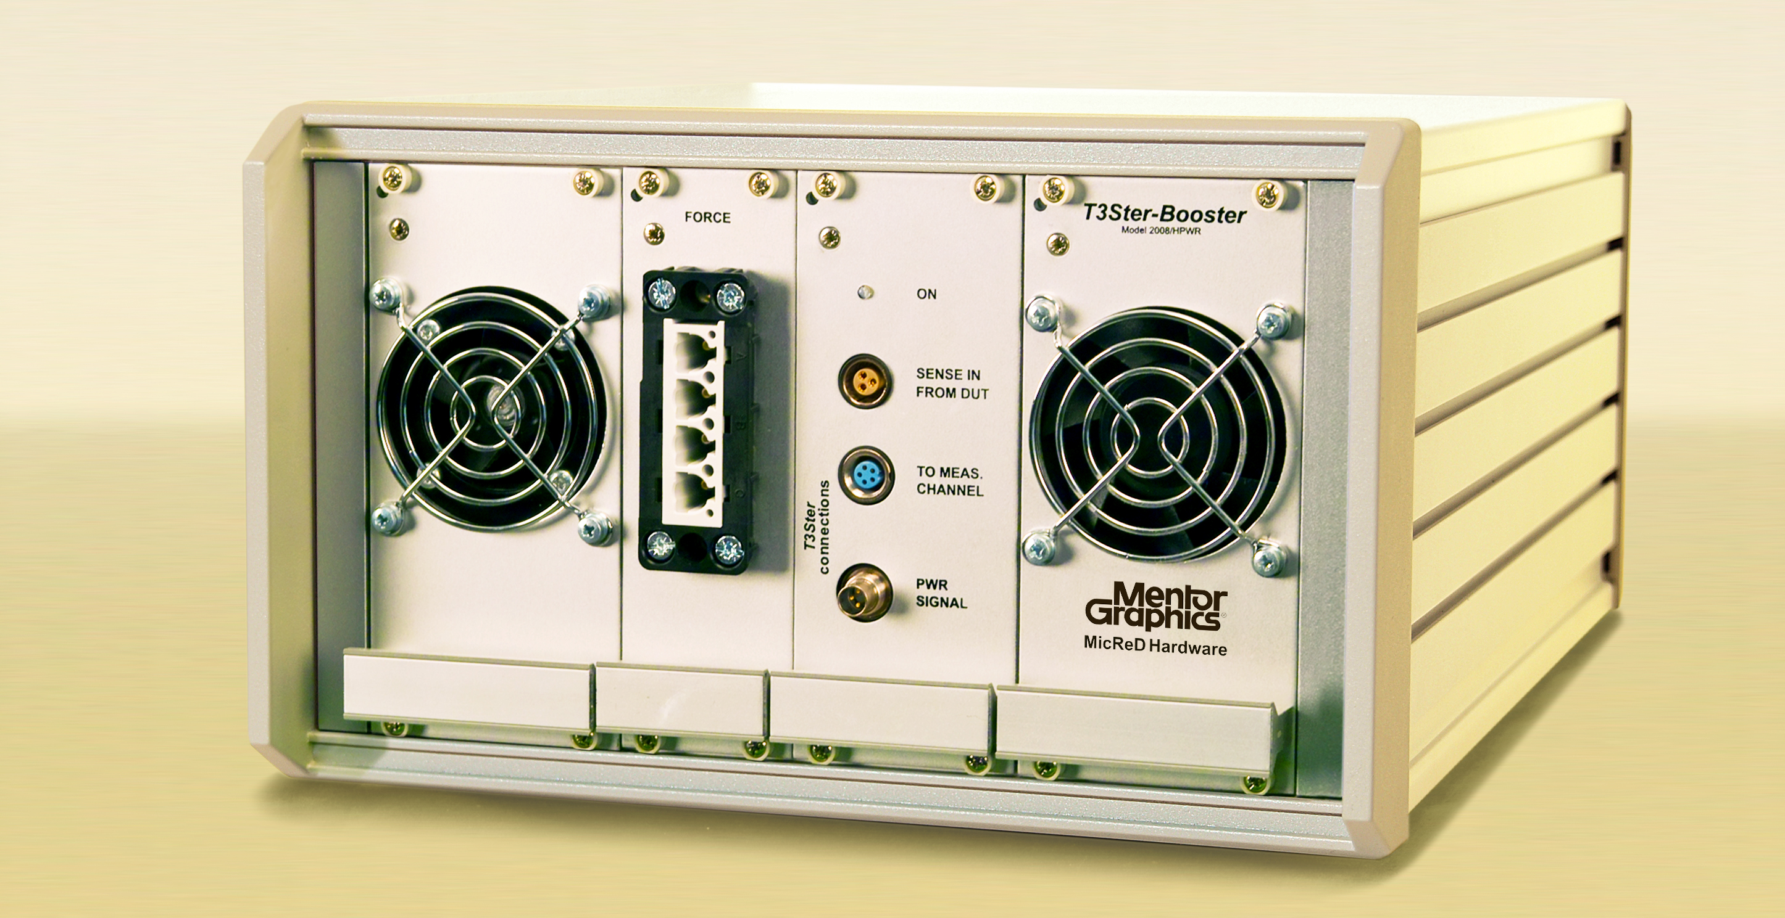
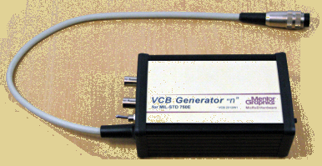
V_{CB} generator for
MIL-750 standard characterization
Simple fixture to generate the voltage
Notes:
This simple fixture acts as independent VCB source. It realizes the rearranged Method 3131 of the previous slide

Slide 10



For diode or transistor measurement all MIL standard methods are available
I_{force}
I_{sense}
to T3Ster channel
Reverse diode measurement
I_{force}
I_{sense}
to T3Ster channel
“MOS diode” measurement
I_{force}
I_{sense}
to T3Ster channel
Saturation mode measurement of IGBTs
U_{GE}
Notes:
Measuring diodes is rather simple, we need just a high current source for driving it and a measurement current source for the cooling time. 3 pin devices are more complex. We can measure a MOS transistor for example driving the reverse clamp diode, the “MOS diode” by connecting the gate to drain and IGBTs in saturation mode.

Slide 11

Method 3161
Using the new LS200A/10V boosters
V_{G} opens the power MOS transistor and high current is used for heating on R_{DSon}
In measurement phase V_{G} switched to 0 and reverse diode opened for sensing
The negative sense current is taken from T3Ster.
V_{diode}≈-0.5V
heating
to T3Ster channel
I_{force}
V_{G}
I_{sense}
Notes:
For large current MOSFET devices it is often a requirement to study the heating on a serial Rdson resistance. Adding a switch to the circuit it is easy to do this with the new booster line. In the heating phase V_{G} opens the power MOS transistor and high current is used for heating on RDSon.

Slide 12
Method 3161
Using the new LS200A/10V boosters
V_{G} opens the power MOS transistor and high current is used for heating on R_{DSon}
In measurement phase V_{G} switched to 0 and reverse diode opened for sensing
The negative sense current is taken from T3Ster.
V_{diode}≈-0.5V
cooling
to T3Ster channel
I_{force}
V_{G}
I_{sense}
Notes:
Iin the cooling phase V_{G} is switched to 0 and the reverse diode is opened for sensing. The negative sense current is continuously on and is taken from T3Ster.
V_{diode}≈– 0.5V. The best measurement results can be achieved if the “switch” is simply a MOSFET of the same type as the device under test.

Slide 13
New high current boosters – ratings
Voltage limit: 10V of DUT voltage in all cases
Power limits: 1600W/unit without Agilent
                2100W/unit with Agilent
Below 40A heating provided by an additional Agilent N5743A DC System Power Supply, 12.5V, 60A, 750W
Several systems can operate in parallel, allowing the measurements up to the kA range
1200A system is in operation
The triple channel version has separate part number and can provide 600A
Notes:
as above

Slide 14
Other features of the new booster line
- Switching takes place physically next to the DUT to avoid disturbing electric effects
- Switching box contains an additional 0.5A/10V sensor source and a 15V voltage source for gate driving
- The system can help to perform reliability studies by making power cycles on the tested devices
- Implicitly a reliability tester for high power semiconductor packages and assemblies
Notes:
as above

Slide 15
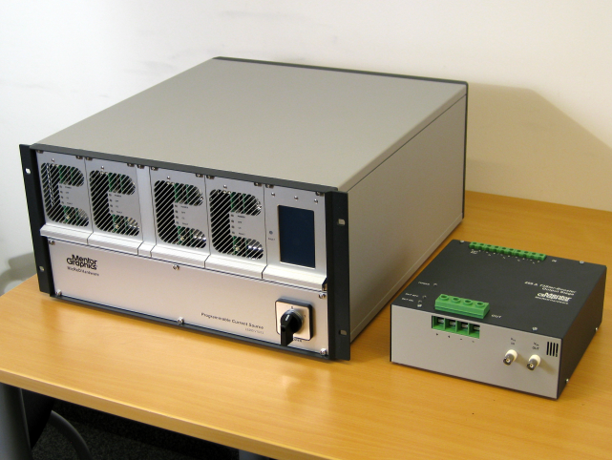
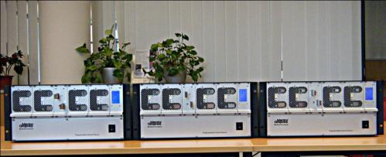
Using the new LS200A/10V boosters for power cycling
These boosters are aimed at the measurement of high current MOSFET-s and IGBT devices in automotive applications, mainly motor driving circuits
The system can help to perform reliability studies by making power cycles on the tested devices
Several systems can operate parallel, allowing the measurements up to the kA range
1200 A system already operational

Slide 16
Measurement of
TIM2 materials

Slide 17
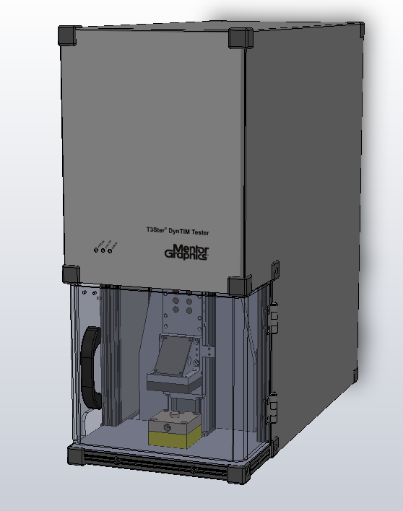
DynTIM -
Automated TIM testing
Fine material thickness setting
  The accuracy of the set value can be even 1µm
All operations are software controlled
Easy sample preparation and high throughput
Automated measurement of compressible materials such as greases, pastes, soft pads, phase change materials

Slide 18
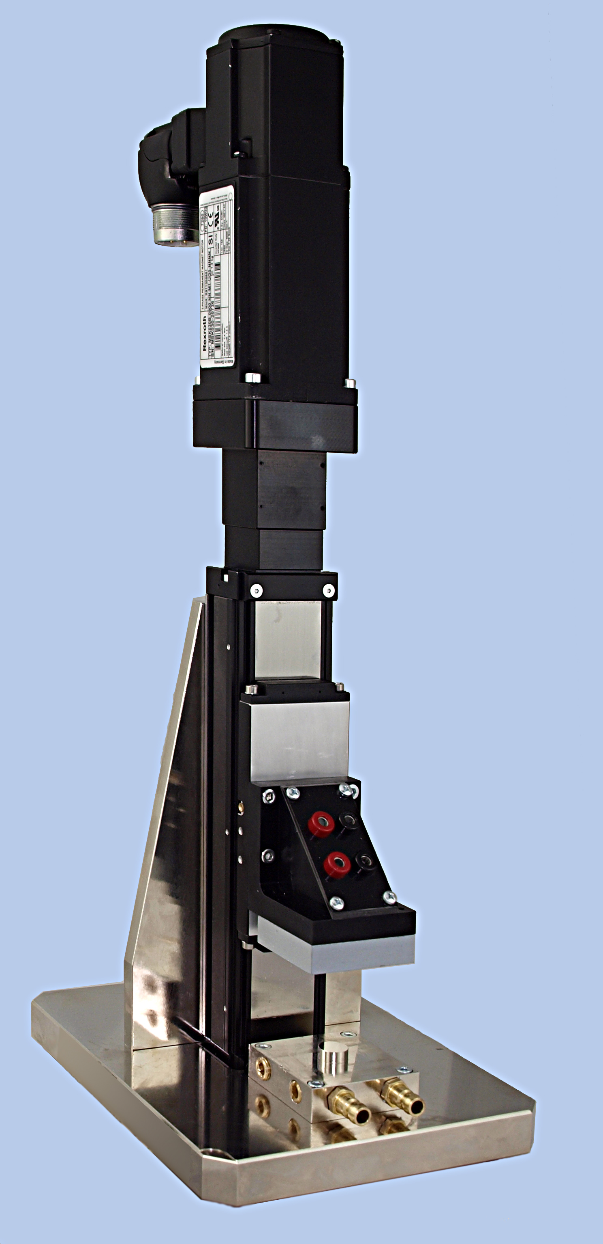
Automated
TIM testing fixture
Diode package moved on a rail
by a step motor
The resolution of the BLT setting is 0.1µm
The accuracy of the set value is 1µm
All operations are software controlled
Easy sample preparation and
high throughput
Automated determination of minimum
achievable BLT value and pressure
Notes:
The thermal resistance of TIM has two components,
1: the surface resistance which depends on the actual surfaces. This is something which cannot be measured separately, only by in situ testing.
2: the bond line thickness dependent material thermal resistance, which is described by thickness and thermal conductivity.
Here we show an instrument measuring thermal conductivity of soft materials (grease, oil, elastomer foils etc.)
Also I will say what is shown on the slide above.

Slide 19
Transient results and structure functions
BLT
Notes:
We can already observe the dependence of thermal conductivity in the measured Zth curve when adding a T3Ster to the fixture. The chart shows the change of the total junction to ambient thermal resistance at BLT when squeezing the material from 1000 μm to 1o μm

Slide 20
Transient results and structure functions
BLT
Notes:
we have a much clearer picture when we follow the same in cumulative structure functions. Reading the total junction to ambient thermal resistance at a high thermal capacitance we can produce a plot where the thermal resistance is shown as a function of the bond line thickness. We can observe that all portions of the structure all stable except the TIM

Slide 21
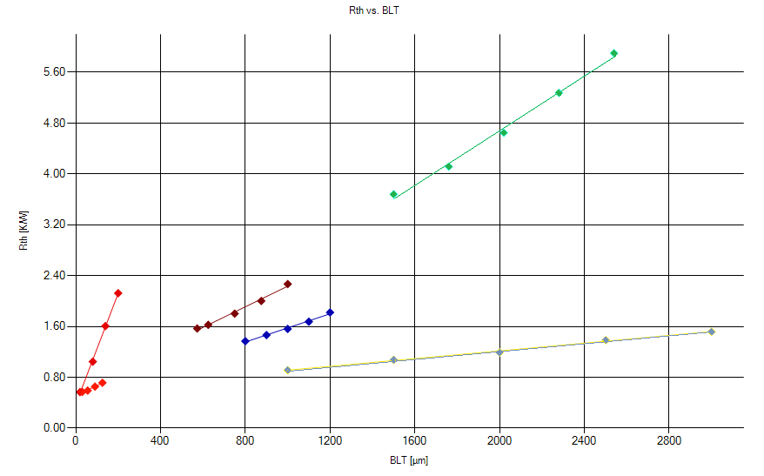
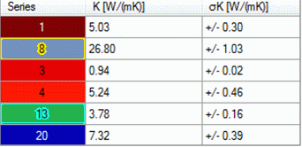
Different materials tested
Gap pad
Silicon grease
Gap pad
Gap pad
Stainless steel
CNT grease

Slide 22
Some results
λ = 4.1 W/mK
k or λ stays for thermal conductivity
Notes:
We can distill the structure functions of the previous chart into this figure. The steepness of the nearly linear curve corresponds to 4.1 W/mK thermal conductivity.

Slide 23
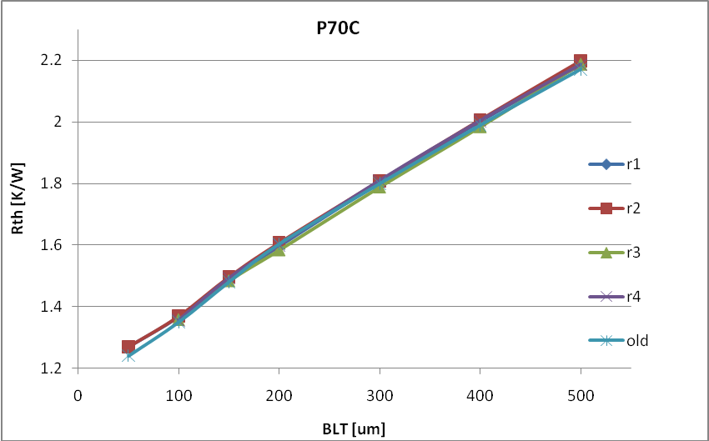
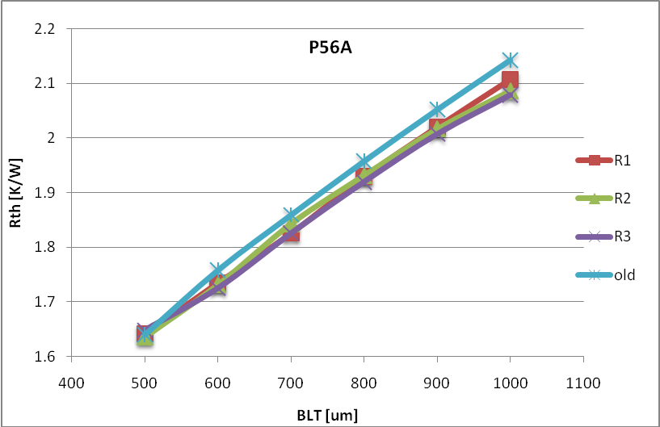
Results - Repeatability
TIM | λ_{average} [W/mK] | Standard deviation
P70C | 4.88 | 0.78%
P56A | 10.83 | 5.75 %
Difference in viscosity
Notes:
Measurements are highly repeatable on low viscosity materials. Viscous materials also show acceptable results, but obviously repeated tests scatter a bit, because when pushing and pulling the TIM it will not smash the surface always the same way. We see here a paste of high silver content.

Slide 24
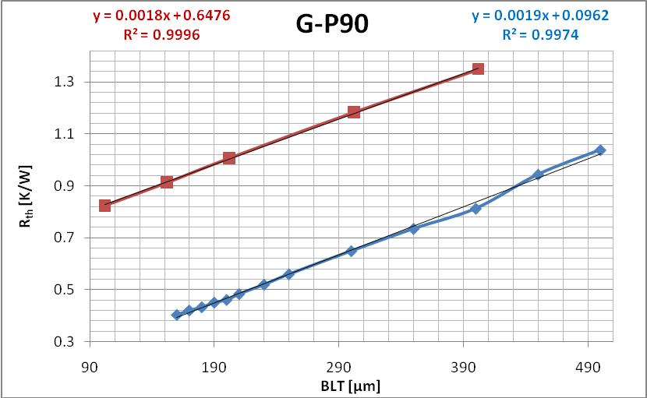
Comparison with laboratory tester
Same slope, only offset difference
Interfacial resistance?
Notes:
Comparing the TIM fixture results to an other high quality thermal tester we find that the measured conductivity is the same. However, the surface material and roughness was different, this causes an offset between measurements. There is nothing wrong with it. In situ testing can help.

Slide 25
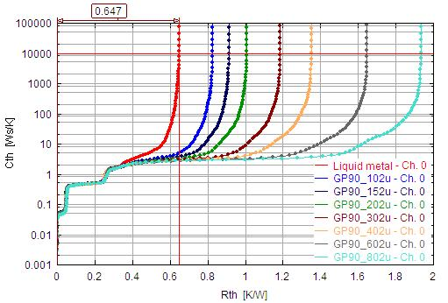
Measurement of the inherent thermal resistance of the system
In order to measure the resistance at 0 BLT, Indium based liquid metal alloy was used
Notes:
In this experiment in order to measure the resistance at 0 BLT, Indium based liquid metal alloy was used. The first red curve characterizes the diode package and the fixture faces.

Slide 26
Deviations from real data in datasheets
Notes:
Here we see measured conductivity with two different Mentor Graphics MicReD testers of very different principle. As we can see, our testers produce nearly the same results. Vendors often give unreliable material data in the datasheet, sometimes much better than reality.

Slide 27
Measurement of
HEMT and MESFET devices

Slide 28
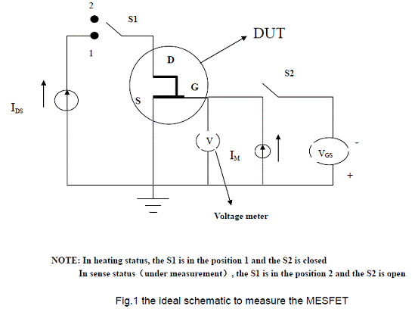
HEMT and MESFET thermal measurements
A textbook scheme for measuring them is basically the following:
Notes:
A textbook scheme for measuring HEMT and MESFET is basically the one here:

Slide 29
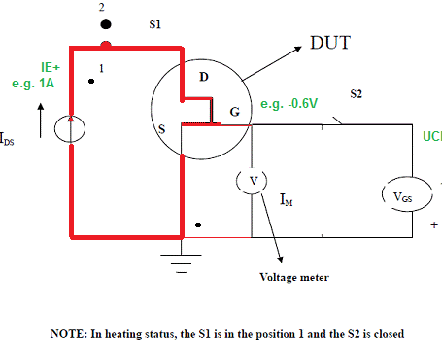
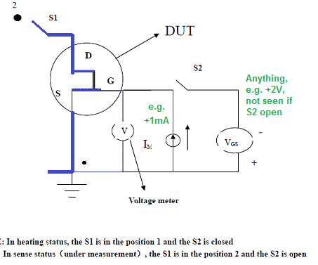
HEMT and MESFET thermal measurements
This can be decomposed on
HEATING
COOLING
Notes:
The test can be decomposed on heating and cooling.
During heating the FET conducts and the channel heats.
During cooling the Schottky gate is forward biased and used as temperature sensor.

Slide 30
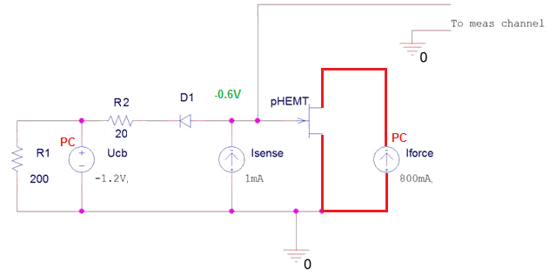
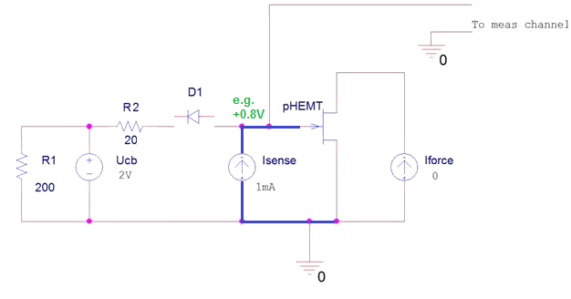
HEMT and MESFET thermal measurements by T3Ster
HEATING
COOLING
Notes:
With a simple circuitry this can be easily realized by T3Ster. The “switch” is just a fast diode. The UCB source of the T3Ster can make it open or close.

Slide 31
Measurement of high voltage device strings

Slide 32
  Measurement of individual LED-s in a chain
The new LED string tapper device enables the test of individual junction temperatures in an LED chain
Notes:
The new LED string tapper device enables the test of individual junction temperatures in an LED chain

Slide 33
Measurement of individual LED-s in a chain
Electrical problem
12V
……
LED N
……
LED 4
LED 3
LED 2
LED 1
If voltage < 12V, each LED can be attached to meas. channel
If voltage is between 58V and 12V, use LED string tapper for the measurement of individual LED-s
Above 58V the measurement can be carried out using individual 10:1 or 20:1 pre-scalers
Notes:
T3Ster Measurement Channel can accept signals ± 5V differential, ±12V common mode. For LEDs or other devices at a higher voltage position an instrument is needed which gets rid of common mode voltage. This is the LED string tapper.
I will also say the sentences on the slide.

Slide 34
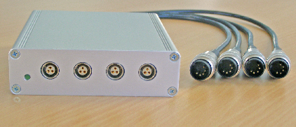
LED string tapper
Specifications
  Number of channels: 4
  Voltage of the LED above the ground -10V .. 58V
  Voltage of a single LED -5V .. 5V
  gain: 1
  input impedance: 20 MΏ
  supply voltage: 24V, typically from Booster
Notes:
It looks like this here. The input connectors are the same ones as in booster. The outputs connet to T3Ster

Slide 35
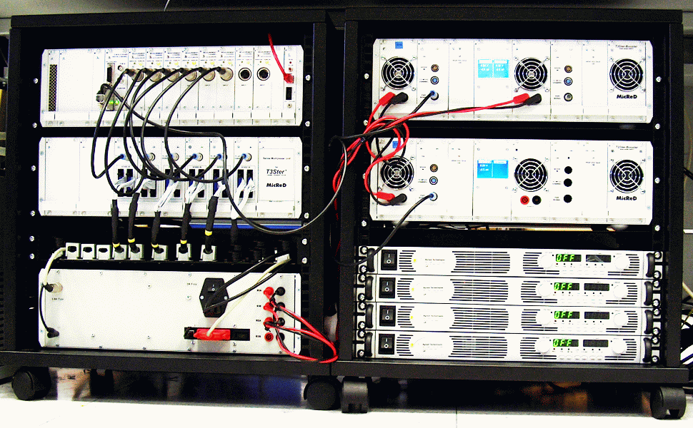
New multiplexer scheme for large scale industrial testing of parts
4 channel 1500 W Booster
T3Ster
Sense Box
Force Box
External power supplies 150V 10A
80 devices to be tested in one batch
20 ºC to 80 ºC
35
Notes:
I will say what is on the slide.

Slide 36
T3Ster Used in Large Scale Testing:
High throughput testing of power LEDs in a customized test environment
Both parallel powering and serial DUT connection applied.
Used for large scale reliability studies
Multiplexers can be used with 3rd party temperature controlled customized test chambers.
Notes:
I will say what is on the slide.

Slide 37
Enhancement of the Teraled system

Slide 38
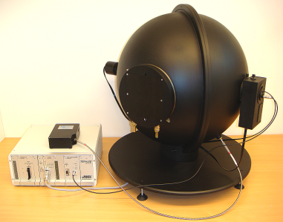
Enhancements of the TERALED system -
∅50cm sphere coming soon
The sphere must be sized according to the power of the LED tested
The temperature controlled DUT holder should be able to stay stable during the test – sufficient heat sinking capability
Previous system: ∅30cm sphere with a ∅60mm DUT LED port for LEDs up to 10W with a filter based detector system.
A ∅50cm sphere with a ∅150mm DUT LED port for LEDs up to 50W with a filter based detector system and with an array spectrometer.
Notes:
I will say what is on the slide.

Slide 39
System characteristics
The best optical filter based photo detector system
  Range matched to the needs of most advanced HB LEDs
  This is the only option to test AC driven LEDs as the waveform of the emitted optical power is needed
Spectrometer support:
  Low-end, cheap array spectrometers can only be used to measure relative spectral power distribution; absolute flux values are to be taken from calibrated filter based detectors; needed for CRI only
  Temperature stabilized array spectrometers are typically used to assure high accuracy – for AC LEDs still, photodetector needed
Enhanced cooling solutions:
  Peltier-based solutions provide fast settling time and easy electronic control – up to 30W
  Liquid-cooled cold-plates practically have no limits in heat-sinking capability

Slide 40
Summary of items to consider
Appropriate level of forward voltage / current has to be provided
  Test equipment cannot cover everything, therefore vendors offer so called LED boosters
Cold-plate must provide appropriate level of heat-sinking capability, matched to the dissipation of the LEDs to be tested
Integrating sphere should be sized according to the power of the LED

Slide 41
Summary of items to consider

Slide 42
Software changes

Slide 43

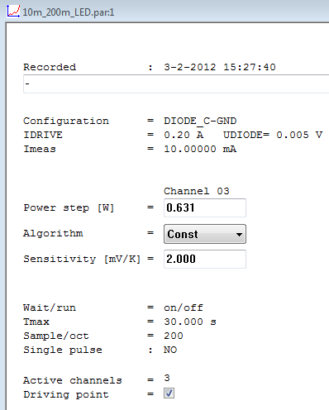
T3Ster-Master new features
“Record Parameters” view is editable.
The software handles the non-linearity of the k-factor.
Stores and uses the non-linear characteristics of thermocouples
Existing customers watch out for the next release! on Supportnet ☺

Slide 44
Case study : complex testing of LED assemblies

Slide 45
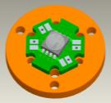
Case study – for the KÖZLED project
3 different assemblies with high-end 10W white LEDs
  FR4 PCB, TIM between the heat-slug and the Cu block
  FR4 PCB, heat-slug soldered to the Cu block
  MCPCB-s made of Al and Cu, heat-slug soldered
CAD images by courtesy of OptimalOptik Ltd.
Notes:
I will say what is on the slide.

Slide 46
Results for 10W white LEDs
Measured at 700 mA and 85ºC
  Structure functions of 3 samples, power corrected with P_{opt}
TG2500
AL
FSF52
R_{thJC real} ≈ 2 K/W
  R_{thJC} is identified in a way similar to the transient double interface method, standardized by the JEDEC JC15 committee
Notes:
Here we compare 3 samples, on different plate, obviously MCPCB was best and FR4 with TIM was poorest.
I will also say what is on the slide.

Slide 47
Results for 10W white LEDs
Measured at 700 mA & between 15ºC and 85ºC
  Structure functions of sample AL-2, power corrected with P_{opt}
  As temperature changed, TIM quality changed
Al MCPCB &TIMs: temperature dependence
LED package: no variation
Notes:
This is newer note, started 8th May. GF
The main message of the slide is that the LED package itself was extremely stable during the reliability test. The change was in the measurement environment, I mean the holding MCPCB and the TIMs did change. We will see the consequences in the next slide.

Slide 48
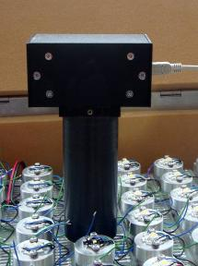
LM80 Tests @ Univ. of Pannonia,
Hungary
LM80 test chamber with all the LEDs assembled
All measurements are done in-situ to eliminate any
R_{th} change which is NOT due to ageing
In-situ thermal transient measurement
In-situ light output measurement
Notes:
I will say what is written on the slide.

Slide 49
Results from LM80 test of different LEDs
In cooperation with University of Pannonia, Veszprém (Hungary), within the KöZLED project
8 different kinds of LEDs from 4 vendors, so far 4000h burning time
Light output drop likely due to increased R_{th} caused by TIM degradation, not by LED degradation
Vendor O. 350 mA
Relative luminous flux
No change inside the LED package
Time [h]
Structure functions taken at
0h, 500h, 1000h
Notes:
The LED samples from Vendor O were very stable, unlike some other makes. There was a few percent luminous flux drop in 1000h. The structure functions confirm that the actual change was a few % in the total junction to ambient thermal resistance, caused by the change in the end of the heat conducting path.

Slide 50
Case study:
Thermal Interface Material testing In Situ

Slide 51
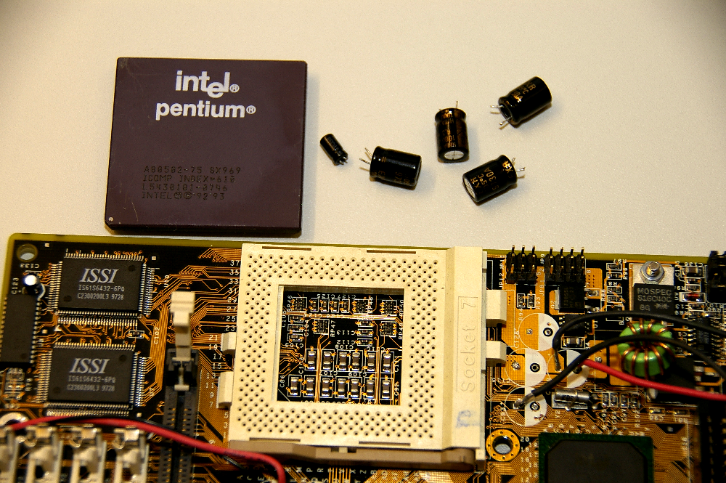
Board prepared for testing
Notes:
This is a short case study, in case the time allows to show. It is not there in the printed material.
In this experiment we made an IN SITU test of TIMs for testing the TIM behavior between an actual CPU package and heat sink.
The CPU was plugged into a real motherboard. For testing we used the substrate diode between VDD and GND reverse biased. For having access we had to remove one single choke (yellow circle) and we had it. For saving them at reverse biasing and for short electric transients we also removed the electrolytic capacitors on that power line (red contour).

Slide 52
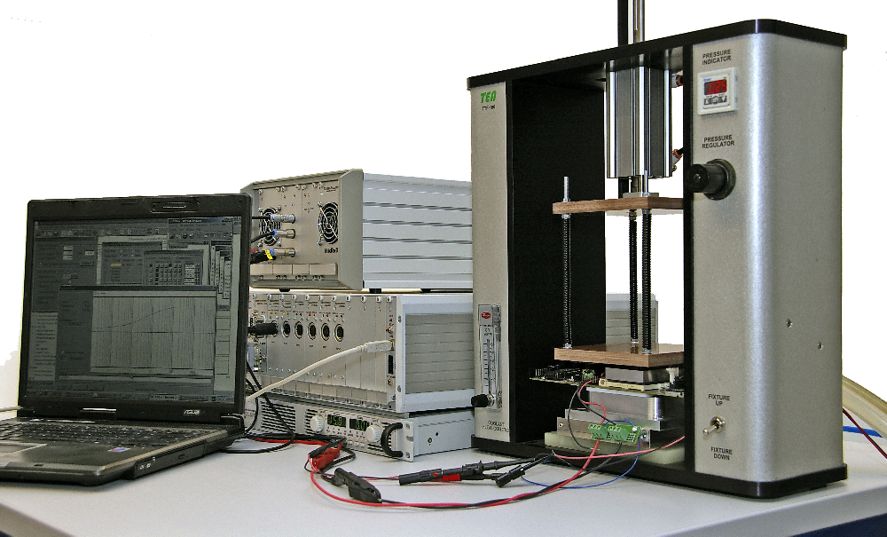
Test stand for in-situ TIM measurement
Pressure control
No BLT control
Notes:
In this test stand we pushed a water cooled cold plate mimicking the heat sink in real life. The test stand had control on pressure but not on bond line thickness.

Slide 53
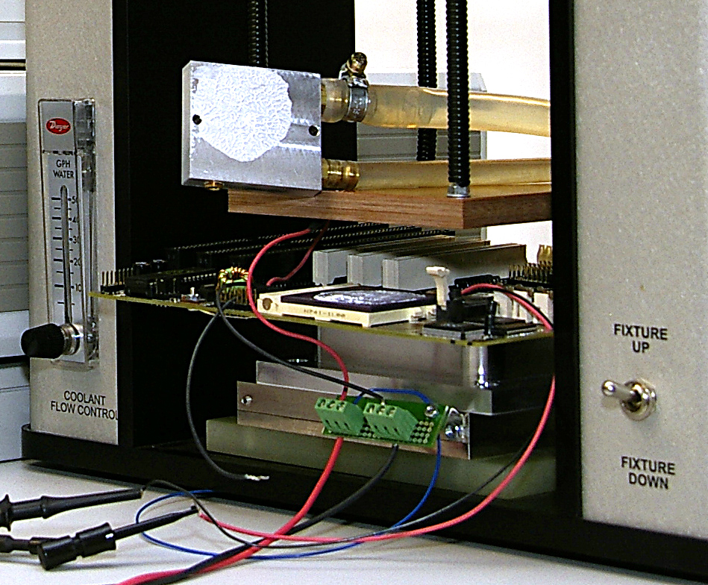
Ready to launch
Notes:
Now we see the CPU and the lifted heat sink. The paste was applied unevenly and with dry spots, which is a frequent in situ case.

Slide 54
Zth, comparison
No change at any pressure
Notes:
In this figure we see Zth curves measured free air (without the heat sink), thermal grease at low pressure (30 kPa) and high pressure (600 kPa) , and finally organic elastomer foil at 30, 200, 600 kPa
(click)
Now, zooming in, we see that wet surface was better than dry, obviously, and the grease squeezed at high pressure giving better cooling.
(click) (click) (click)
On the other hand, we see that elastomer foil was not sensitive on the actual pressure, it performed well already at 30 kPa.

Slide 55
Cumulative structure functions, all materials, all pressures
Heating/cooling symmetry?
grease
Grease at high pressure performs best
air
foil
Notes:
Structure functions give a clearer view. We see that grease at high pressure was the best among the materials in the near environment. But elastomer foils were nearly equal in the total junction to ambient thermal resistance.

