Slide 1
Microelectronics, BSc course
Introduction
Szabó Péter Gábor, assoc. prof. (QB330)
szabop@eet.bme.hu
Poppe András, prof. (QB326)
poppe@eet.bme.hu
This presentation is available at: www.eet.bme.hu/~poppe/miel/en

Slide 2
Microelectronics BSc. Course
Microelectronics usually means analog electronics design (mainly on chip level).
  Analog design in the BME ciriculum: Electronics 1.
  Microelectronics extends it with chip level considerations
  A.S. Sedra, K.C. Smith, Microelectronic Circuits, Oxford Series in Electrical and Computer Engineering 6th Edition, ISBN-13: 9780199339136
Related knowledge, skills
  Semiconductor and quantum physics, solid-state physics, semiconductor manufacturing technology, Mixed-signal CAD design, simulation methodologies, packaging, modern VLSI circuits, etc.

Slide 3
Microelectronics BSc. Course
New skills and knowledge, modern technologies, methodologies:
  Operation, build-up, manufacturing of applied semiconductor devices (diode, transistor)
  Logic gates and standard cells
  Design methodology of modern ICs, VLSI circuits
  MEMS and optoelectronic devices, etc.

Slide 4
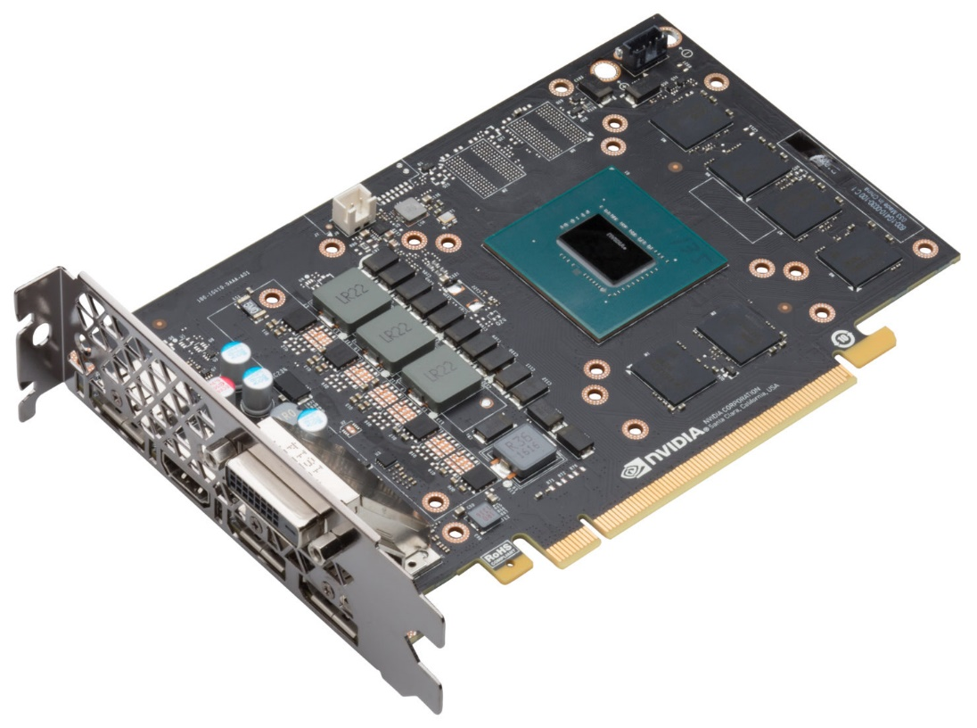
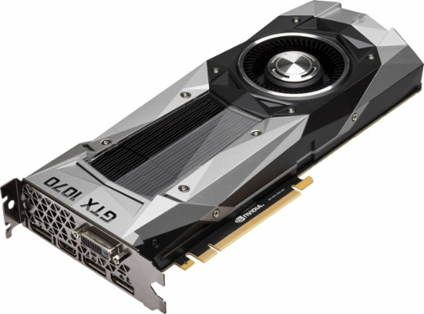
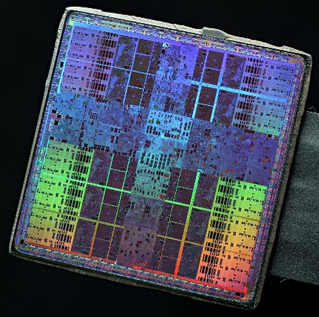
Basics
Integrated circuits (IC-s) on a surface mounted printed circuit board (PCB)
We are interested in seeing the inside of these
Let’s have a look inside the package!
There are silicon chips inside

Slide 5
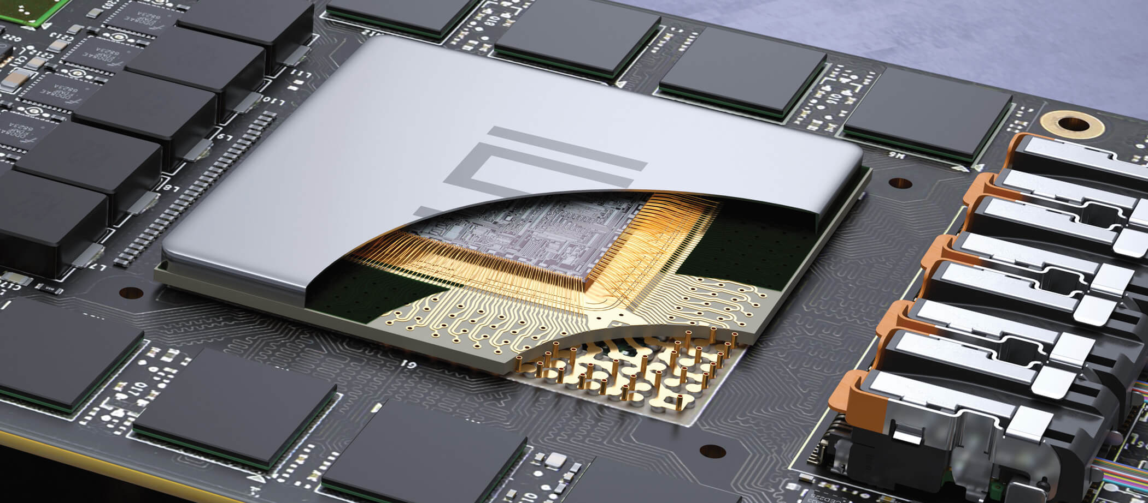
Inside the package
Lid seal
Silicon die
Gold wire bonds
Redistribution substrate
Lead frame, vias

Slide 6
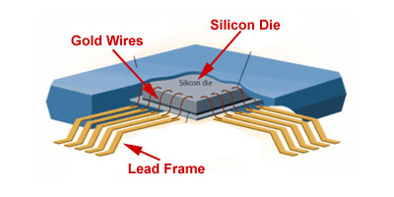
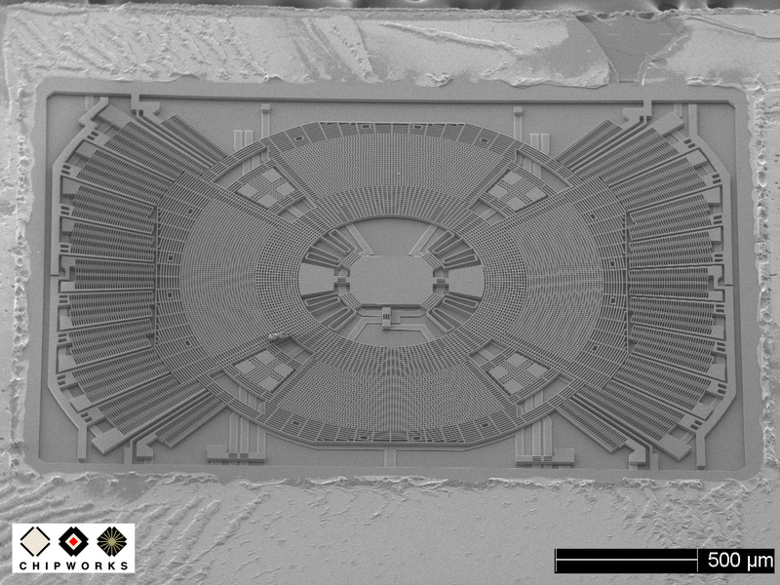
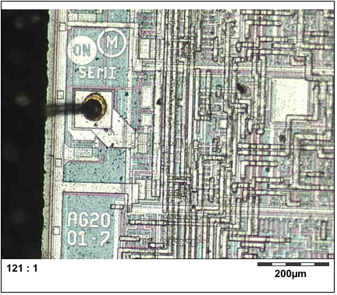
Inside the package

Slide 7
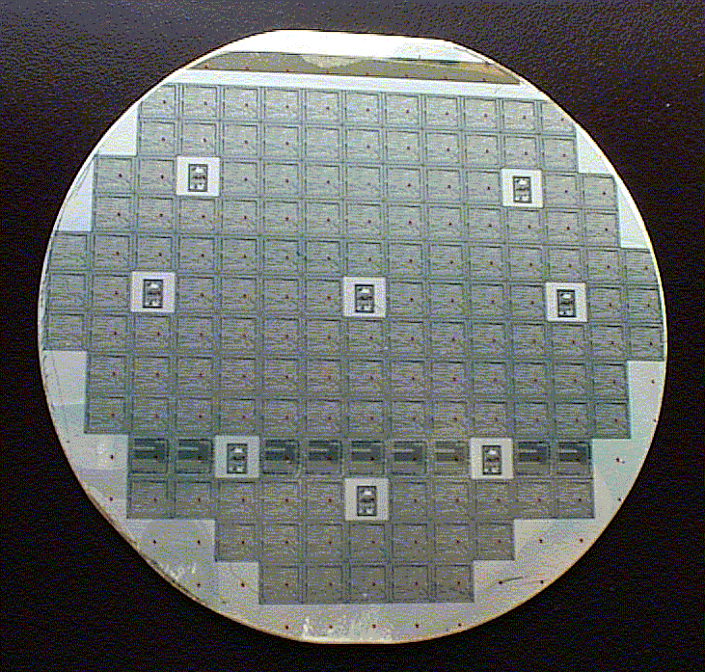
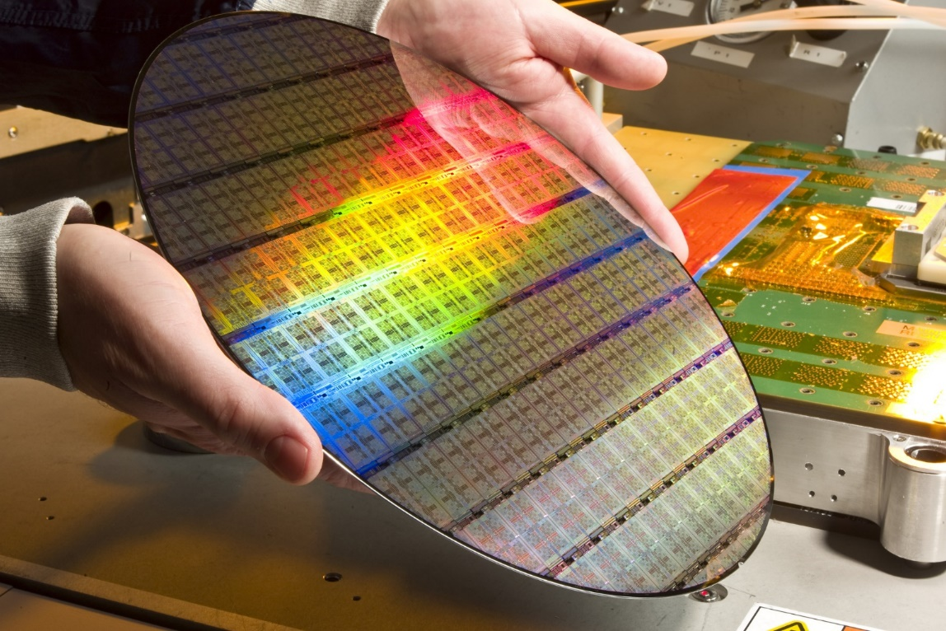
Basics
Wafer, die or chip:
  wafer made of perfect single Si crystal
There are many identical dies (chips) on a wafer
Wafer diameters: 15-20-25… cm or 4-6-8"
100…2000 dies/wafer, manufactured simultaneously

Slide 8
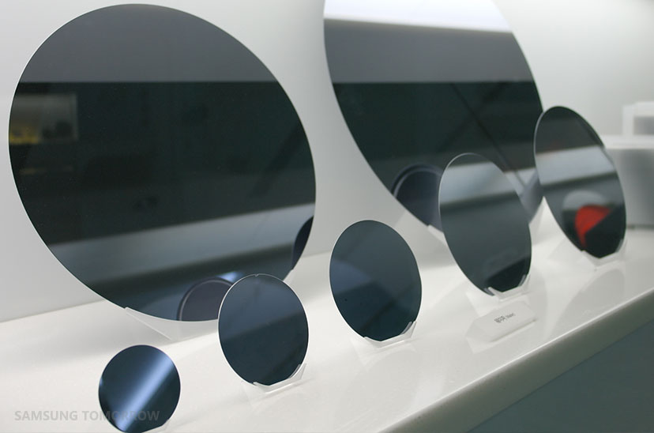
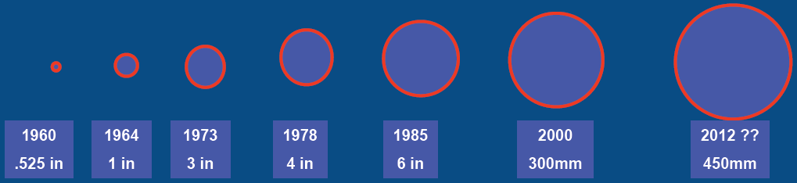
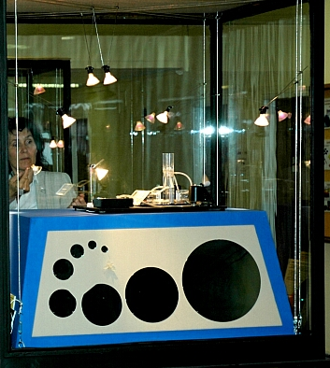
Si single crystal wafers
empty Si wafers:
~1965
2006
DED, 2009

Slide 9
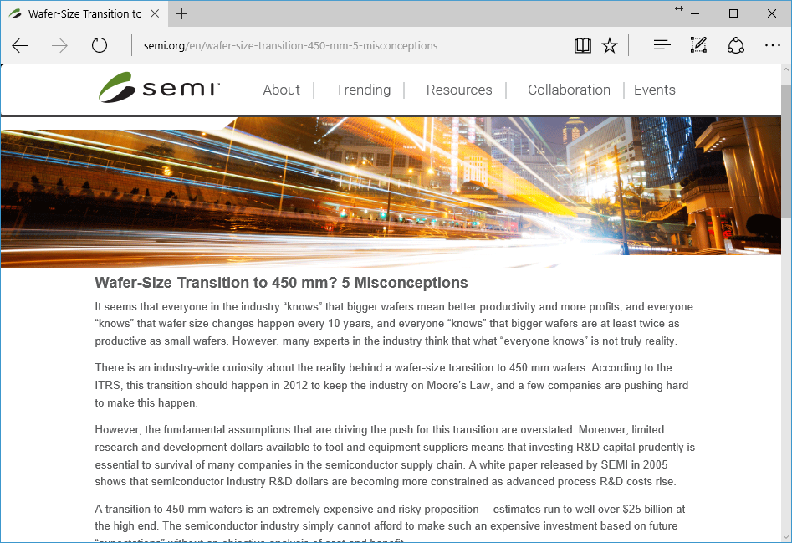
Si single crystal wafers

Slide 10
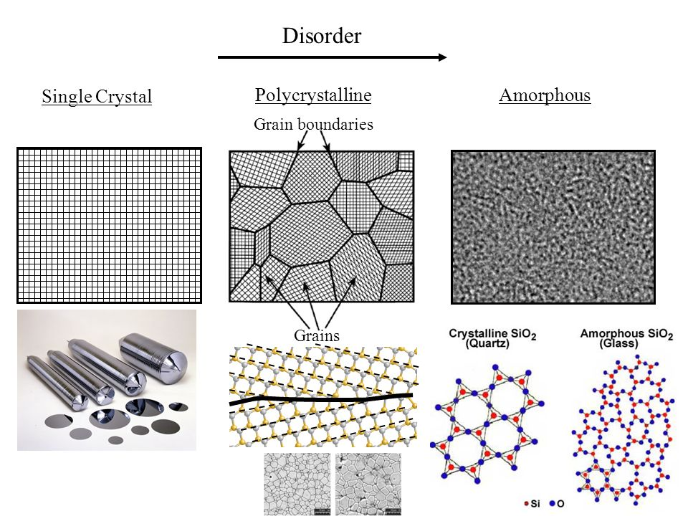
Crystalline structures
Solidification & Crystalline Imperfections
Published by Blanche Parsons
Notes:
https://slideplayer.com/slide/7070232/
Solidification & Crystalline Imperfections
Published byBlanche Parsons

Slide 11
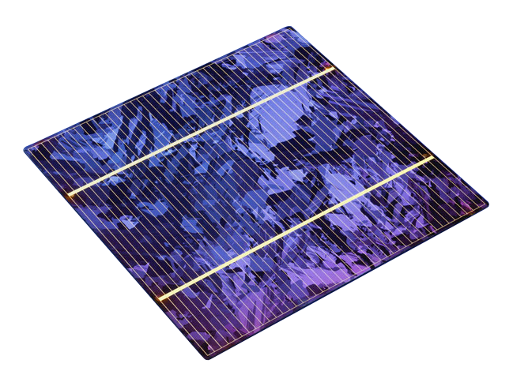
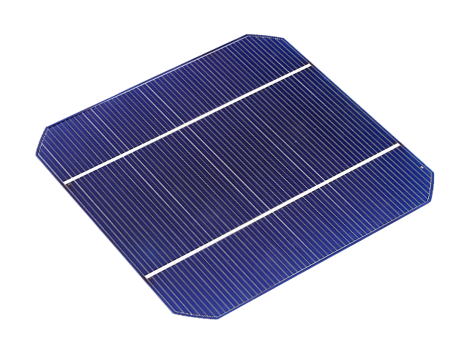
Results of crystallization
Poly-Crystalline Solar Cell
Mono-Crystalline Solar Cell
Notes:
https://www.redarc.com.au/mono-vs-poly

Slide 12
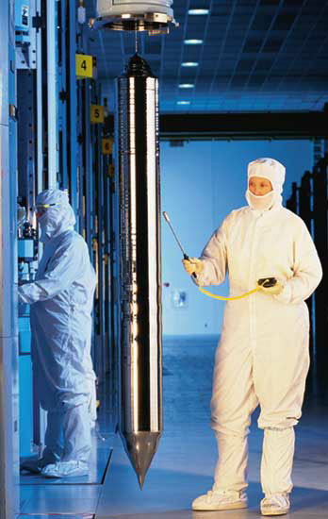
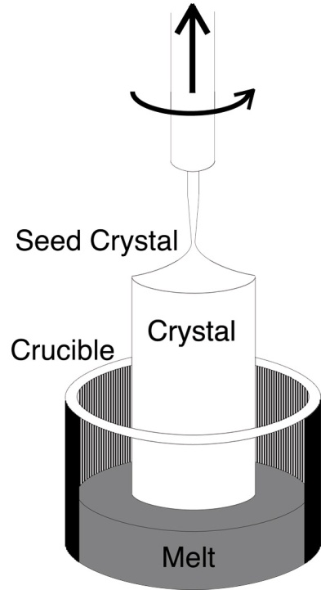
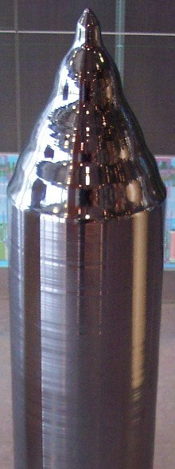
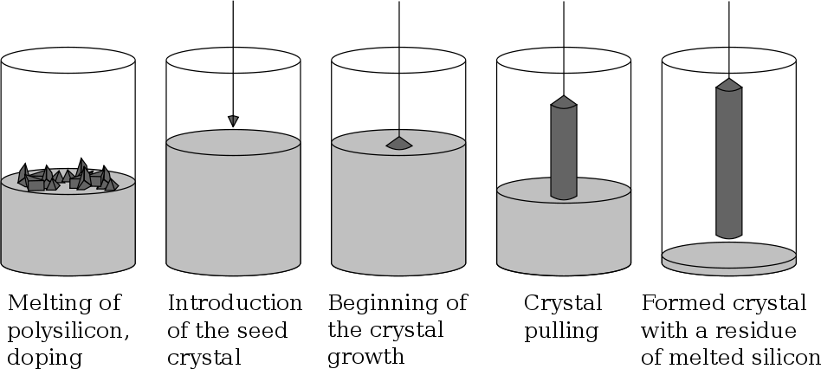
Manufacturing of single crystal wafers

Slide 13
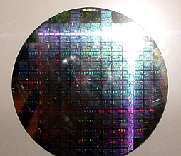
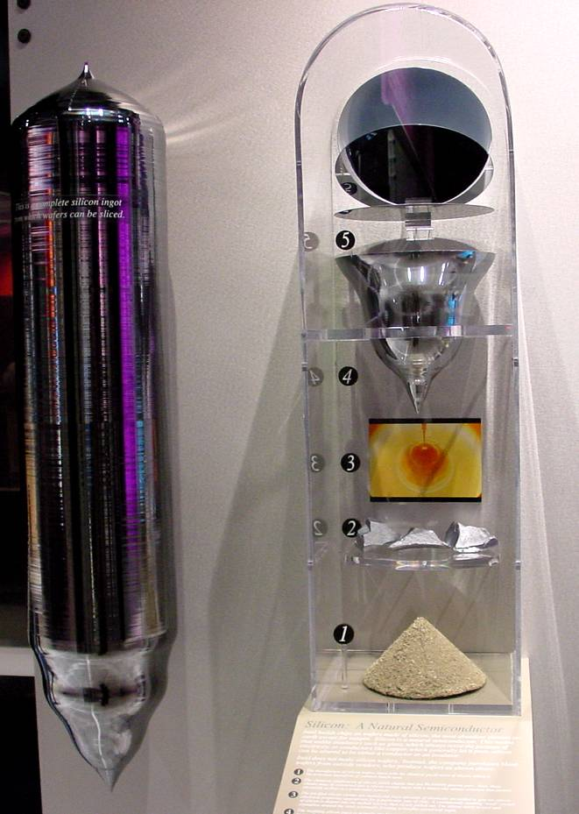
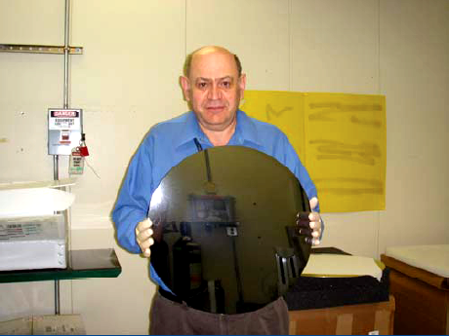
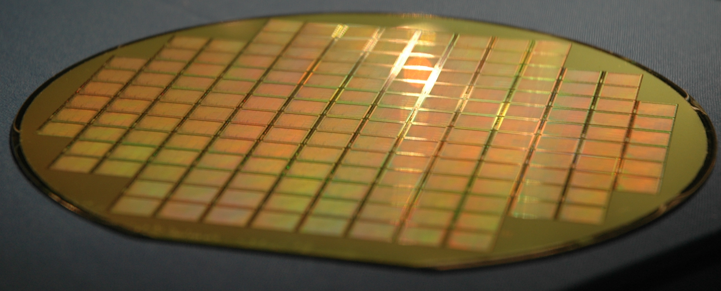
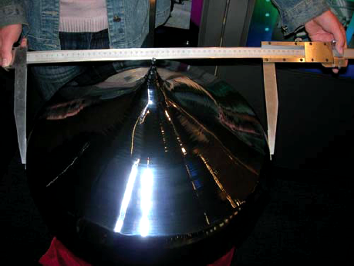
Si single crystal, wafers (2007: 12")
8" wafer with Pentium processors, Intel Museum
~2007
Finished Si wafer

Slide 14
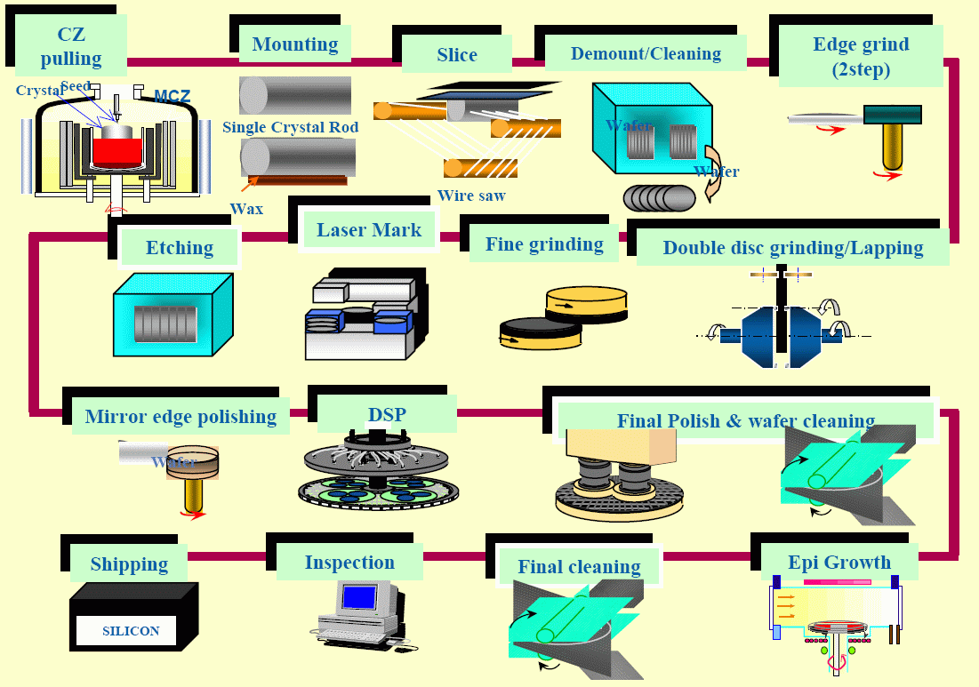
Manufacturing of wafers

Slide 15
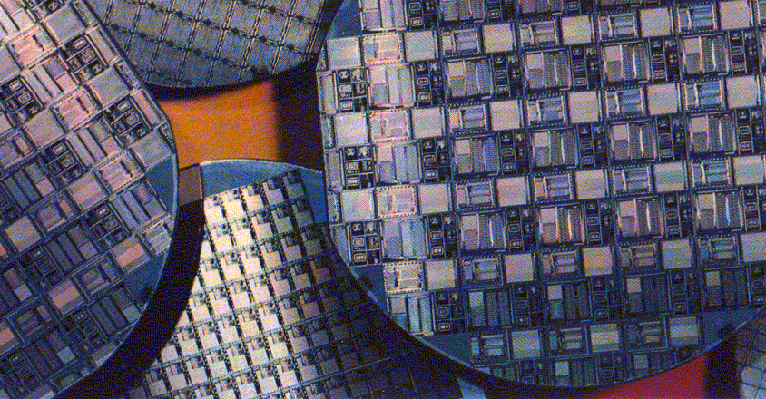
Basics
Finished wafers before dicing

Slide 16
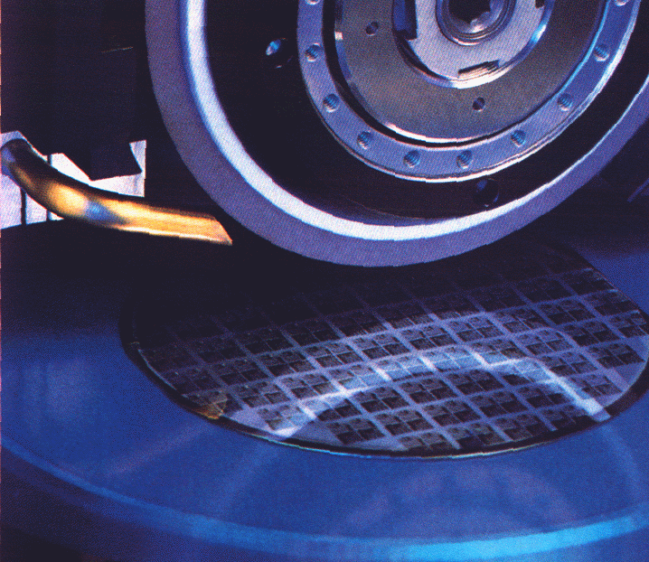
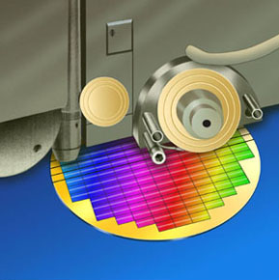
Basics
Diamond cutter
Dicing of a wafer
A finished wafer with dice (chips) on top

Slide 17
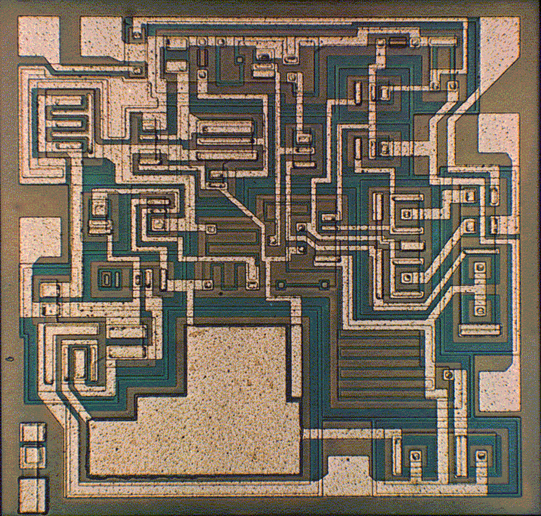
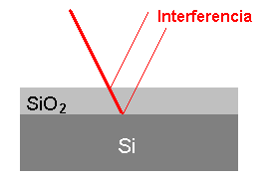
Basics
A simple analog IC – microphotograph through an optical microscope
Features seem in different colors due to interference through SiO₂ layers of different thickness:
Interference
μA 741

Slide 18
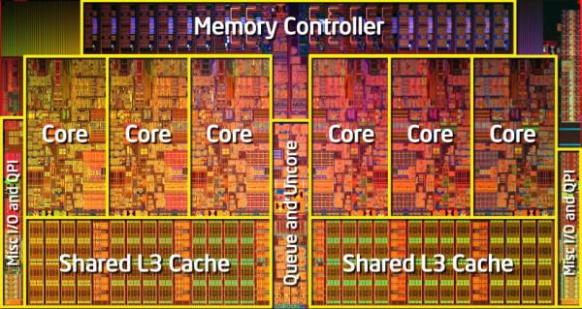
Basics
Intel Xeon 5600, 434 mm²
Notes:
Egy subsztrát, hogy megbízható, gyors, párhuzamosítható, és közös erőforrást tudjon használni

Slide 19
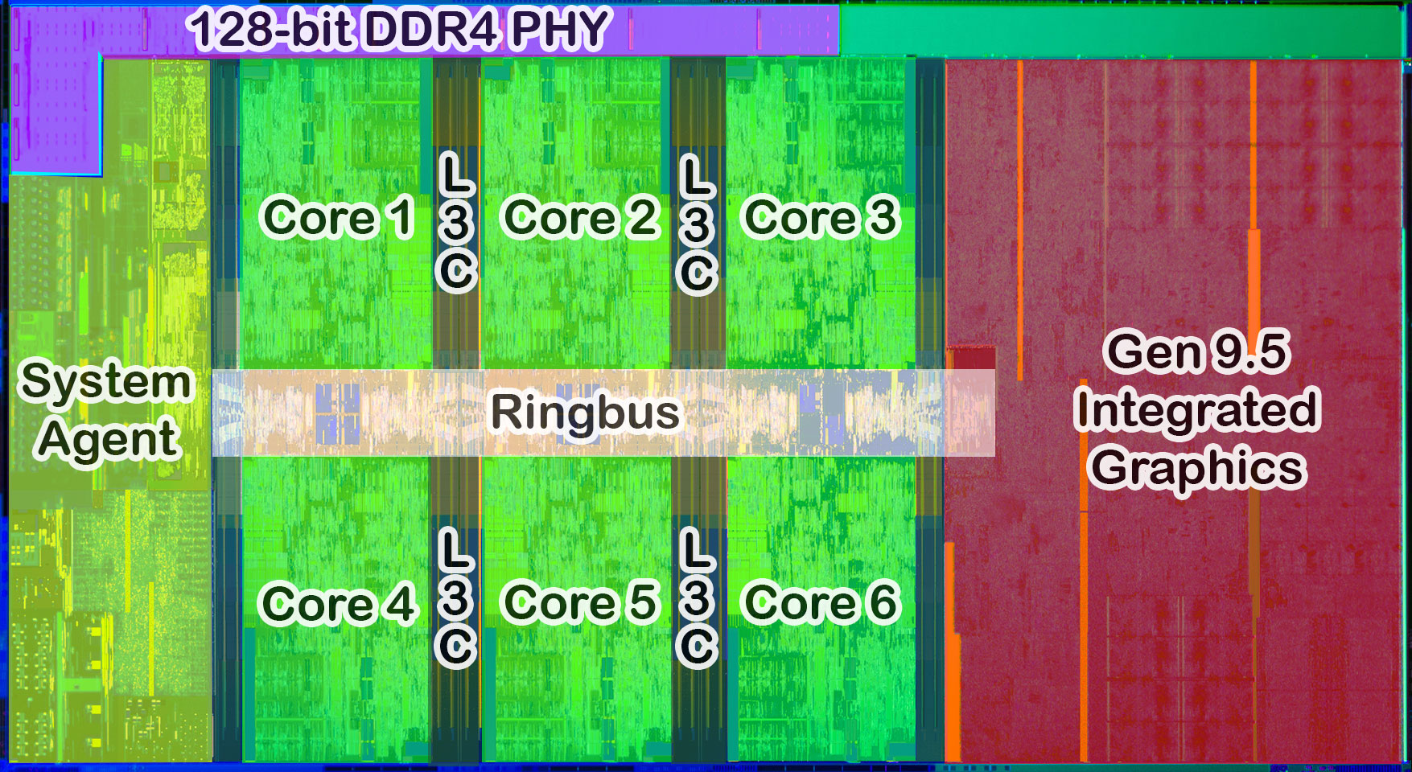
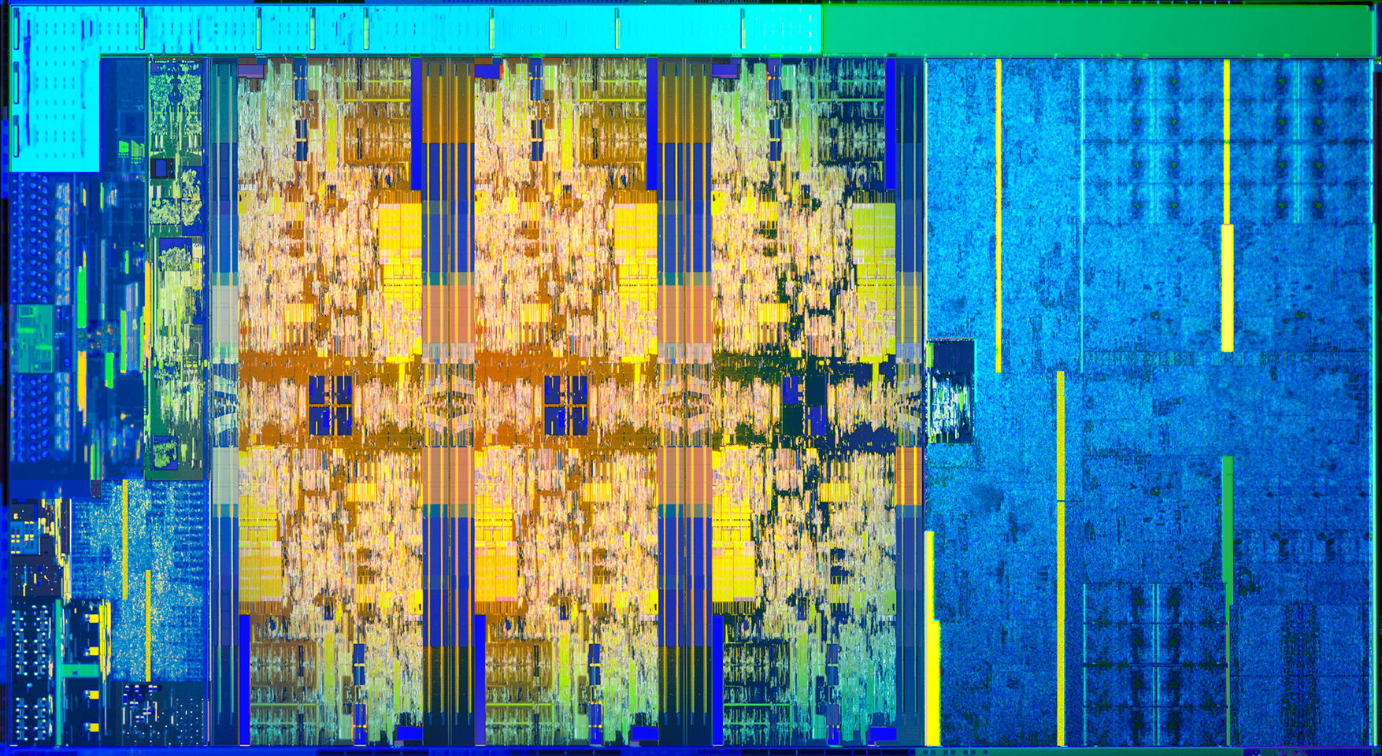
Basics
Intel Core i5-8400, 150 mm²
Notes:
Egy subsztrát, hogy megbízható, gyors, párhuzamosítható, és közös erőforrást tudjon használni

Slide 20
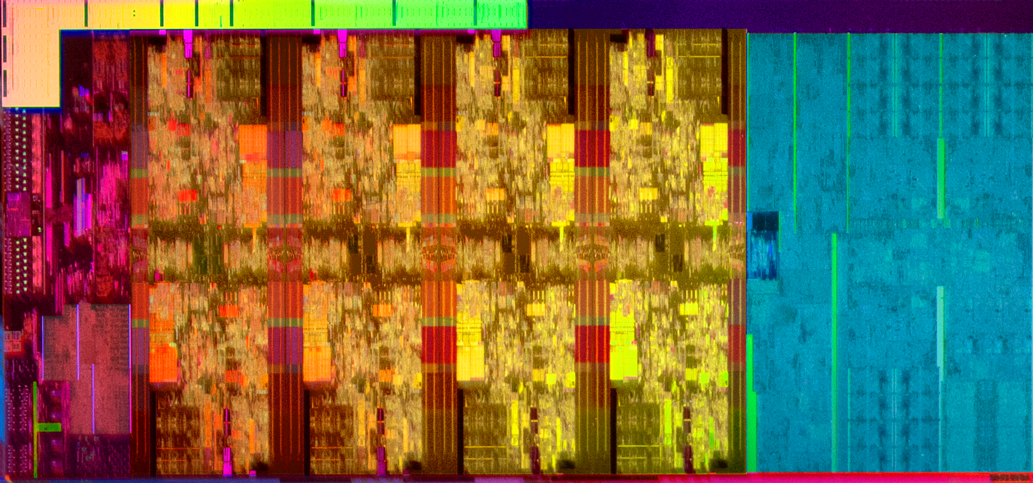
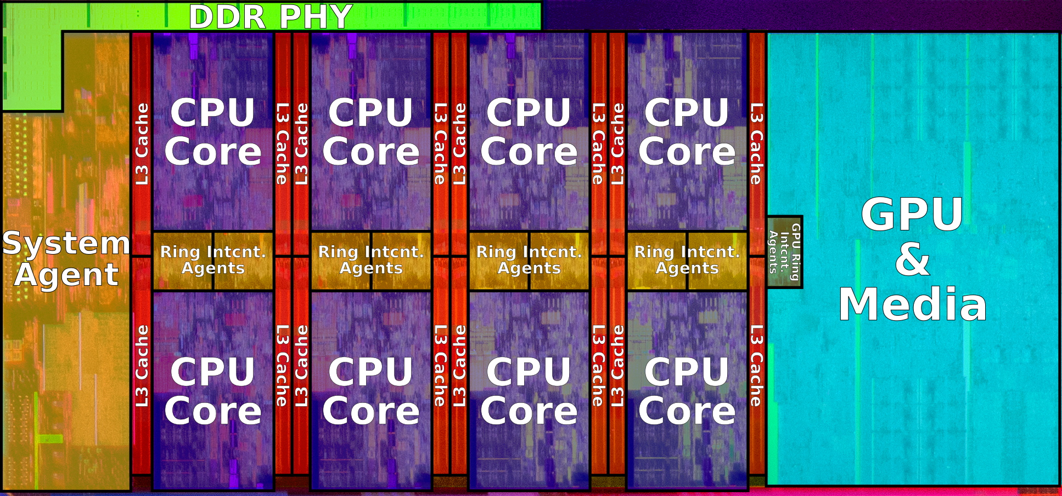
Basics
Intel Core i9-9900K, ~177 mm² (unknown)
Notes:
https://en.wikichip.org/wiki/i9-9900K

Slide 21
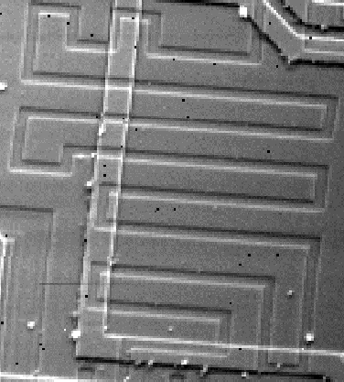
Basics
Minimal feature size (MFS) – the smallest (thinnest) feature that you can create on the top of a silicon wafer (substrate)
Metallization line ("wire")
Doped region ("diffusion line")
MFS in the early days: 15-20µm
MFS today: 10-14 nm or even less
SEM microphotograph

Slide 22
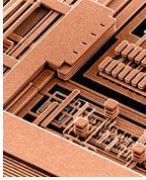
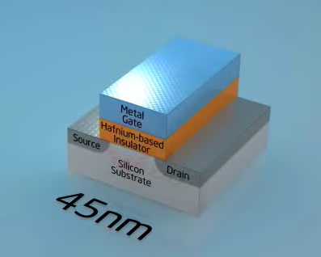
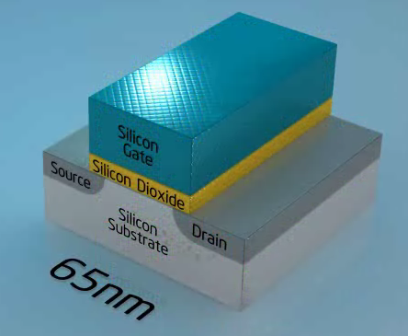
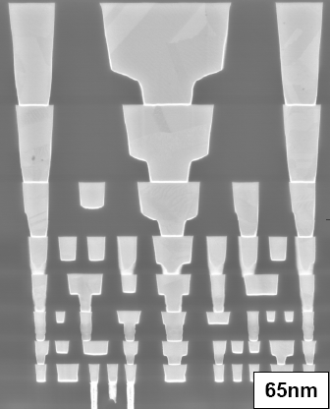
Basics
Minimal feature size (MFS) 2007/2008, Intel:
Intel
IBM
Many metallization layers, Cu instead of Al

Slide 23
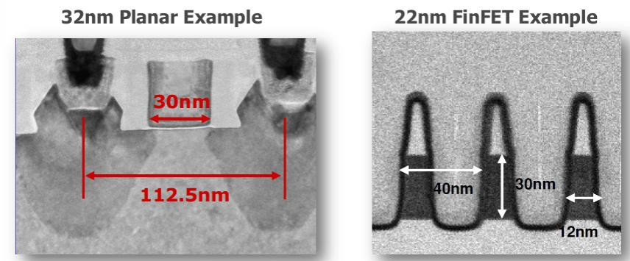
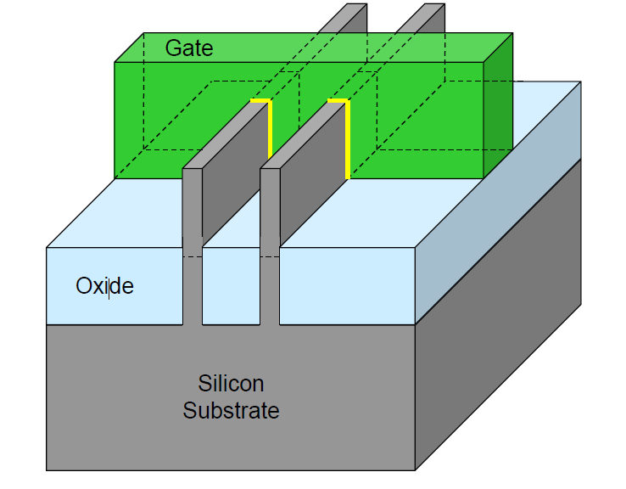
Basics
Minimal feature size (MFS)
Intel 2012, 2014 (14nm)

Slide 24
Basic processing principles
Layer growth or deposition: new material layer is formed over the entire surface of the wafer
Patterning: some patterns are formed in the deposited layer
  deposition of a photo-sensitive lack (photoresist)
  photographing the pattern onto the lack
  developing the photoresist: pattern formed in the resist layer
  transferring the pattern from the resist to the material layer underneath by some kind of etching
  removal of the resist
In-depth deposition of external material: ion implantation (formerly: diffusion)
Notes:
Az egész Si tehcnológia lényege, hogy leválasztjuk, megmintázzuk és eltávolítjuk ami nem kell

Slide 25
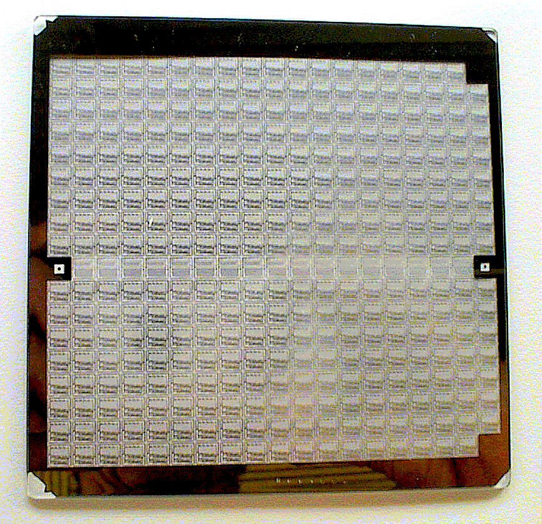
E.g. patterning
The original pattern is on a so called photo-mask
  made of chromium on glass substrate
  many times larger than a chip
Need for high level of accuracy:
  0.03µm over 30cm!
  10⁻⁷
Visible light:
  λ=0.3-0.6 µm
  deep UV needed!

Slide 26
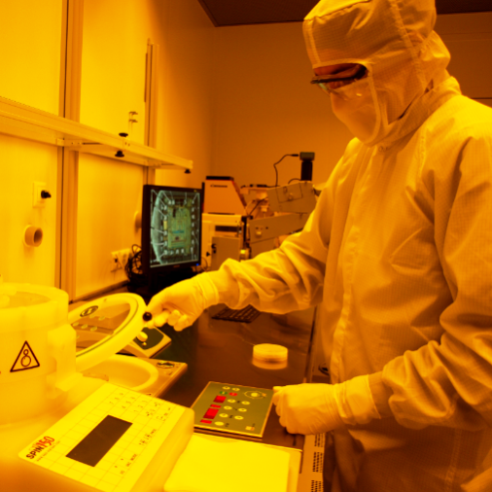
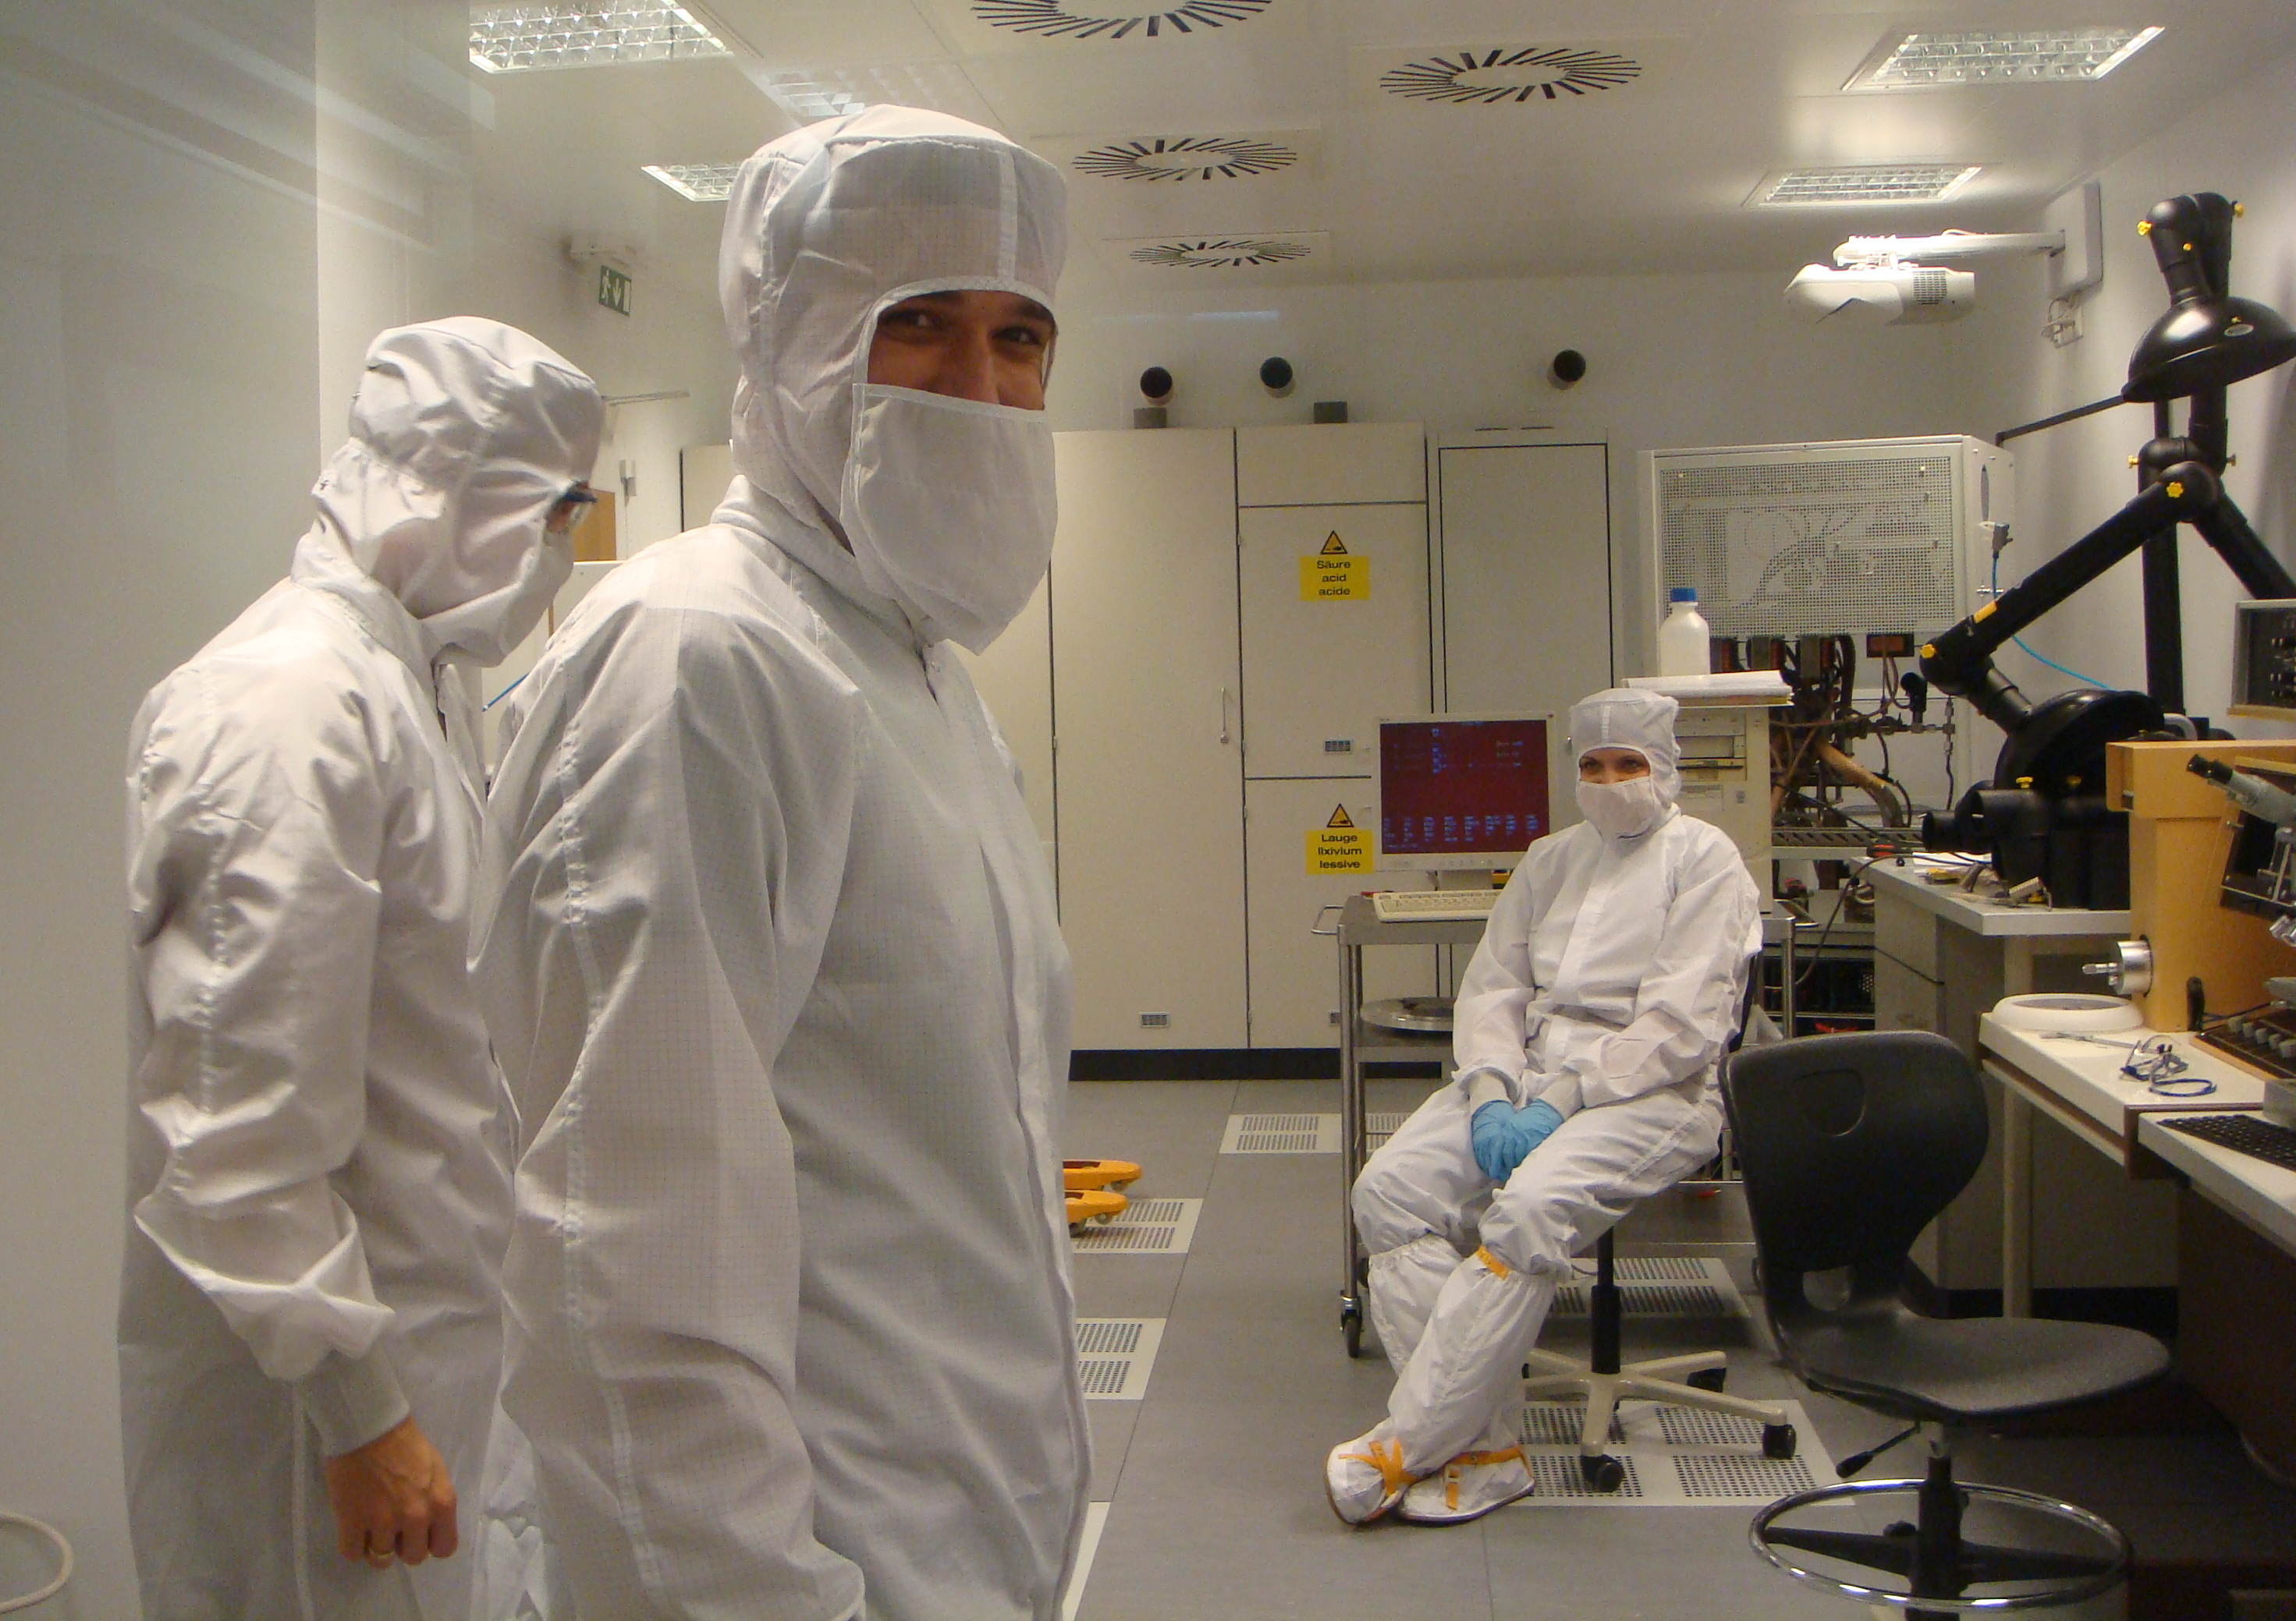
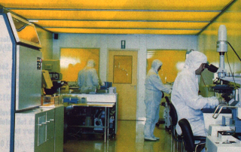
Making tiny structures (patterning)
Basic process: photolithography. Small features of a mask are photographed onto a lack called photo-resist
Our old facility
A fab somewhere in the world
UV light is used
Resist is not sensitive to yellow
Our old facility
Semiconductor Technology Lab, Microelectronics branch at DED

Slide 27
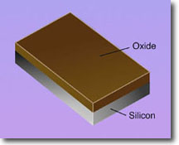
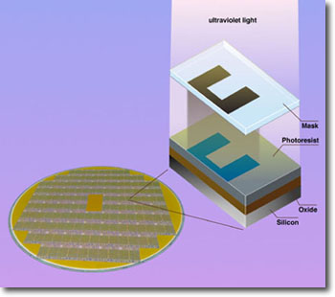
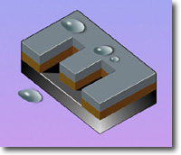
Patterning: photolithography
Notes:
SiO₂ lesz az adalékolás maszkoló rétege
fotoreziszt felvtele
mintázat fényképezése a rezisztre
előhívás (oldás, hőkezelés)
mintázat átvitele a rezisztről az oxidre nedves marással

Slide 28

Typical types of patterns on a chip
Metallization
Contact window
P diffused (doped) region
N diffused (doped) region
One process: 15..25 masks
Problem: alignment of masks
SEM of a resistor in an analog IC

Slide 29


Basics
Layout: collection of all features on all material layers (and in-depth doped ones) which form the IC
Bonding PADs
Circuit CORE
Layout of a small IC as designed in the computer
Layout photograph of a small TTL IC (7400)
Notes:
PAD a kommunikáció, külvilággal valló kapcsolat
Core: funkció megvalósítása

Slide 30



Packaging: a great challenge today
Bonding machine
Many connections – fine pitch
high frequency properties
thermal properties

Slide 31

Modern packaging – 3D integration

Slide 32




Packaging – one of the big challenges
SoP - System on Package - Complete system integration
SiP - System in Package - is a number of integrated circuits enclosed in a single module (package)
SoC - System on Chip - integrates all components of a computer or other electronic system into a single chip.
LoC - is a device that integrates one or several laboratory functions

Slide 33
The silicon fab
Cleanroom
Some process steps

Slide 34

The cleanroom
Special suit – like for astronauts
Special room: cleanroom; much cleaner than the operation room of a hospital
Tiny structures are created on the surface of the wafers: high level of cleanness is required!

Slide 35



The cleanroom
Tiny structures are created on the surface of the wafers: high level of cleanness is required!
EET cleanroom
IBM
Intel Museum

Slide 36


The cleanroom
Notes:
Fentről lefele, és olyan sebességgel, hogy ne legyen örvényes az áramlás

Slide 37


The cleanroom

Slide 38




Cleanroom at the DED
New semiconductor lab @ Building Q
Semiconductor Technology Laboratory,
Smart System Integration MSc minor spec.
Solar cells manufacturing

Slide 39




Ion-implanter, diffusion furnace
1200+ °C !!!
IBM
DED, Building Q
Semiconductor Technology Lab, Microelectronics branch at DED

Slide 40

A batch
Si wafers are processed in so called batches
40..100 wafers/batch, 10 000 – 50 000 chips/batch
Batch fabrication
Inserting a batch into a diffusion furnace

Slide 41

Wafer sizes
Today at around 30cm in diameter (8") or even 12"

Slide 42


An Intel fab

Slide 43
Intel fab sites
Fab name | City | Production start year | Process (Wafer, node)
D1X | Hillsboro, Oregon, United States | 2013 | 300 mm, 14/10/7nm
D1D | Hillsboro, Oregon, USA | 2003 | 300 mm, 14/10/7nm
D1C | Hillsboro, Oregon, USA | 2001 | 300 mm, 22/14/10 nm
Fab 12 | Chandler, Arizona, USA | 1996 | 300 mm, 65 nm
Fab 32 | Chandler, Arizona, USA | 2007 | 300 mm, 14/10 nm
Fab 42 | Chandler, Arizona, USA | 2020^{[1]} | 300 mm, 10/7 nm
Fab 11 | Rio Rancho, New Mexico, USA | 1993 (Closed) | 200 mm, 45/32 nm
Fab 11X | Rio Rancho, New Mexico, USA | 1995 upgrade 2020/2021 with 22/14 | 300 mm, 45/32 nm
Fab 17 | Hudson, Massachusetts, USA | 1998 (Closed) | 200 mm, 130 nm
Fab 24 | Leixlip, Ireland | 2006 | 300 mm, 14 nm
Fab 28 | Kiryat Gat, Israel | 2008 | 300 mm, 22/10 nm
Fab 68 | Dalian, Liaoning, China | 2010 | 300 mm, 65 nm 3DNAND, 3DXPoint^{[2]}

Slide 44



Intel fabs 2006-2008
65nm fabs, ~2006 45nm: "Fab32", 2007-

Slide 45
History, trends

Slide 46






Roots
1837 Morse, telegraph
~1920 radio reciever

Slide 47



Microelectronics: fastest growing industry
Revolution of the transistors
Transistor – Bardeen (Bell Labs), 1947
Bipolar transistor – Schockley, 1949
The 1st bipolar logic gate – Harris, 1956
The 1st monolithic IC – Jack Kilby, 1959
The 1st commercial IC with logic gates – Fairchild, 1960
TTL – 1962..1990-ies
ECL – 1974..1980-ies
You can make an IC of such a "complexity" in the cleanroom of the Department
ECL 3-input Gate
Motorola 1966
Notes:
Transistor–transistor logic (TTL) is a logic family built from bipolar junction transistors. Its name signifies that transistors perform both the logic function (the first "transistor") and the amplifying function (the second "transistor");
Emitter-coupled logic (ECL) is a high-speed integrated circuit bipolar transistor logic family. ECL uses an overdriven BJT differential amplifier with single-ended input and limited emitter current to avoid the saturated (fully on) region of operation and its slow turn-off behavior;
ECL RF-hez, kiszajú gyors

Slide 48
Microelectronics: fastest growing industry
Development of the MOSFETs:
MOSFET transistor – Lilienfeld (Canada, 1925) and Heil (England, 1935)
CMOS – 1960s, stack due to manufacturing problems
pMOS processes in the 1960s
nMOS processes in the 1970s (4004, 8080)
CMOS processes from the 1980s – preferred MOSFET process due to low power consumption
Nowadays e.g.:
  BiCMOS, GaAs, SiGe – for very high frequency circuits
  SOI, Cu metallization, low-K dielectrics

Slide 49

Gordon Moore, 1965:

Slide 50
Microelectronics: fastest growing industry
Moore's law
In 1965 Gordon Moore predicted that in every 14..18 months the number of transistors integrated in a chip will double (exponential growth)
This prediction is valid even today.
The 1 million transistors/chip threshold was reached in the 1980s
  2300 transistors, 1 MHz clock frequency (Intel 4040) - 1971
  16 million transistors (UltraSPARC III)
  42 million transistors, 2 GHz clock frequency (Intel P4) - 2001
  140 million transistors, (HP PA-8500) – 1998
  ~3 billion transistors, (i7-9900K) - 2018
More than Moore: further increase of integration density, e.g. 3D stacking of chips (RAM-s, pen drives)

Slide 51

Moore’s law
Result of 50 years of progress presented through a modern CPU and a processor of a modern smart phone

Slide 52


Microelectronics: fastest growing industry
2250 transistor
55 million transistor
1971 -Intel 4040
2002 - Intel Pentium IV

Slide 53


Microelectronics: fastest growing industry
~600 million transistor
1 billion transistor
2007 - Intel Core2 EE
2012 - Core i7

Slide 54

Microelectronics: fastest growing industry
Notes:
Embedded

Slide 55

Prognosis: roadmap

Slide 56

Recent – company webpages
Notes:
Tick Tock

Slide 57

Recent – company webpages
Notes:
Tick Tock

Slide 58

Minimal feature size – trend (Intel)
14 nm
2013

Slide 59

Minimal feature size – trend (Intel)
Notes:
Trigate

Slide 60

Toplist of processors in 2015
Main features:
  clock frequency,
  CACHE size, organization
  Packaging
  die size,
  number of transistors
  power consumption

Slide 61

A Moore's law for processors
Number of transistors doubles in almost every year

Slide 62
Development of DRAMs
4-times growth in every 3 years
0.07 μm
2 h audio CD,
30 s HDTV
0.1 μm
0.13 μm
0.18-0.25 μm
an average book
0.35-0.4 μm
human brain,
human DNA
0.5-0.6 μm
0.7-0.8 μm
1.0-1.2 μm
1.6-2.4 μm
a page of A4 paper

Slide 63
Increase of the die size
2-fold growth in 10 years – 7% annual growth, corresponds to Moore's law
100
P6
486
Pentium ® proc
10
386
Die size (mm)
286
8080
8086
8085
8008
4004
Source: Intel
1
1970
1980
1990
2000
2010
Year

Slide 64

Increase of the die size

Slide 65

Clock frequency trend
2× every 2 years

Slide 66

Power consumption trend
Continuous increase in case of processors
Limiting factor

Slide 67

Increase in dissipation density
Power consumption growth faster than the die size
Dissipation density limits
Cooling!!!

Slide 68

Cooling problem
Clock frequency stagnant

Slide 69

More than Moore integration ITRS

