Slide 1
Nano-Materials Characterization
Nano
Systems
Growth and
Characterization
Design and
Processing
Modeling
and Analysis
Yoram Shapira, EE Nano-bio-electronics 18.12.01

Slide 2
Nano-Materials Characterization

Slide 3
Nano-Materials Characterization

Slide 4
Nano-Materials Characterization

Slide 5
Transmission Electron Microscope
(TEM)

Slide 6
Nano-Materials Characterization

Slide 7
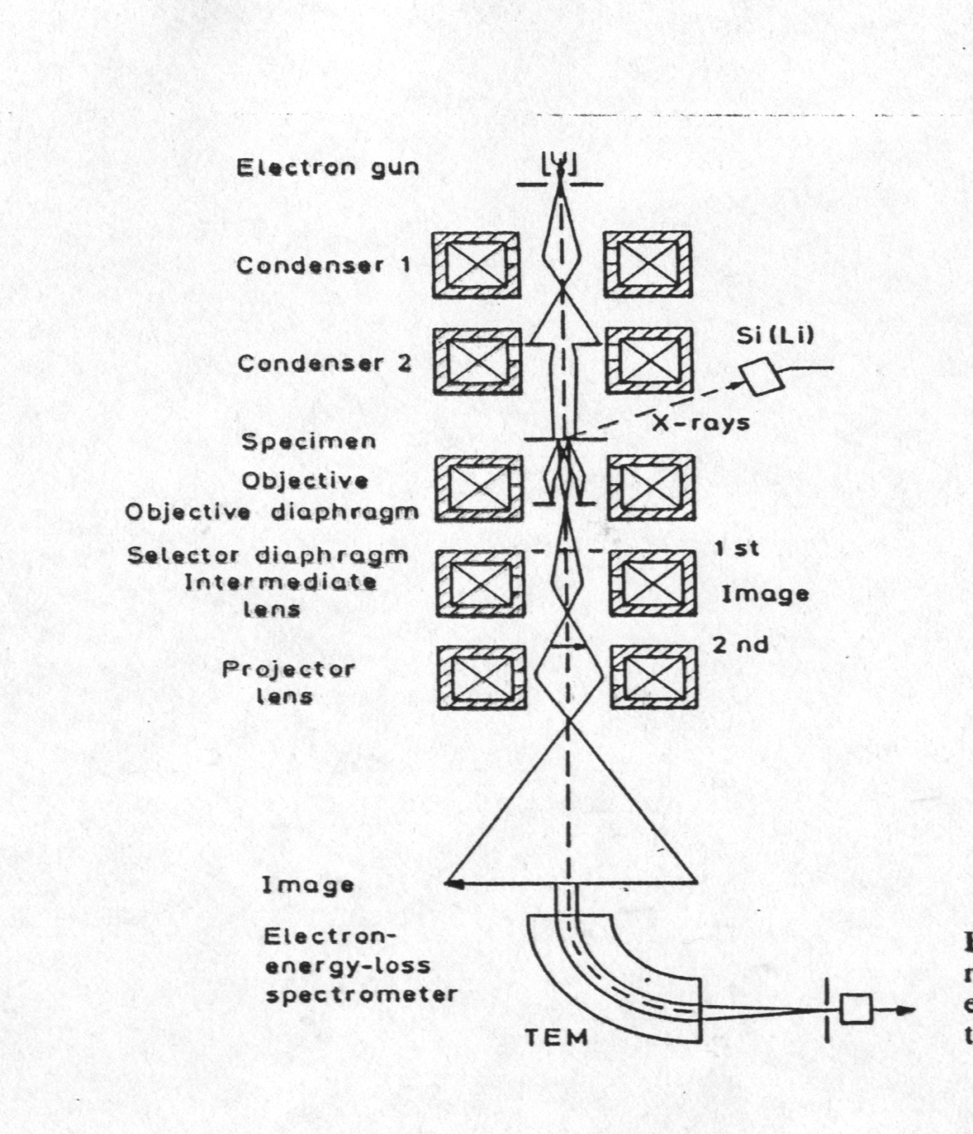
Courtesy Yossi LEREAH
Transmission Electron Microscope
Electron source: W, LaB6, FEG
Condenser Lenses (Electromagnetic)
Sample
Objective Lens (determine the point resolution)
Post Sample Lenses
Detector: electron- light converter
Chemical analysis: EDS, GIF
Wavelength at 200KV - 0.0025nm

Slide 8
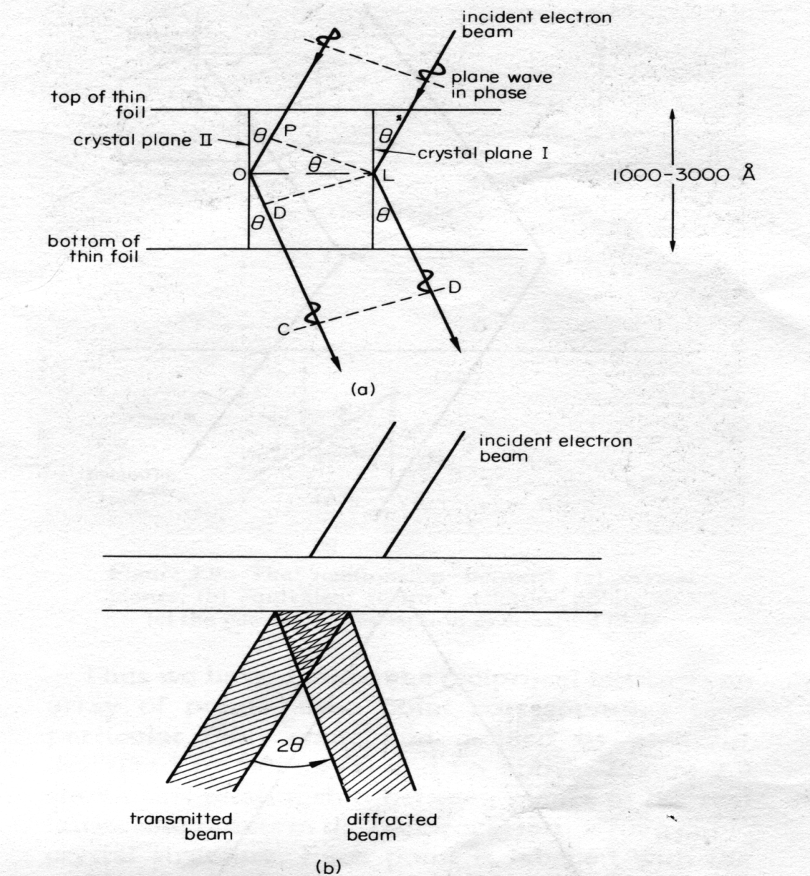
Nano-Materials Characterization
Bragg’s Law
2dsinθ=λL
Courtesy Yossi LEREAH

Slide 9
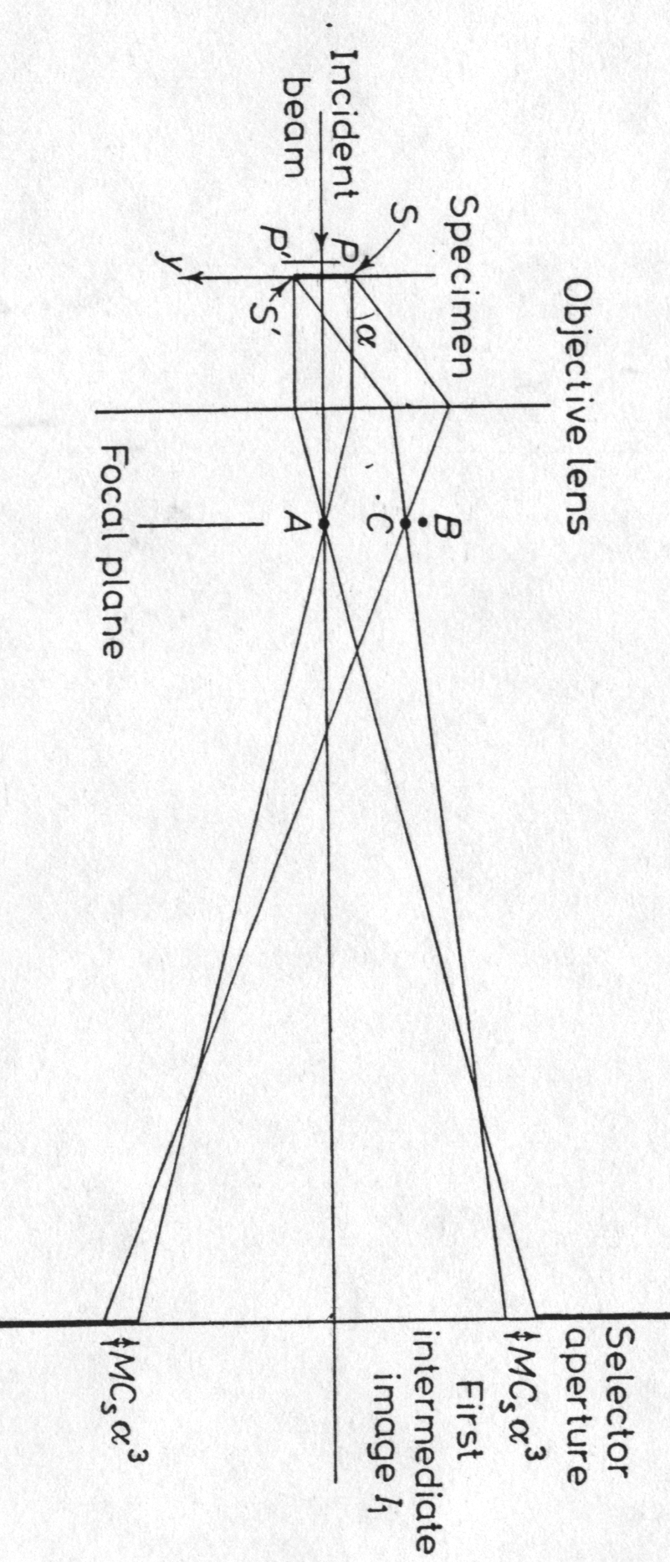
Objective Lens
The Core of TEM
Back Focal Plane: Diffraction Pattern
Image Plane
Diffraction Contrast: Bright Field or Dark Field by excluding one of the beams (in the back focal plane)
Phase Contrast by including all beams
Courtesy Yossi LEREAH

Slide 10
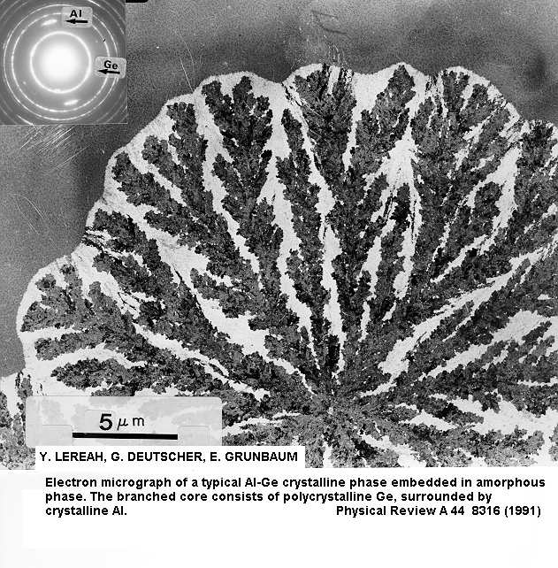
Crystallization of Ge:Al (1)
A branched Morphology in Material Science that is relevant to Life Science
Contrast: Mass thickness, Bragg Conditions
Diffraction: Polycrystalline, Preferred orientation
Yossi LEREAH TEL AVIV University

Slide 11
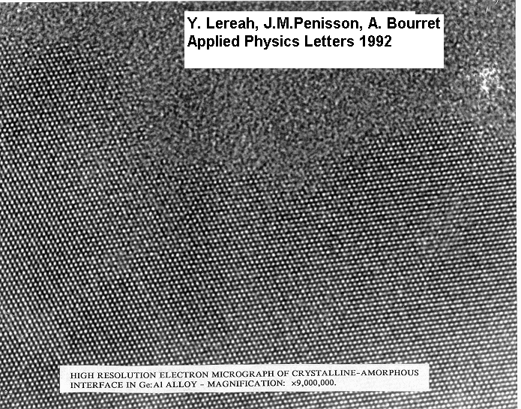
Yossi LEREAH TEL AVIV University
Crystallization of Ge:Al (2)
Phase Contrast reveals the periodicity of the atoms.
The interface is rough down to atomic scale
Courtesy Yossi LEREAH

Slide 12
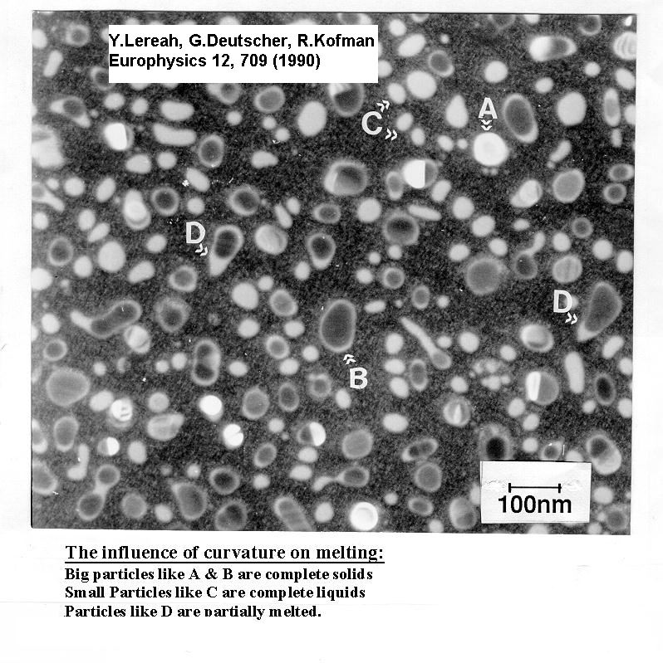
Melting of Nano-Particles
Melting temperature depends on the particle size.
Existence of surface melting.
Diffraction Contrast between solid and liquid phases
Yossi LEREAH TEL AVIV University

Slide 13
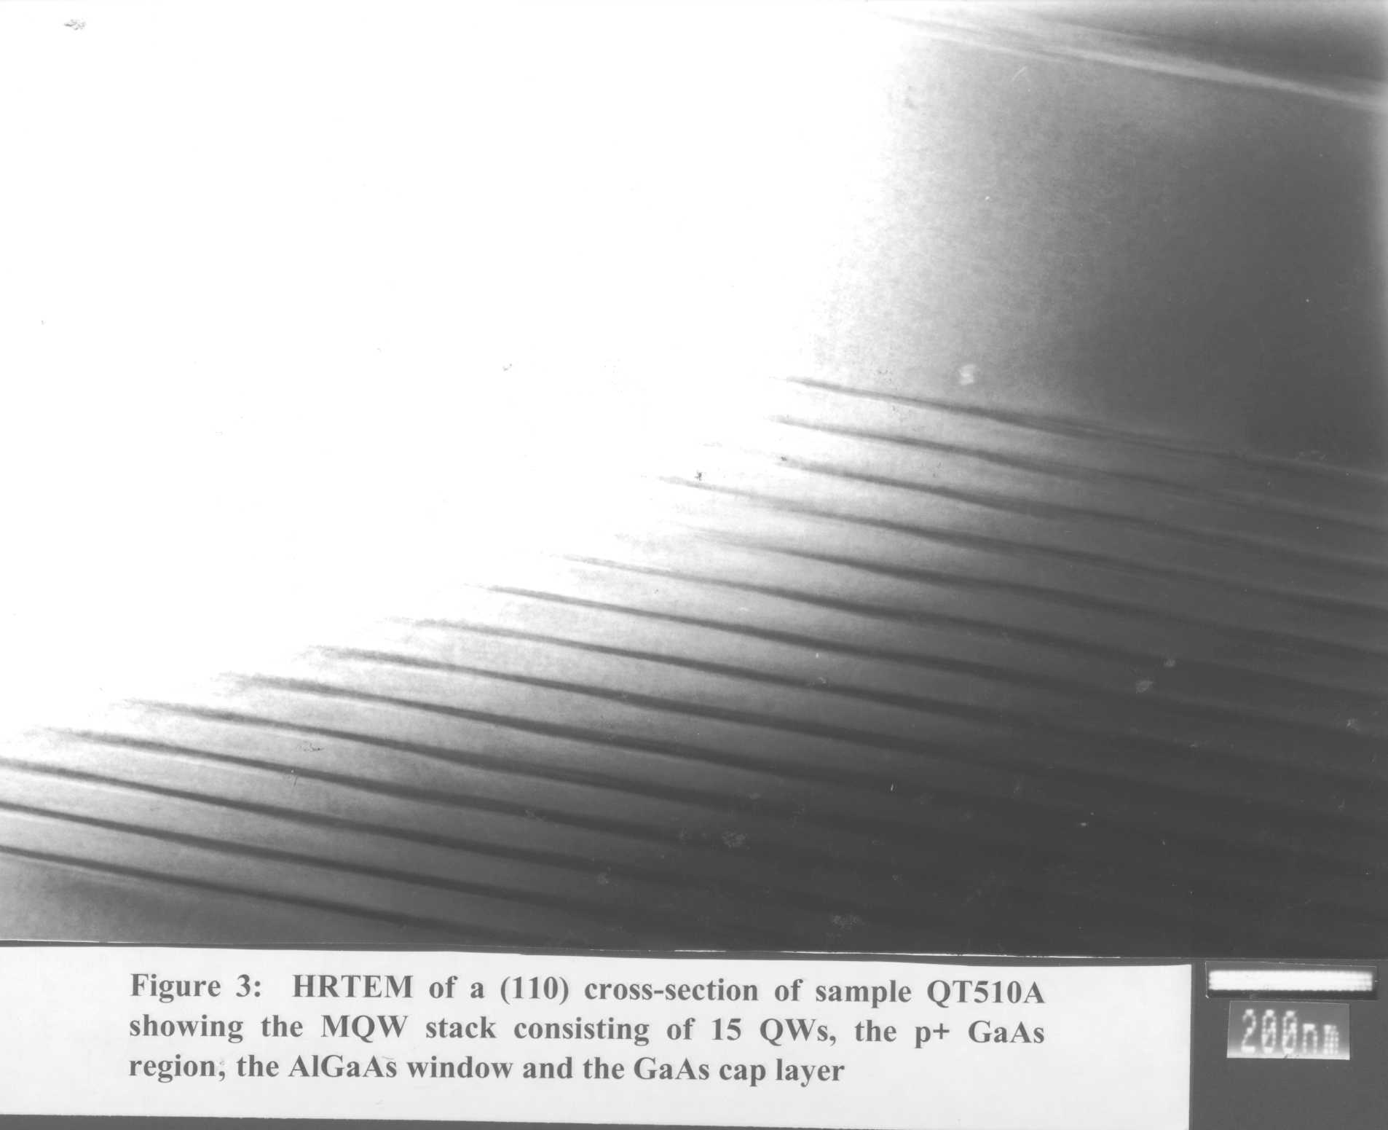
Nano-Materials Characterization

Slide 14
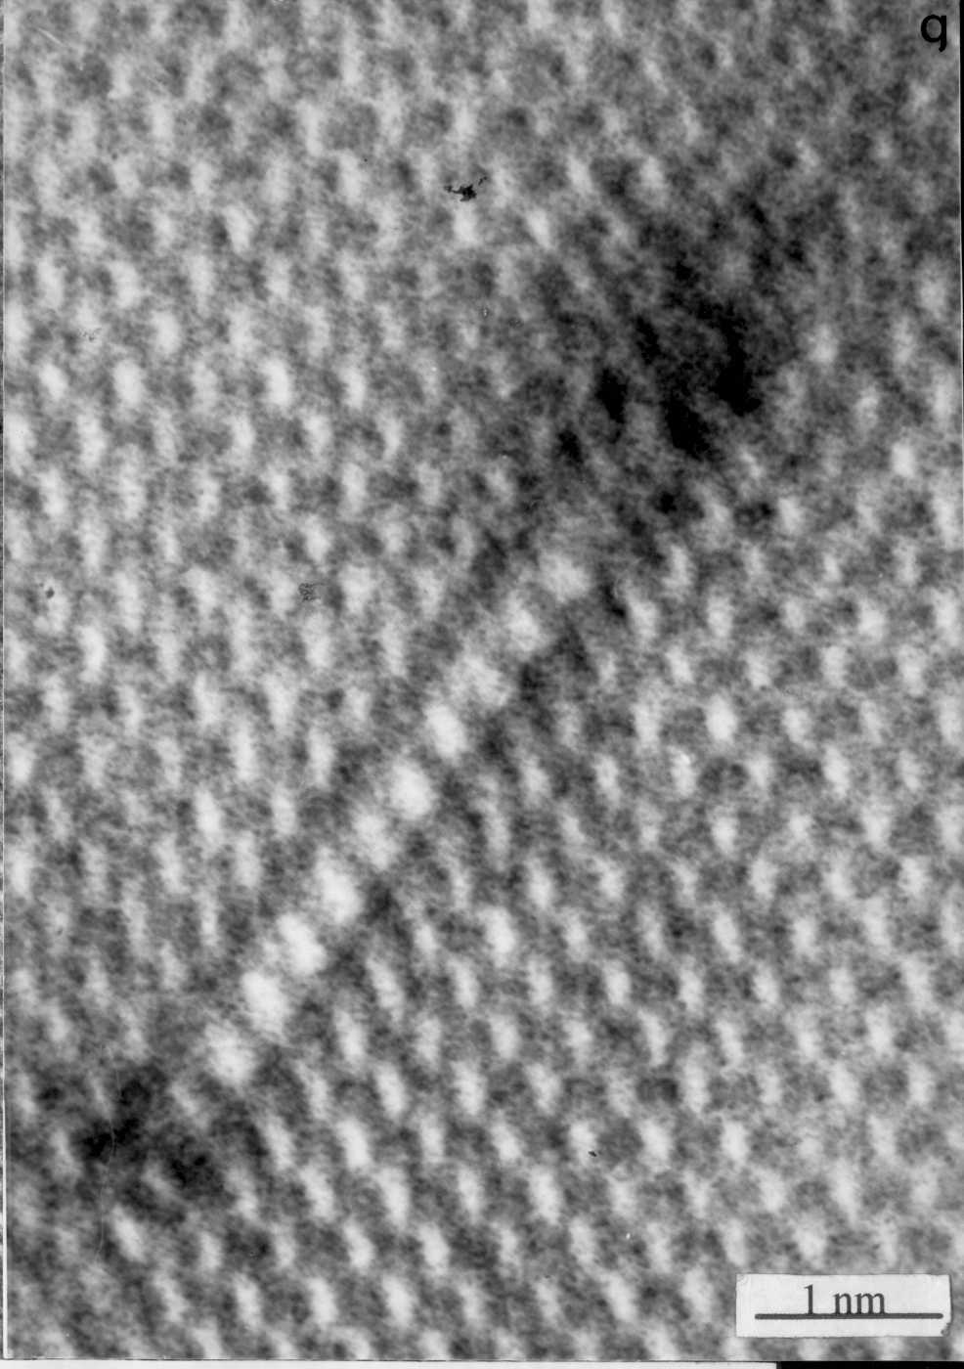
Nano-Materials Characterization
Courtesy Yossi LEREAH

Slide 15
Scanning Electron Microscope
(SEM)

Slide 16
Nano-Materials Characterization

Slide 17
Collected signals in SEM
Incident beam
X-rays
Backscattered electrons (BSE)
Cathodoluminescence(CL)
Secondary electrons (SE)
Sample
Absorbed current
Courtesy Z. Barkay

Slide 18
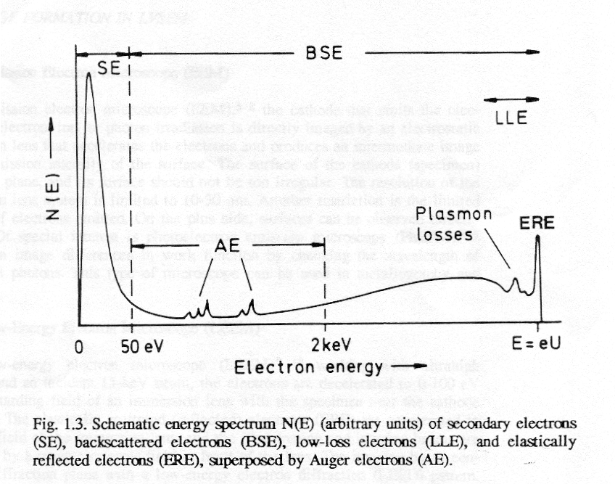
Energy distribution of SE and BSE
Courtesy Z. Barkay

Slide 19
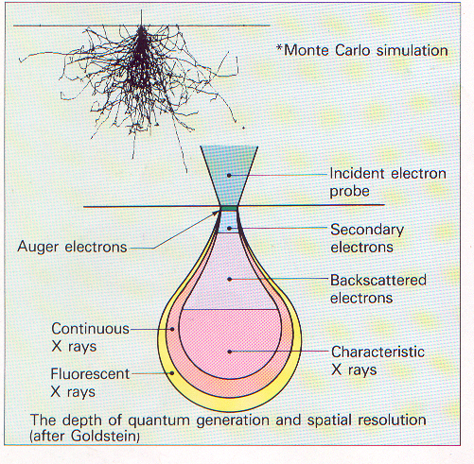
Signal emission from interaction volume
Rp
Courtesy Z. Barkay

Slide 20
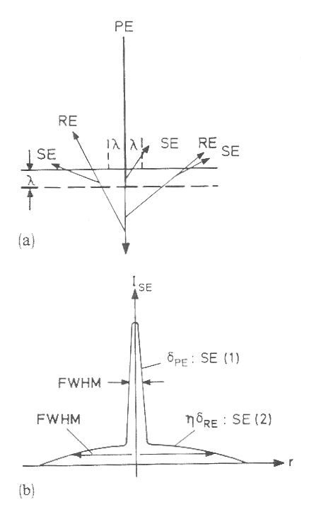
The origin of high SE spatial resolution
High resolution SE(1): 1 nm
Lower resolution SE(2): 0.1-1 μm
Courtesy Z. Barkay

Slide 21
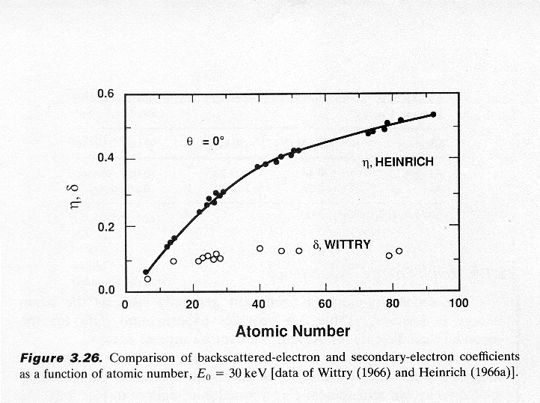
Composition dependence
Ε=30keV
Usually δ ≈ 0.1, at 30KeV
η=η(z)
Courtesy Z. Barkay

Slide 22
Basic SEM modes of operation - summary
(*) usually sizes of 1cm, dependent on SEM configuration
(**) voltage and Z dependent
Additional modes: Voltage contrast (VC) and EBIC - usually used in devices and p-n junctions.
Courtesy Z. Barkay

Slide 23




Eye of an ant
Human hair
Ant
Courtesy A. Merson

Slide 24
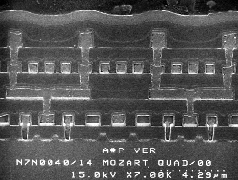
Nano-Materials Characterization

Slide 25
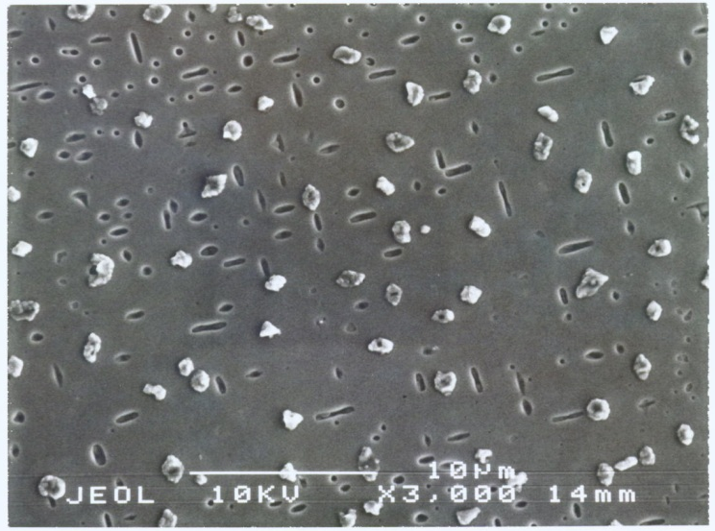
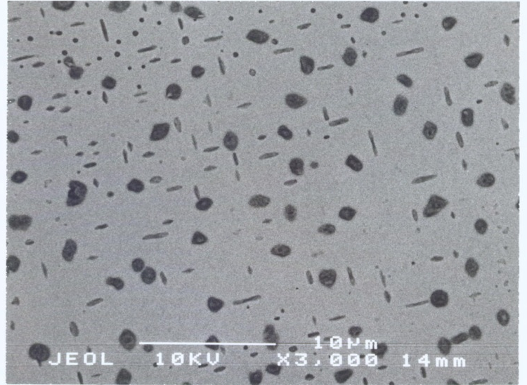
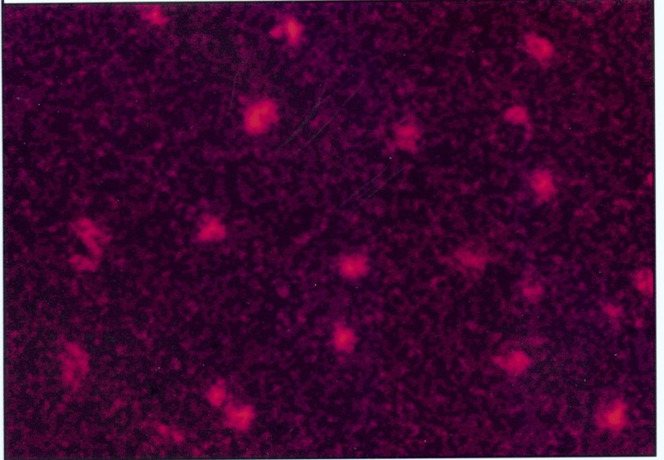
Surface, Atomic number, Element imaging
SE
BSE
Cu
Courtesy Z. Barkay

Slide 26
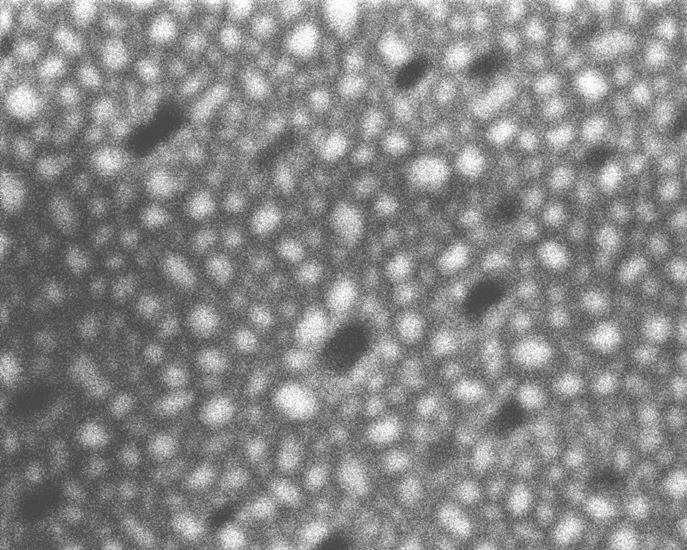
Nano-Materials Characterization
Courtesy Z. Barkay

Slide 27
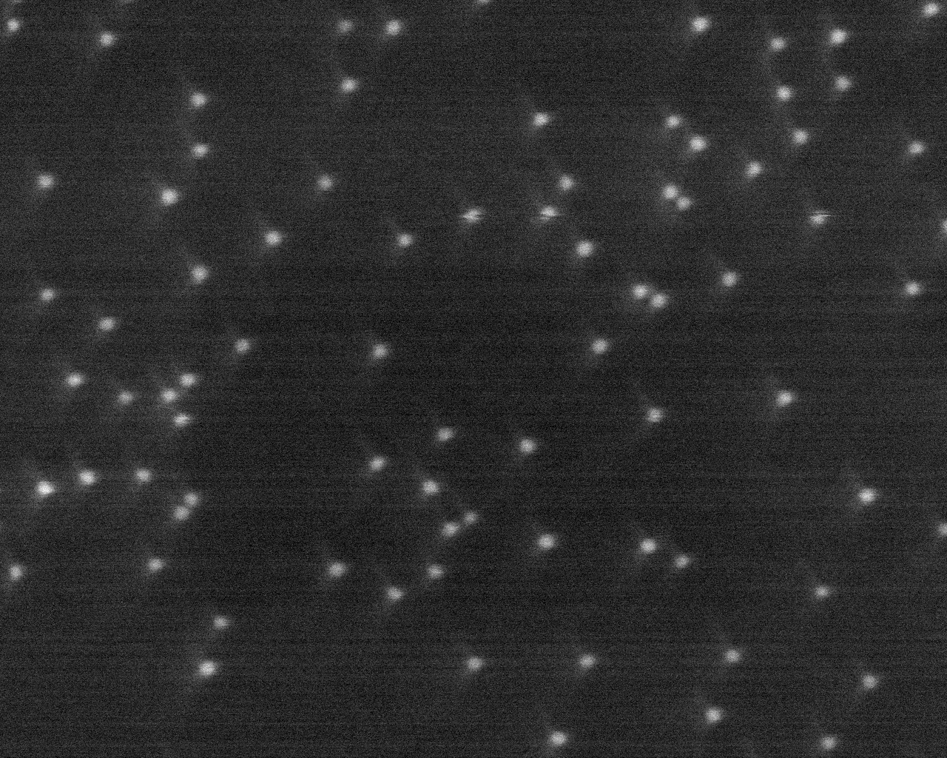
Nano-Materials Characterization
Courtesy Z. Barkay

Slide 28
Nano-Materials Characterization

Slide 29
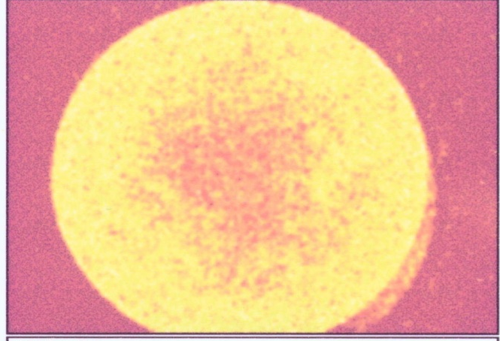


Atomic mapping and analysis
Cl
Brr
Agr
Courtesy Z. Barkay

Slide 30
Nano-Materials Characterization
Courtesy CEA

Slide 31
Nano-Materials Characterization

Slide 32
Nano-Materials Characterization
Auger Electron Spectroscopy

Slide 33
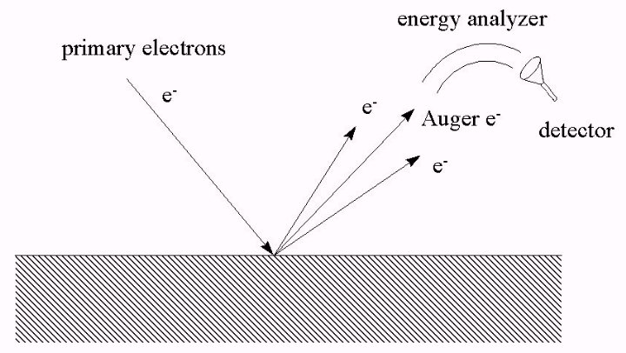
Auger process
Courtesy A. Merson

Slide 34
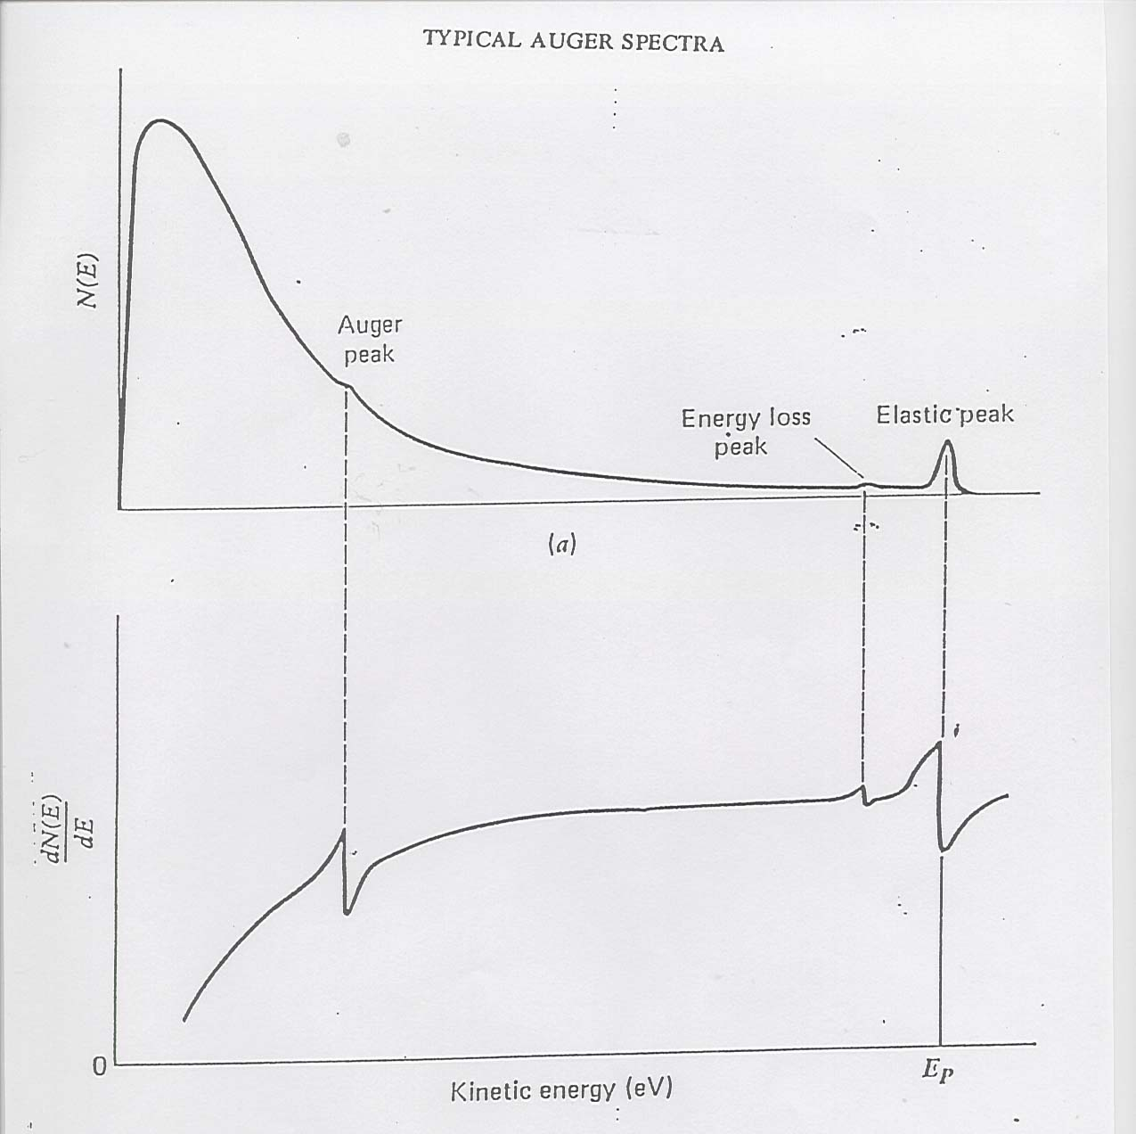

Slide 35
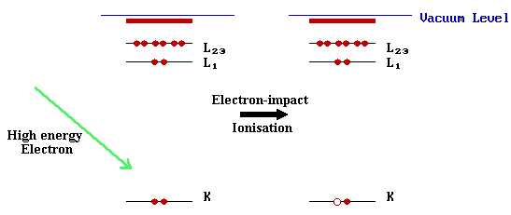
Courtesy A. Merson

Slide 36
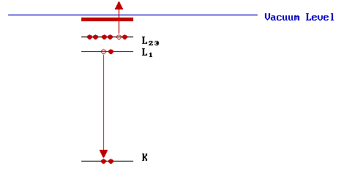
a. X-ray fluorescence
b. Auger emission
Auger Emission
Courtesy A. Merson

Slide 37
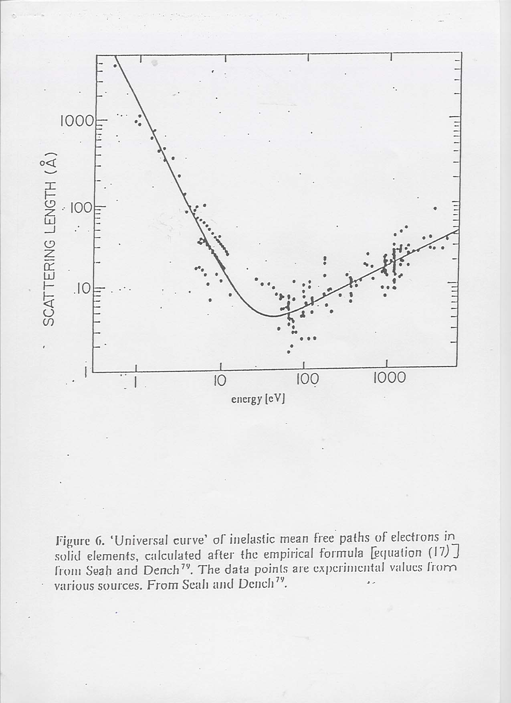

Slide 38
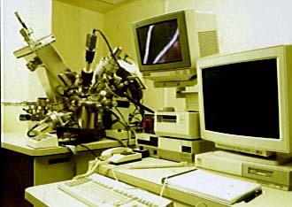

Slide 39
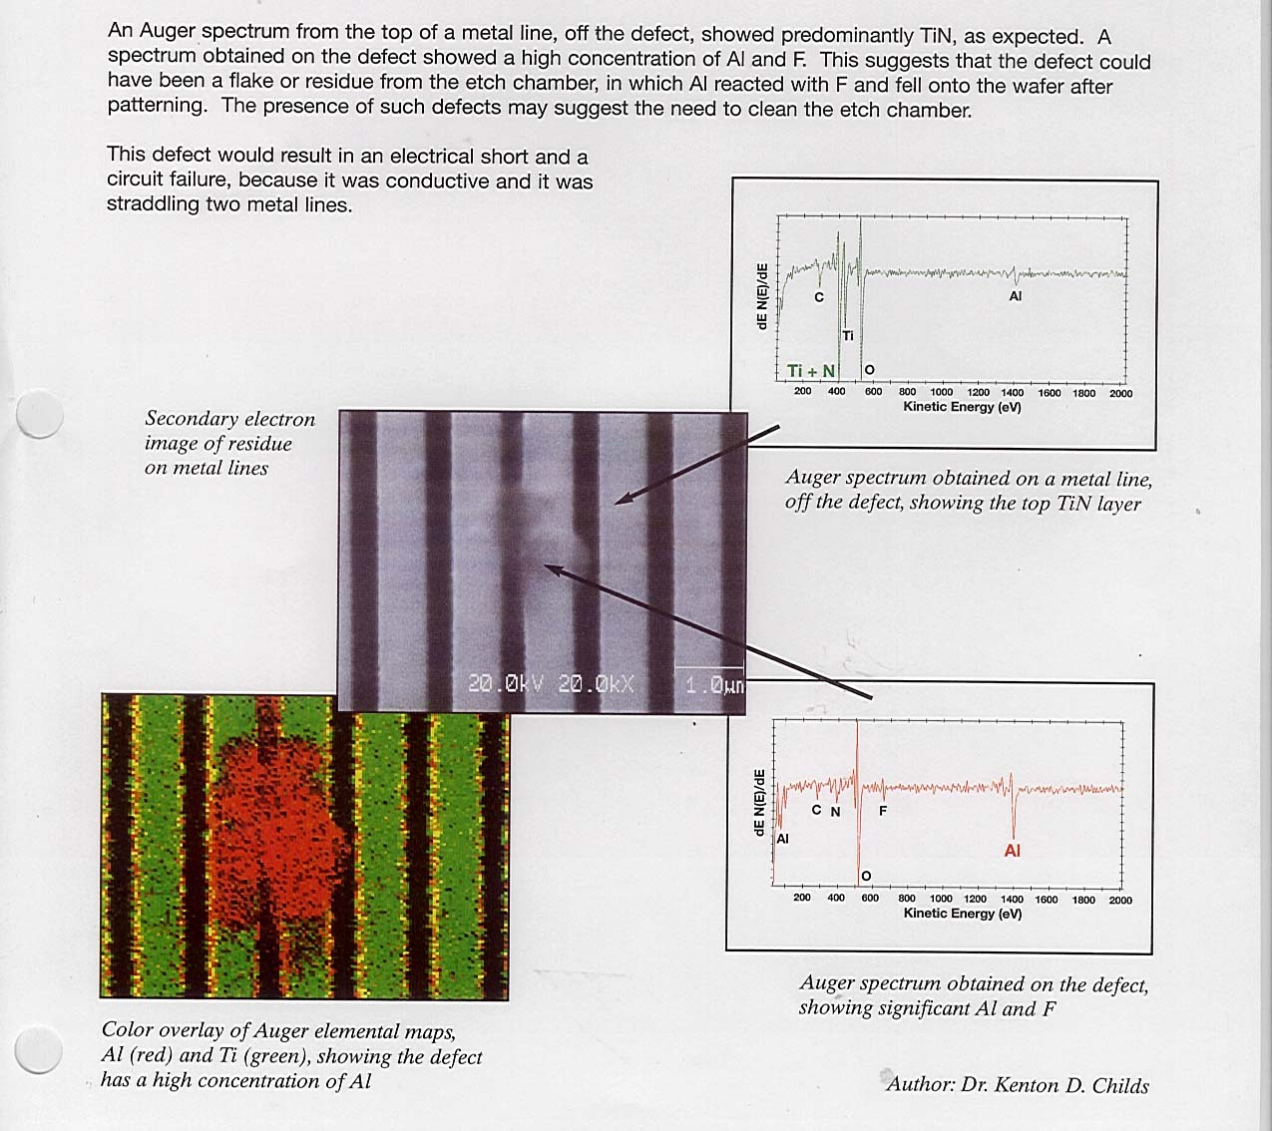
Courtesy PHI

Slide 40
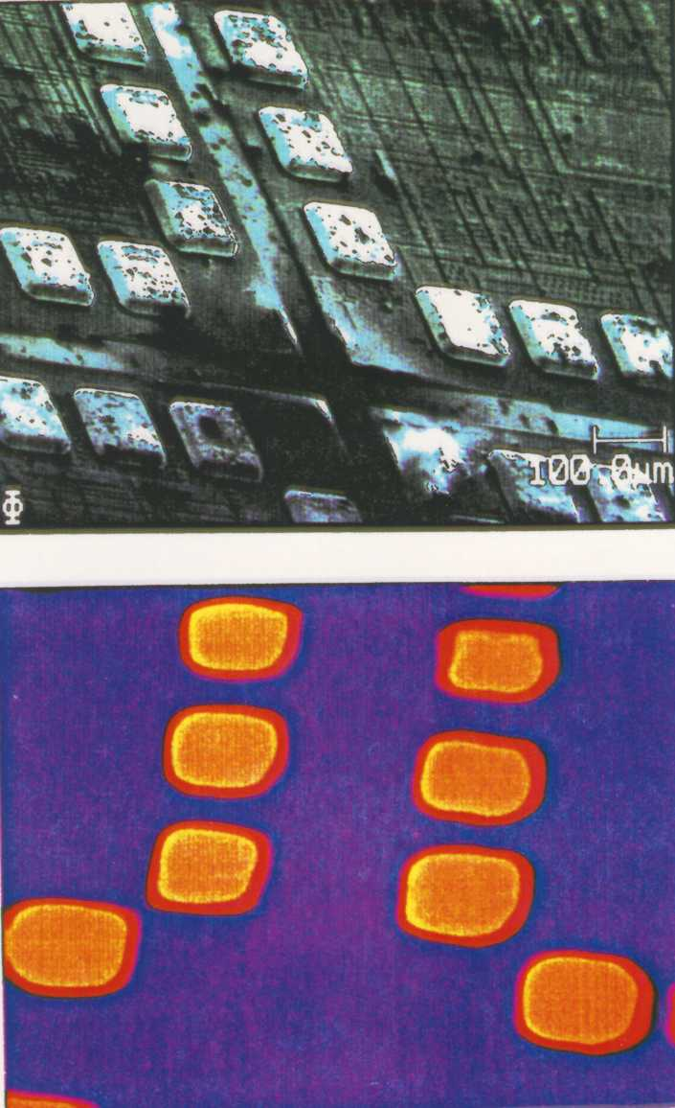
Courtesy PHI

Slide 41
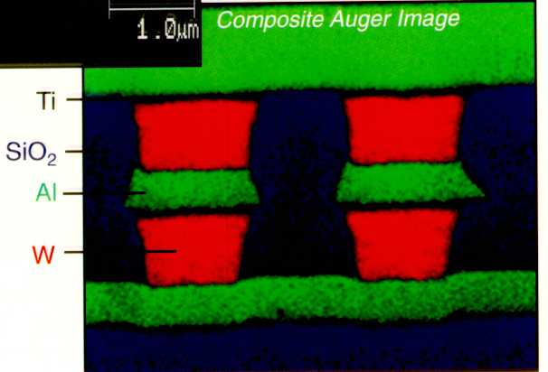
Nano-Materials Characterization
Courtesy PHI

Slide 42
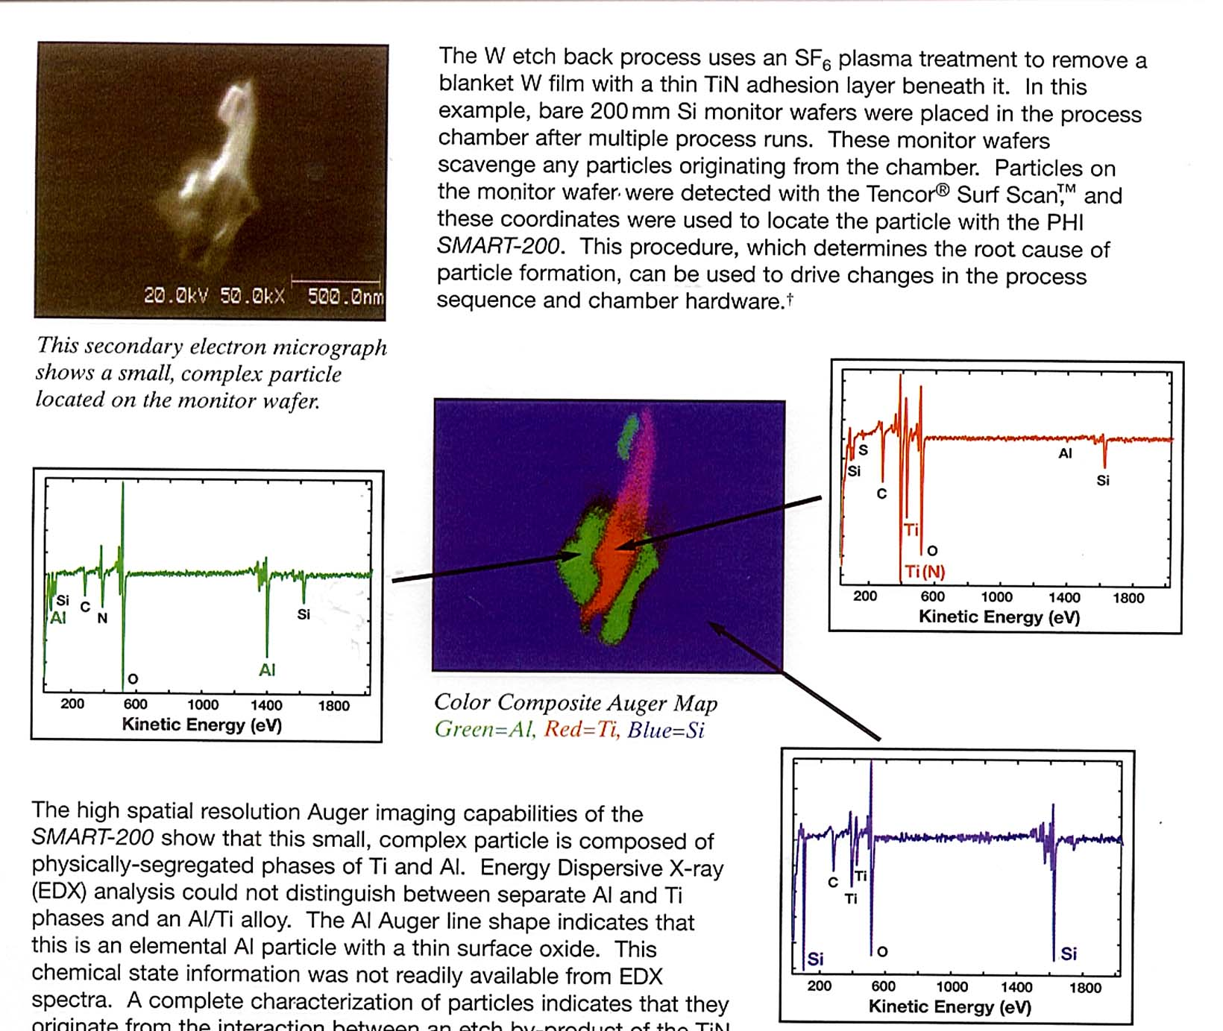
Courtesy PHI

Slide 43
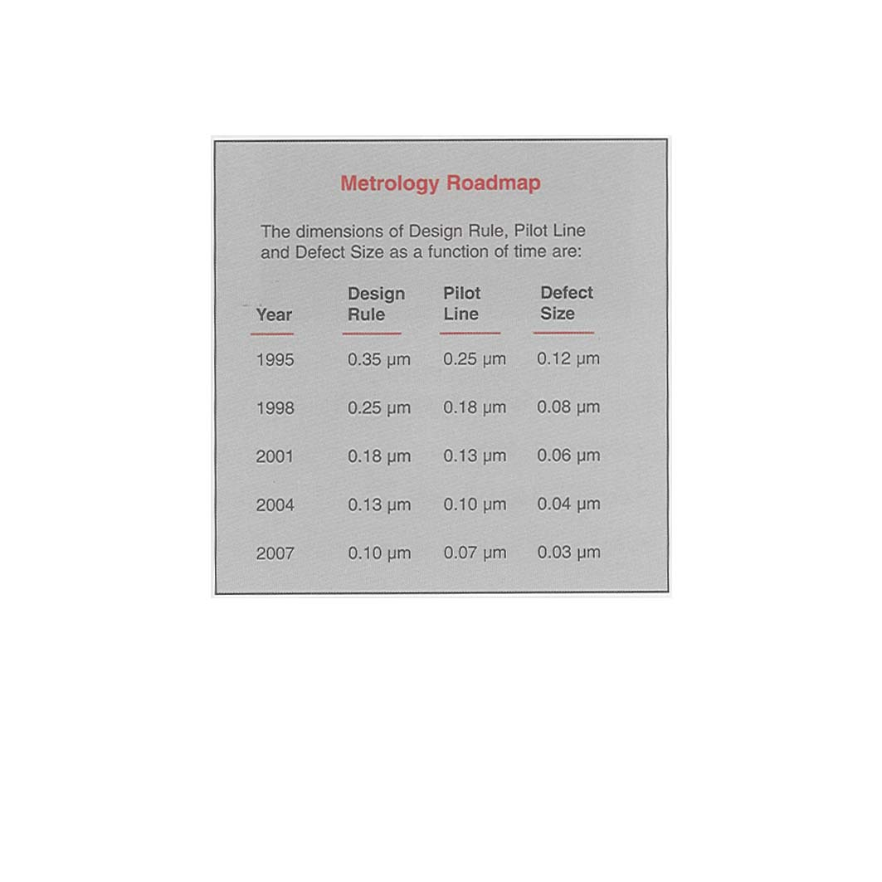
Nano-Materials Characterization
Courtesy PHI

Slide 44
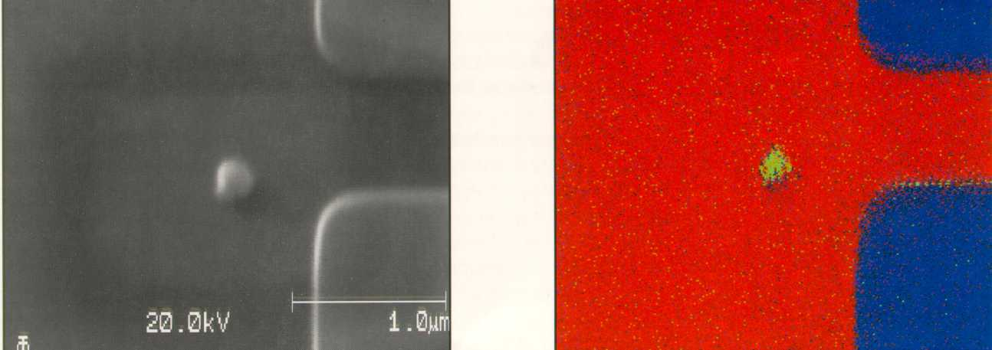
Nano-Materials Characterization
Courtesy PHI

Slide 45
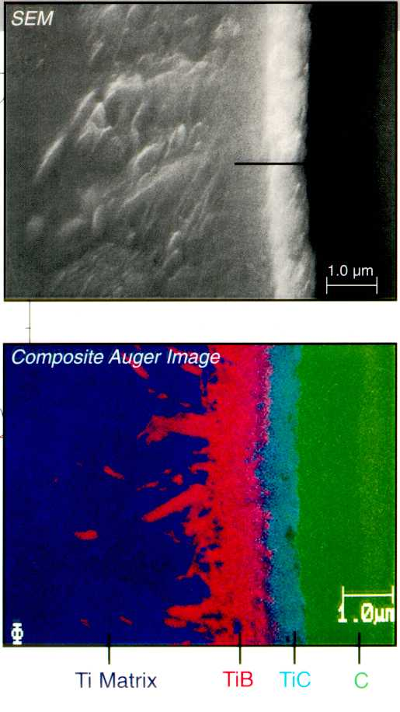
Nano-Materials Characterization
Courtesy PHI

Slide 46
Nano-Materials Characterization
X-ray Photo-electron Spectroscopy

Slide 47
Nano-Materials Characterization

Slide 48
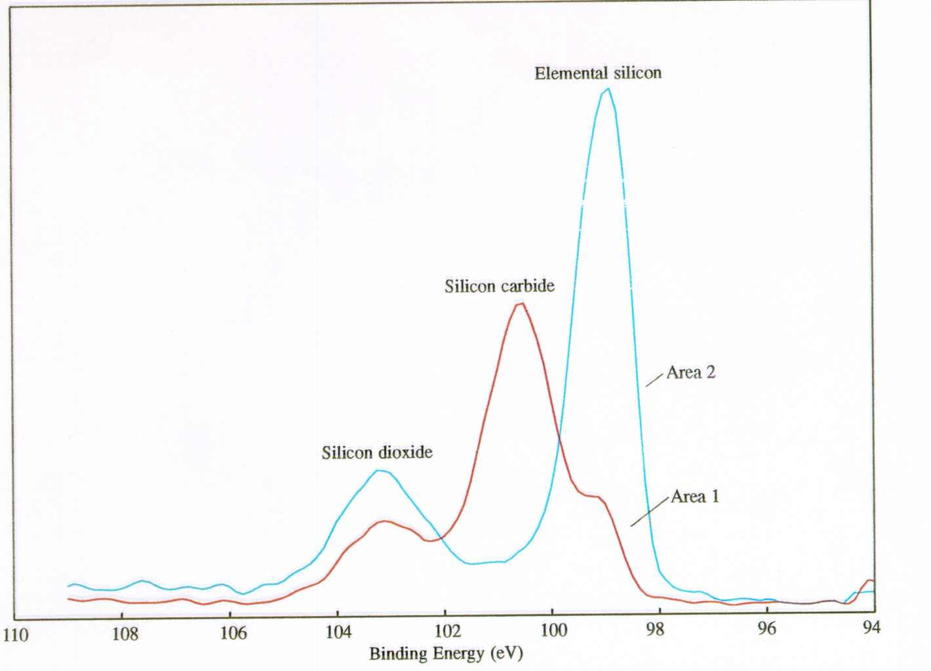
Nano-Materials Characterization
Courtesy PHI

Slide 49
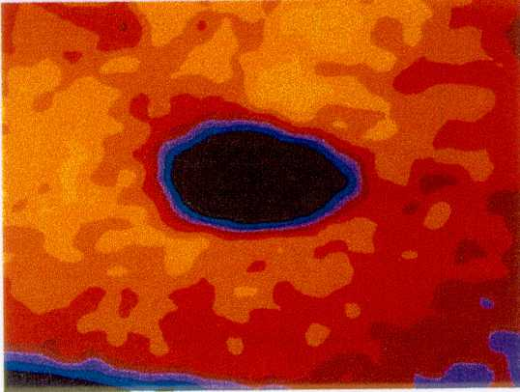
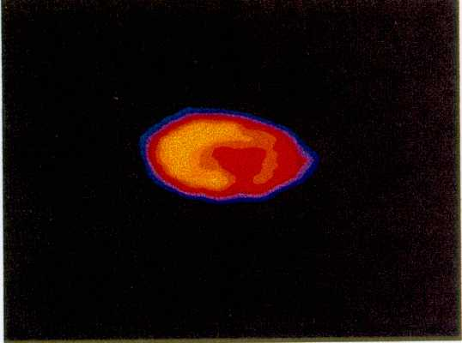
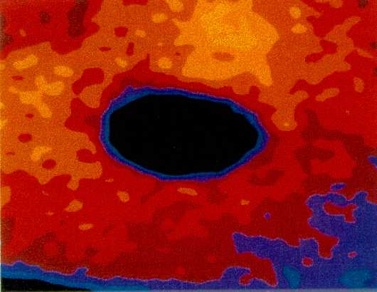
Nano-Materials Characterization
Courtesy PHI

Slide 50
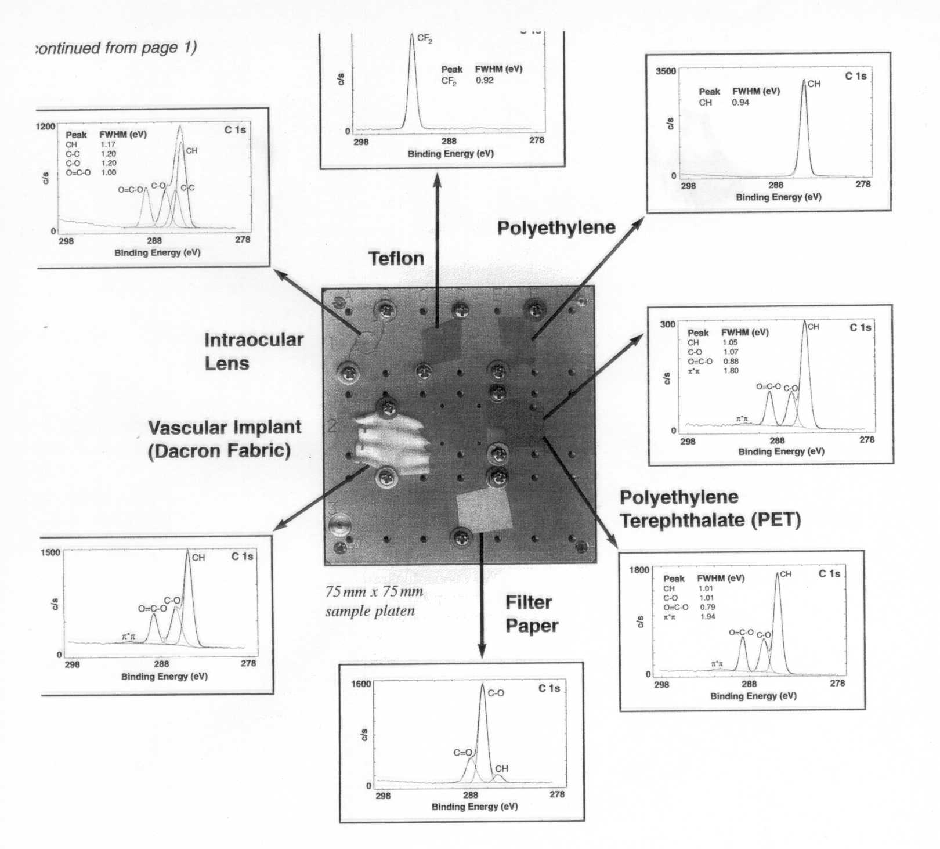
Nano-Materials Characterization
Courtesy PHI

Slide 51
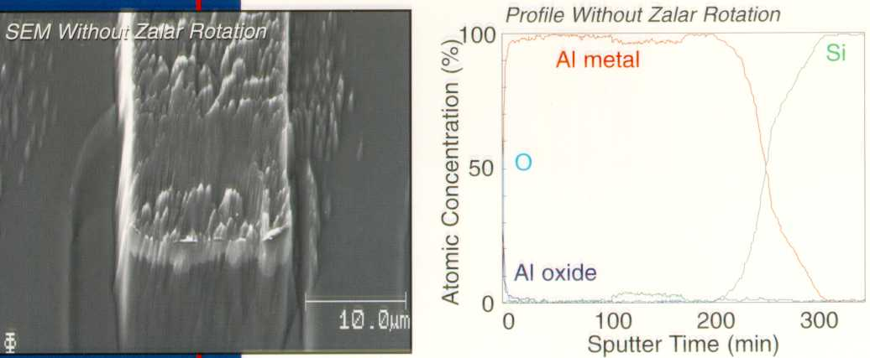
Nano-Materials Characterization
Courtesy PHI

Slide 52
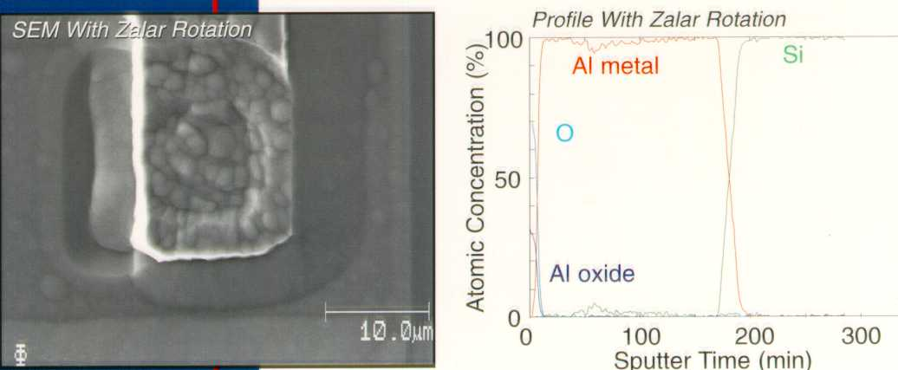
Nano-Materials Characterization
Courtesy PHI

Slide 53
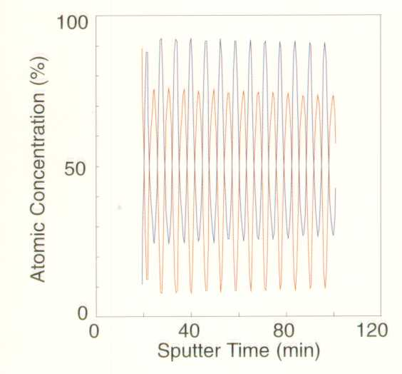
Nano-Materials Characterization
Courtesy PHI

Slide 54
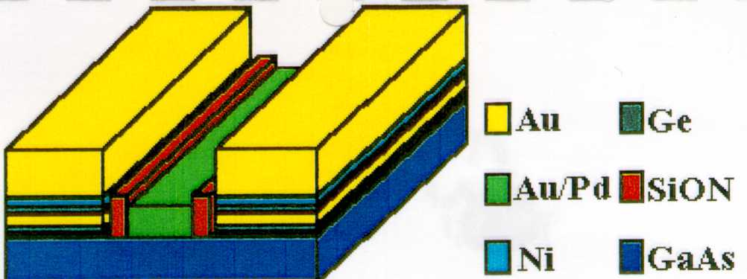
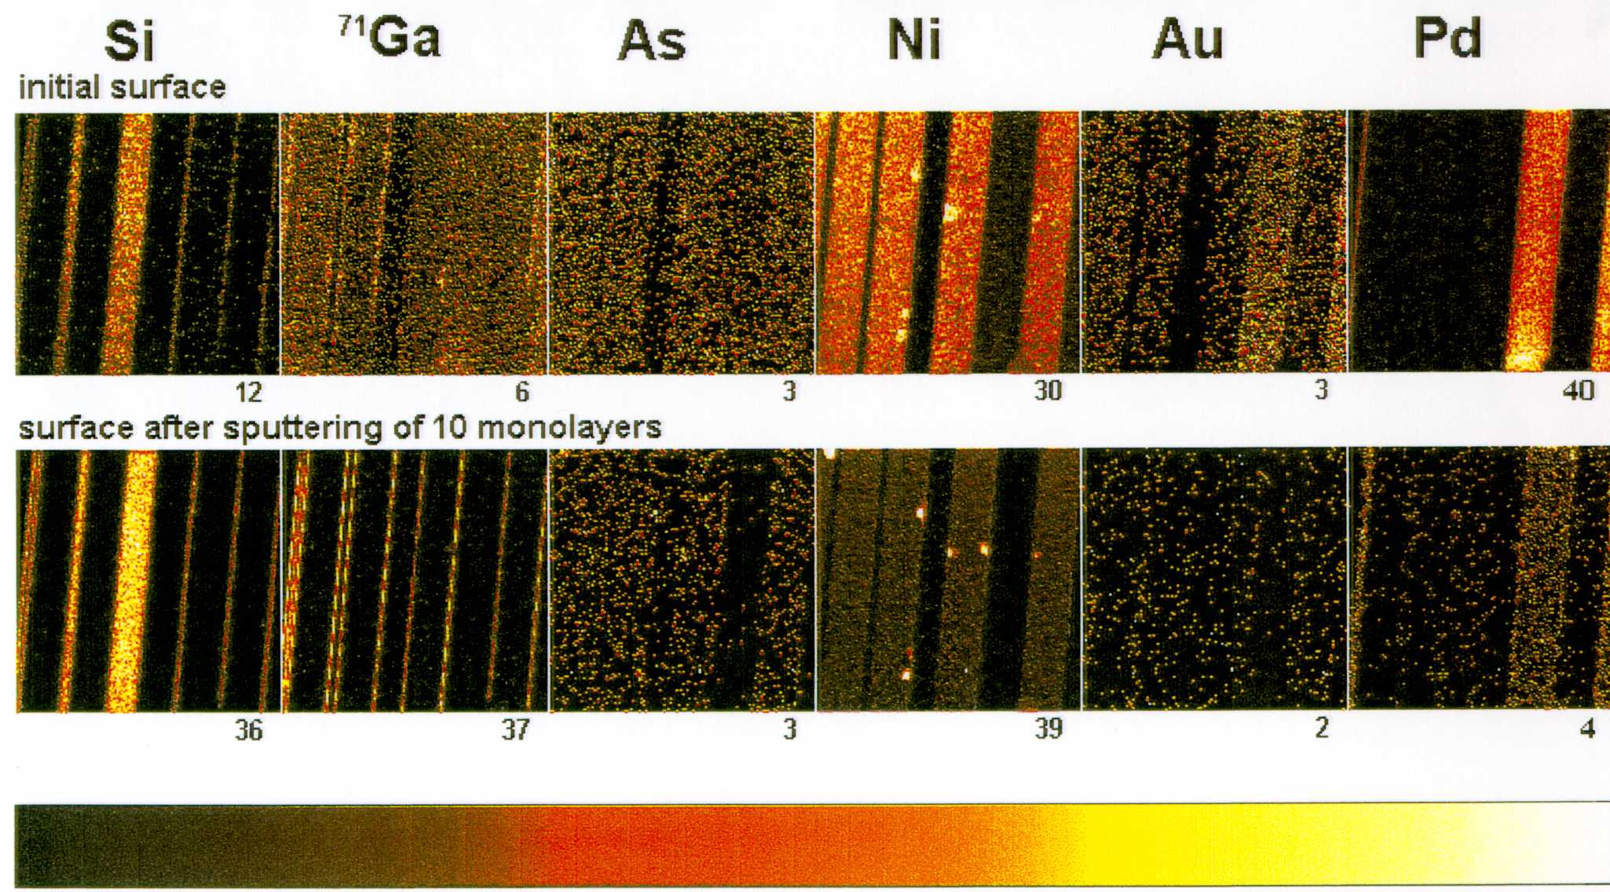
Nano-Materials Characterization
Courtesy PHI

Slide 55
Nano-Materials Characterization

Slide 56
Nano-Materials Characterization
TOF-SIMS

Slide 57
Courtesy A. Merson

Slide 58
Courtesy A. Merson

Slide 59
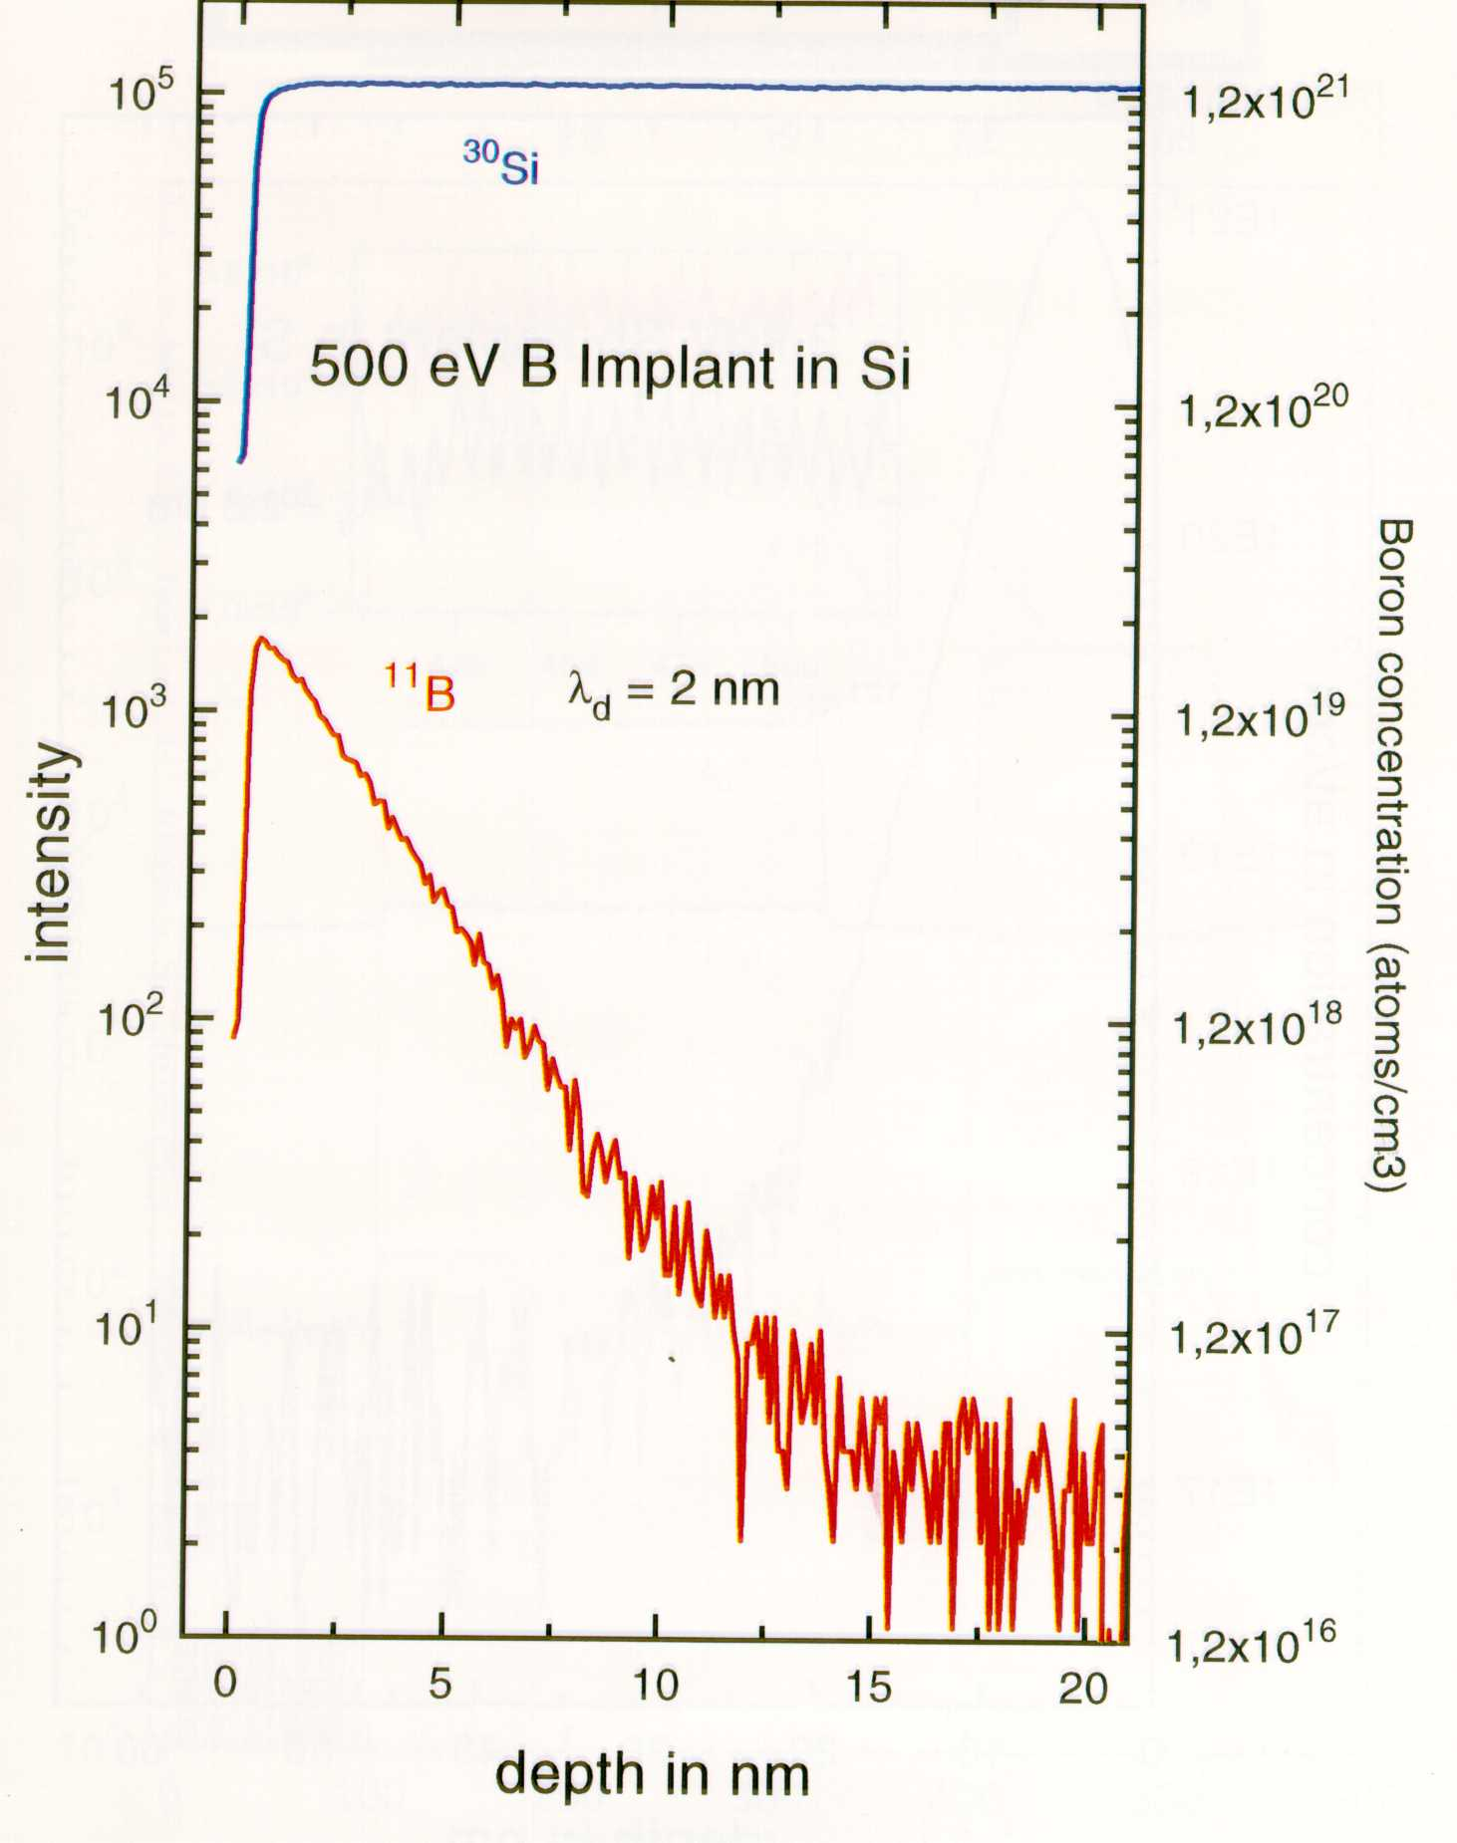
Nano-Materials Characterization
Courtesy PHI

Slide 60
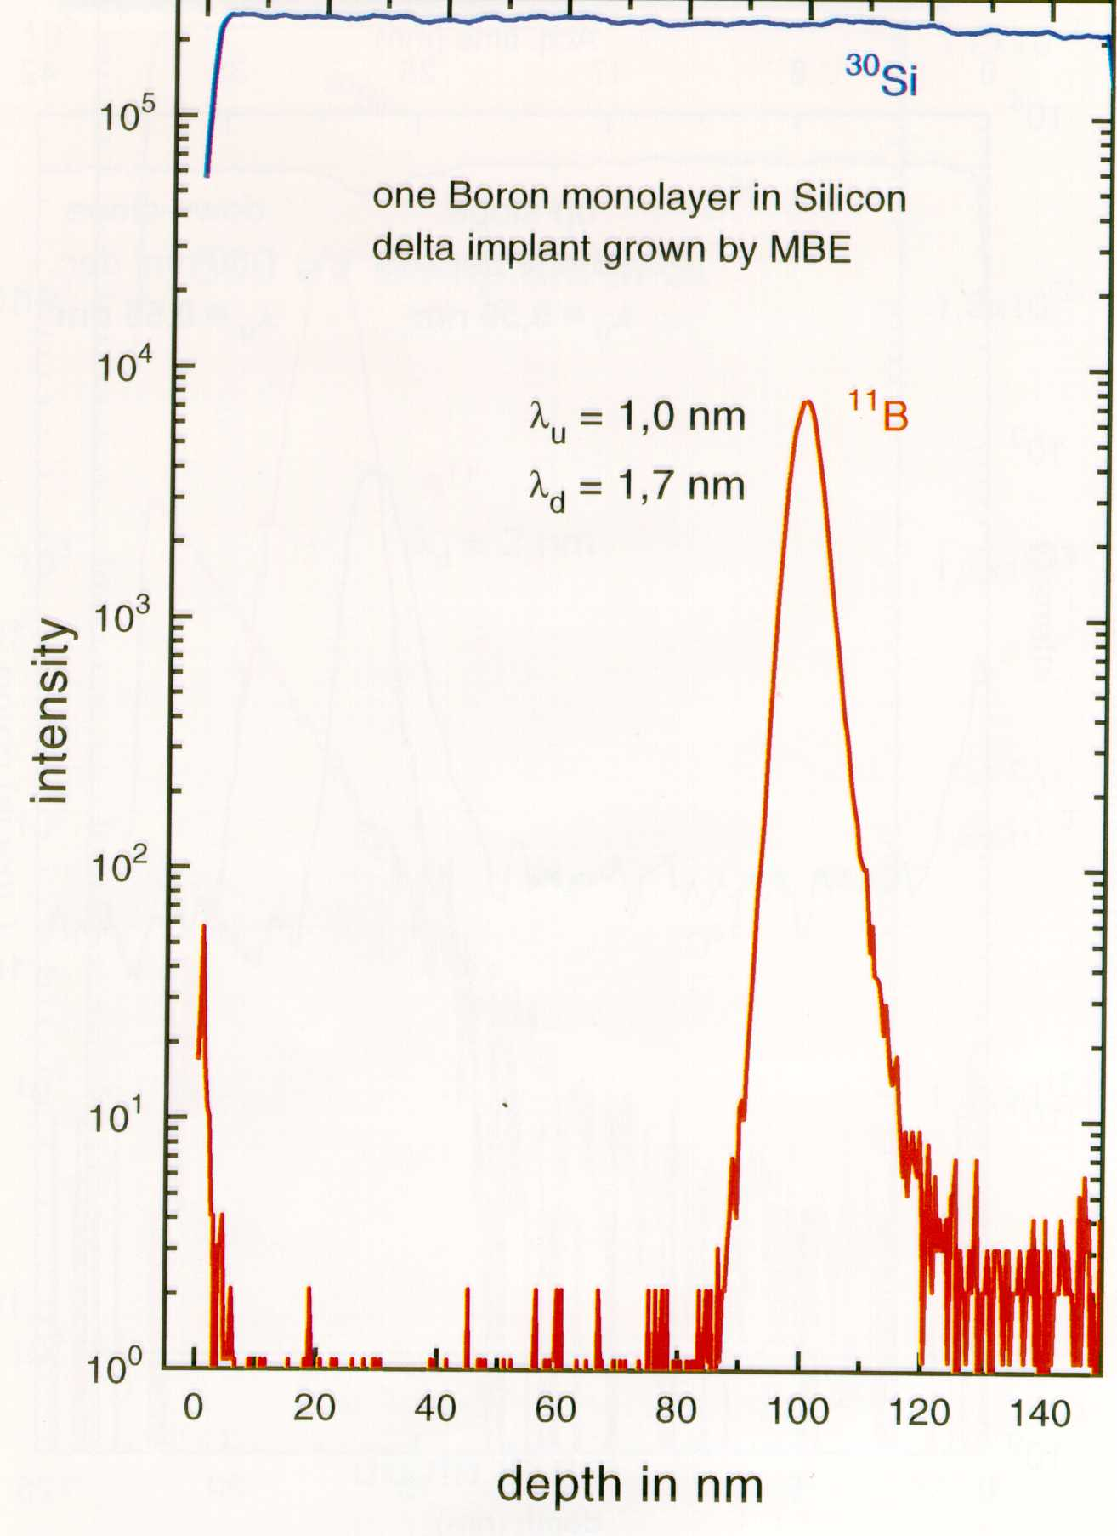
Nano-Materials Characterization
Courtesy PHI

Slide 61

Nano-Materials Characterization
Scanning Tunneling Microscopy
(STM)

Slide 62
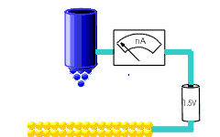
I~exp(-2kd)
Courtesy A. Merson

Slide 63
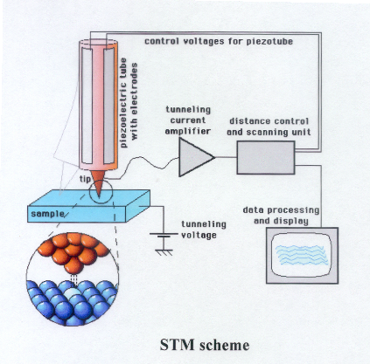
Courtesy A. Merson

Slide 64
Atomic Force Microscopy
(AFM)

Slide 65
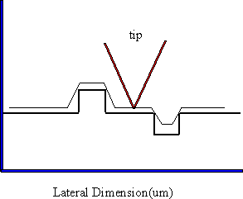
Non-contact mode
Courtesy A. Merson

Slide 66
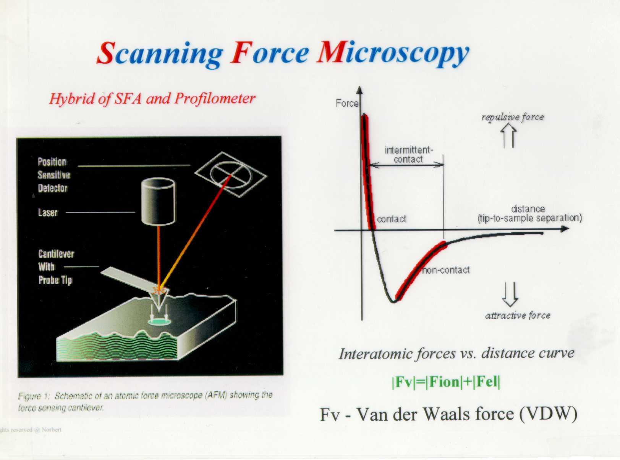
Nano-Materials Characterization
Courtesy Y. Rosenwaks

Slide 67

Nano-Materials Characterization

Slide 68
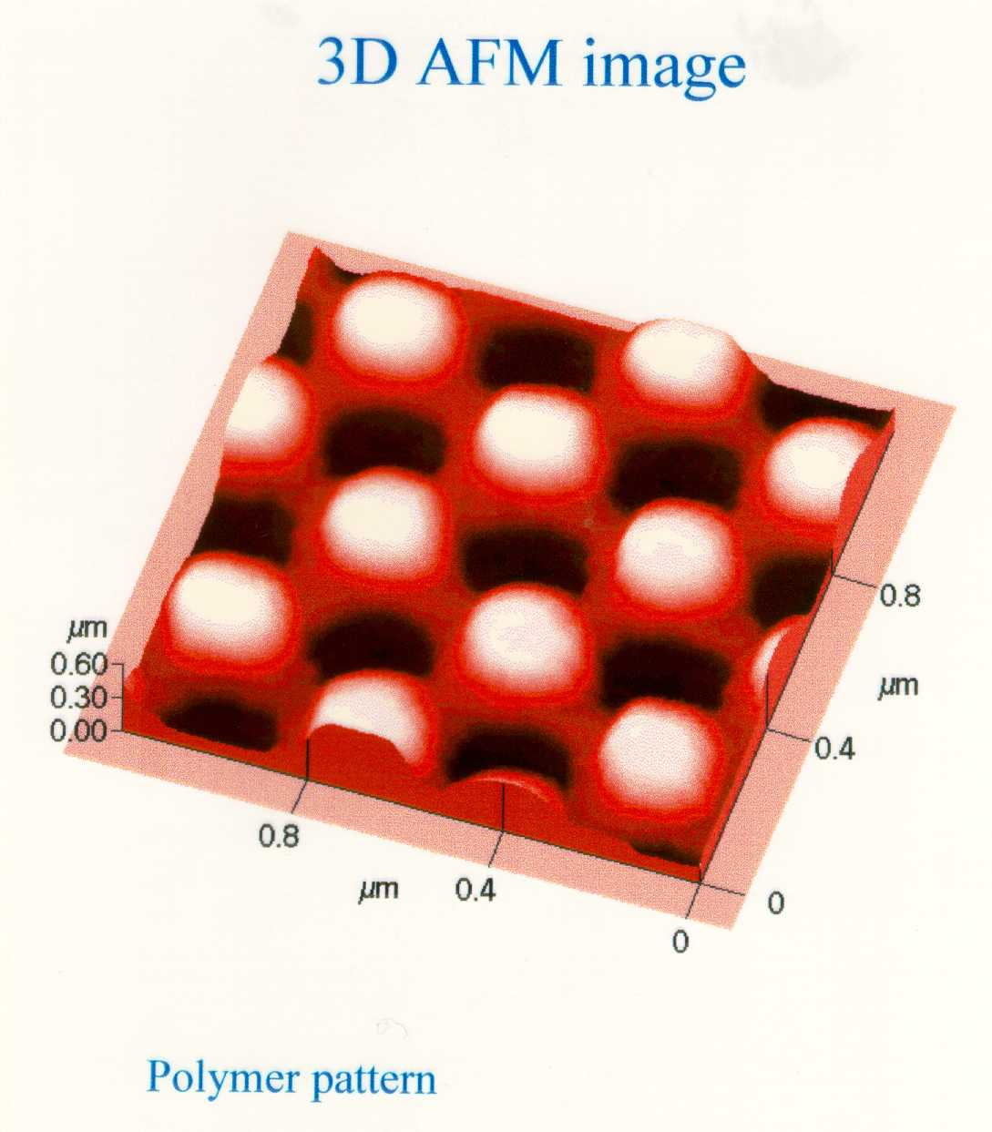
Materials Characterization
Courtesy Dr. Z. Barkai

Slide 69
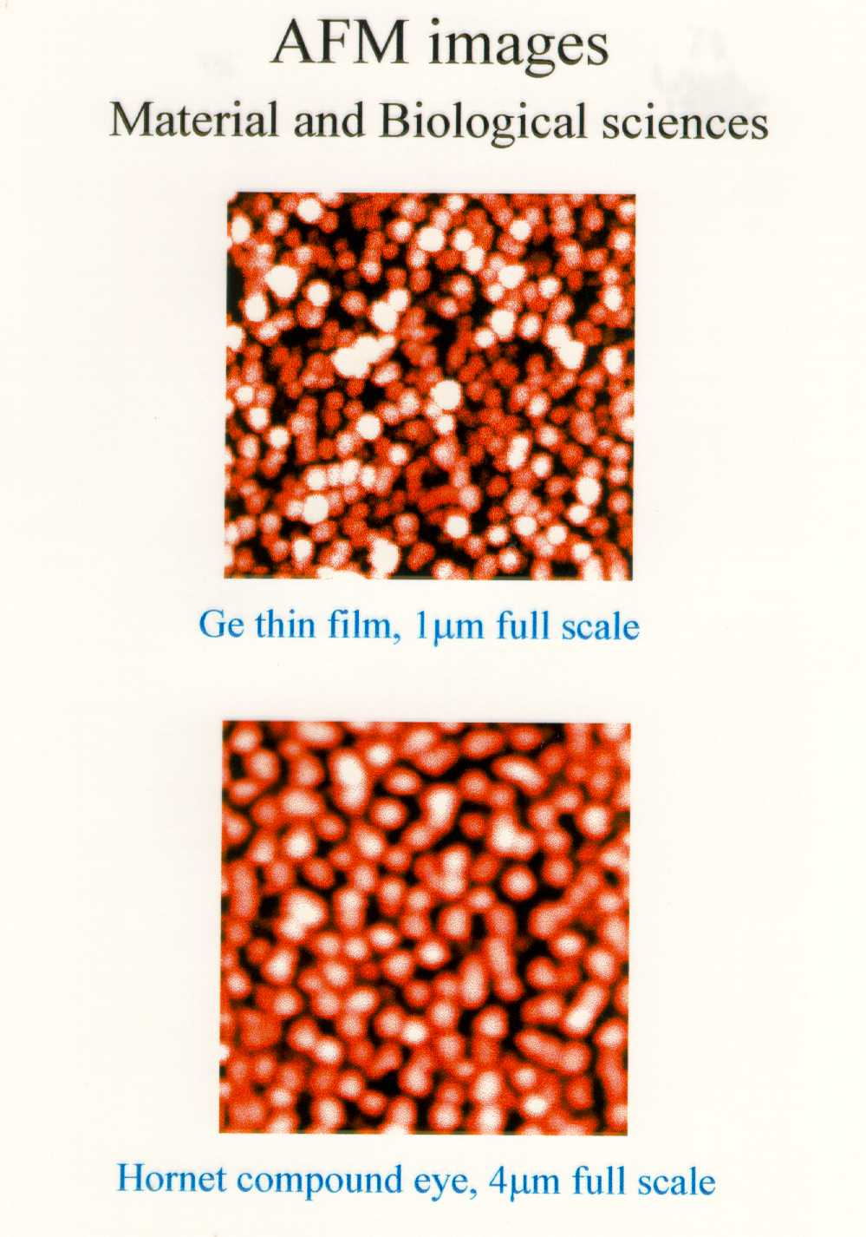
Courtesy Dr. Z. Barkai

Slide 70

Nano-Materials Characterization
STM: Si(7x7)

Slide 71

Nano-Materials Characterization
A superlattice of alternating GaSb (12 ml) and InAs (14 ml) was MBE grown by W. Barvosa-Carter, B. R. Bennett, and L. J. Whitman. Only every-other lattice plane [Sb (reddish) and As (blueish)] is exposed on the (110) surface.

Slide 72


Materials Characterization

Slide 73

Iron (on Cu) “Coral”

Slide 74

Nano-Materials Characterization
Courtesy Z. Barkay

Slide 75

Nano-Materials Characterization
Courtesy Z. Barkay

Slide 76

Courtesy Y. Rosenwaks

Slide 77


Materials Characterization
Courtesy Y. Rosenwaks

Slide 78

Nano-Materials Characterization
Courtesy Dr. S. Richter

Slide 79

Materials Characterization
Courtesy Dr. S. Richter

Slide 80

Courtesy Dr. S. Richter

Slide 81

Materials Characterization
Courtesy Dr. S. Richter

Slide 82

Materials Characterization
Courtesy Dr. S. Richter

Slide 83
Nano-Materials Characterization
Thank you for your attention
Yoram Shapira
Shapira@eng.tau.ac.il

