Slide 1
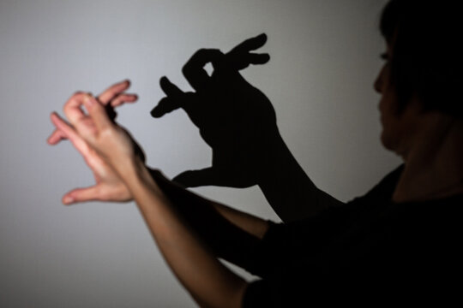
Human vision Illusion and the technology behind it
Ernő KOLLÁR
27 Jun 2024
Ernő KOLLÁR, PhD
Notes:
µLED Technology & Market, Dr. Kéri Orsolya, 2020.10.01. (13) µLED Technology & Market (Yole Developpément), Dr. Kéri Orsolya, 2021.09.30. (54) MicroLED technology & market in 2022, Szűcs Tamás, 2023.01.19. (100)

Slide 2
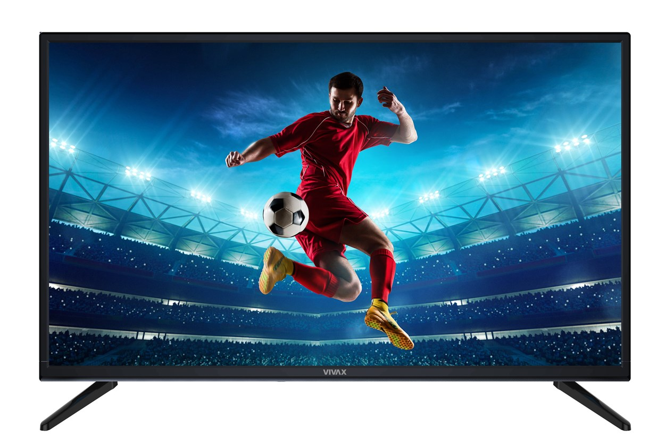
Human Vision
Illusion and the technology behind it
Content
Receptors & angular resolution of the human eye
Brain image processing
Color mixing, white balance
Short LED history
Cinema, TV Broadcasting
Cathode Ray Tube (CRT)
4k CRT?
CIE-1931, CIE-1976
LED structures
LED size
Multiplex LED driving

Slide 3
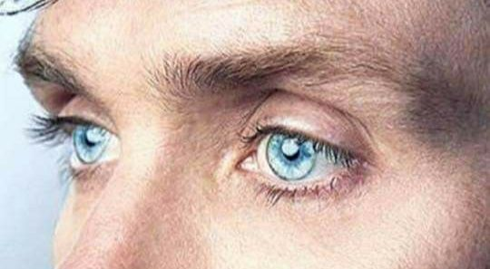
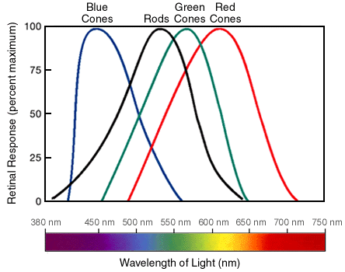
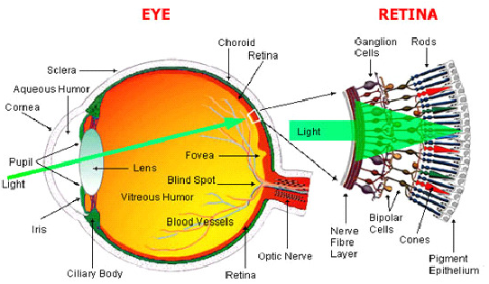
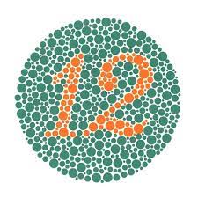
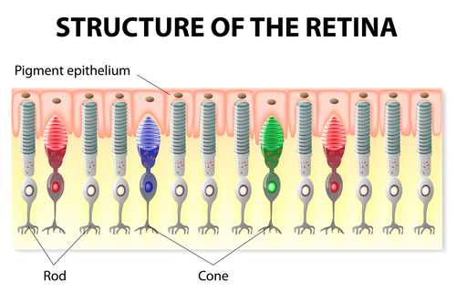
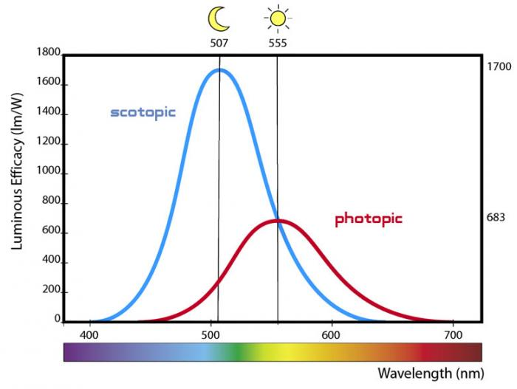
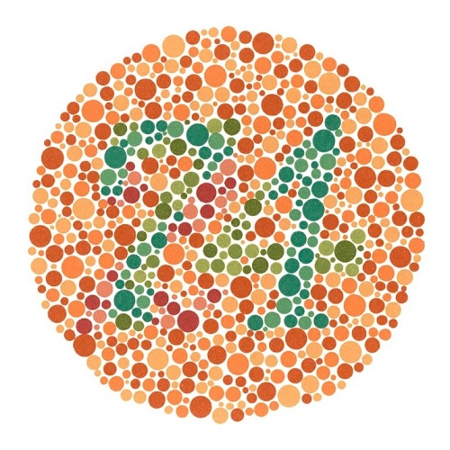
Illusion and the technology behind it
Receptors of the human eye I
498
nm
533 nm
437
nm
564
nm
Image-forming receptors

Slide 4
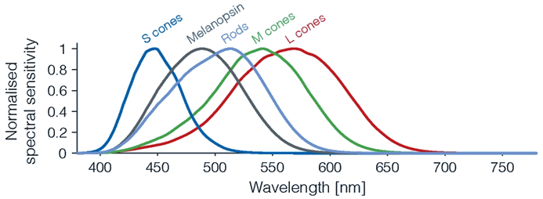
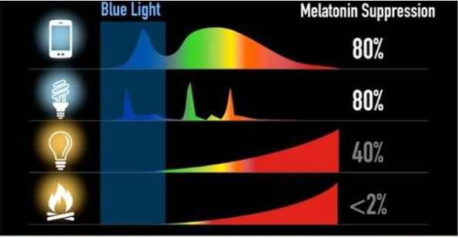
Illusion and the technology behind it
Receptors of the human eye II
Non-image-forming receptors
Intrinsically photosensitive retinal ganglion cells (ipRGGs):
Melanopsin (1998)
Melanopsin in particular is highly sensitive to blue wavelengths of light (480 nm). About 2 percent of retinal photoreceptors are melanopsin containing.
Limiting blue light exposure before bedtime can help keep melatonin levels high at night, helping you get to sleep sooner. Try blue light blocking glasses at night to help you get to sleep better.

Slide 5
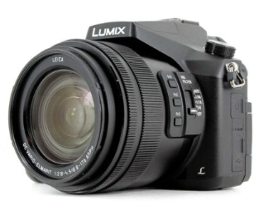
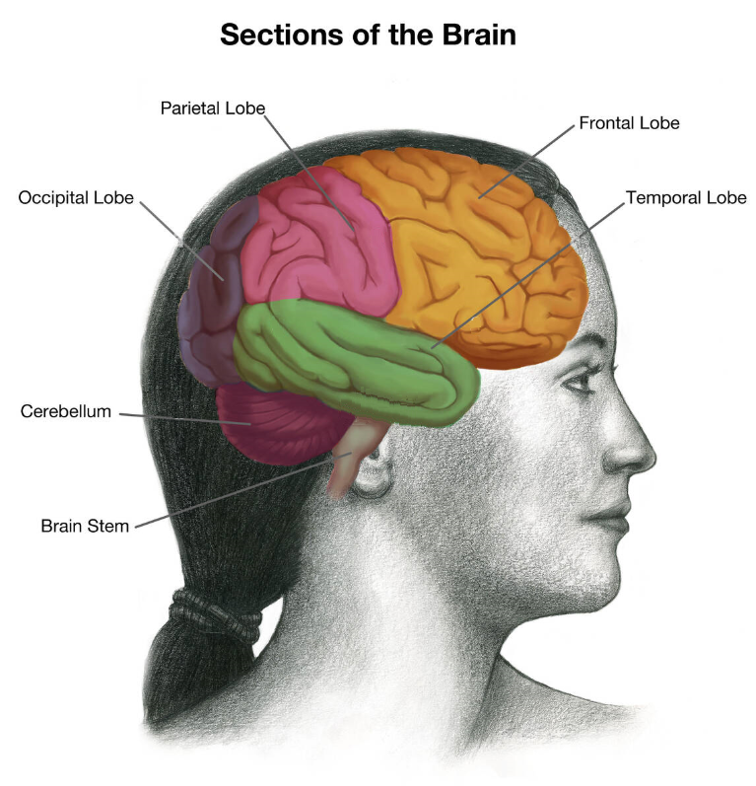
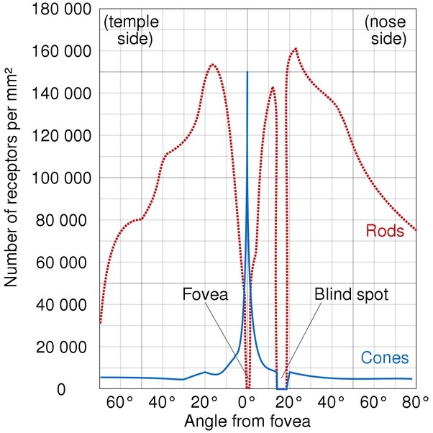
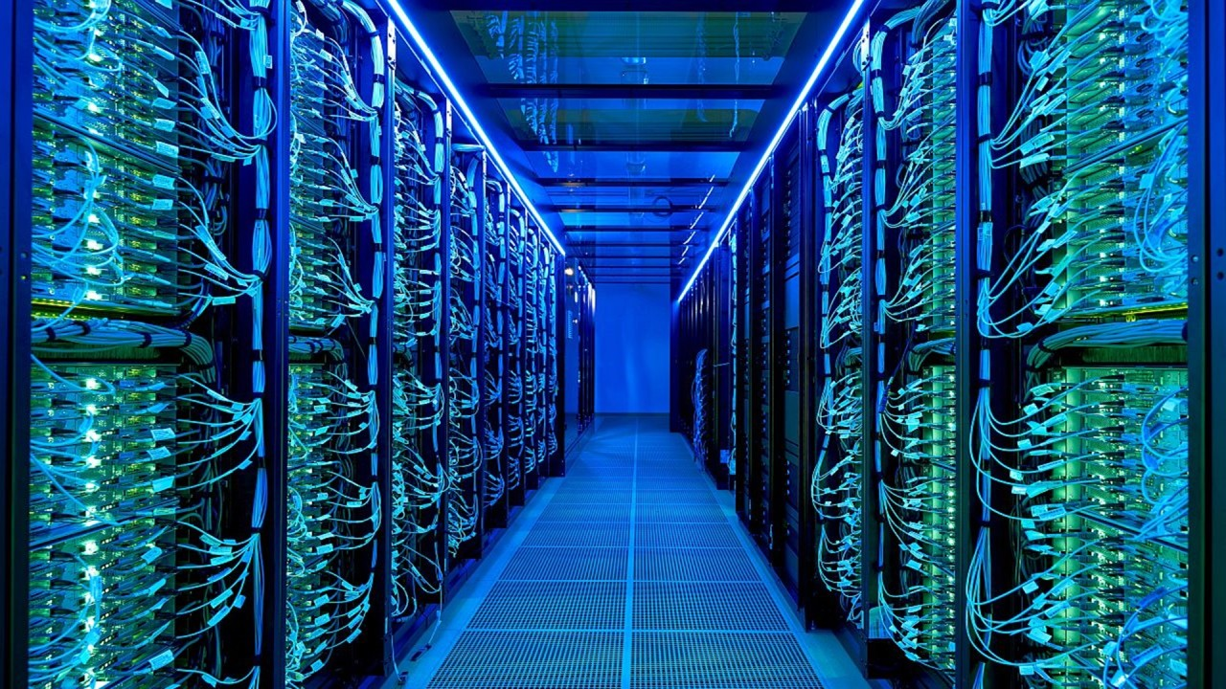
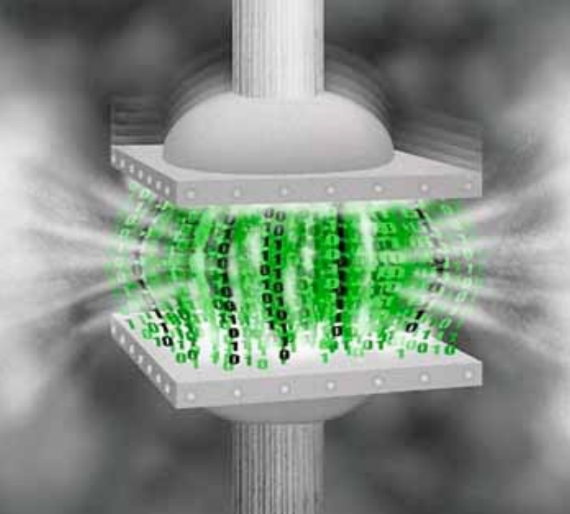
Illusion and the technology behind it
Angular resolution of human eye
Brain image processing

Slide 6
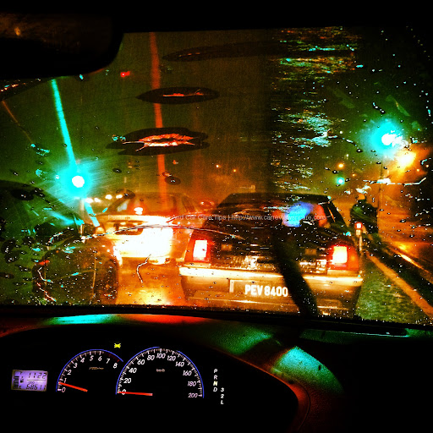
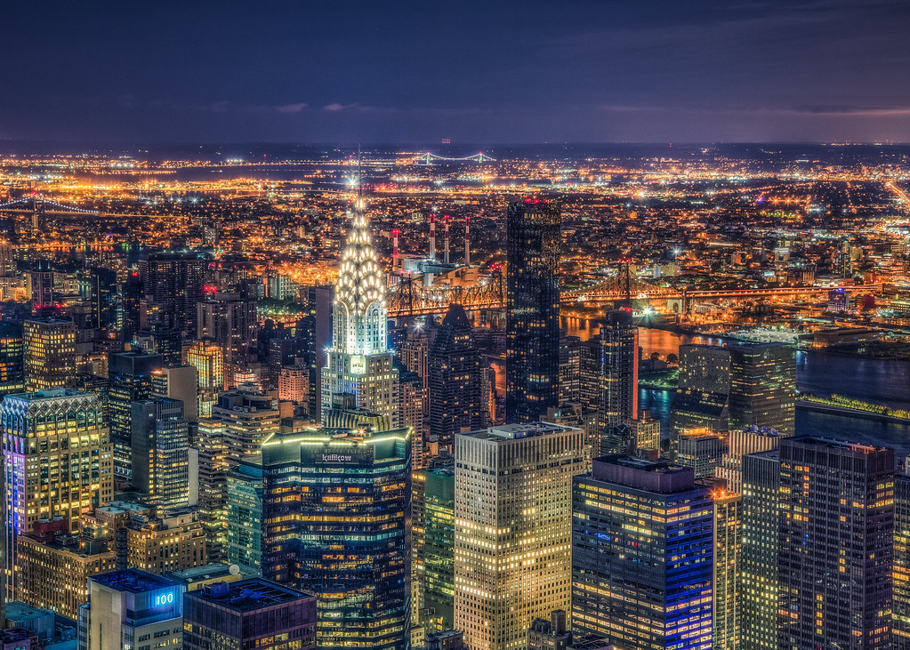
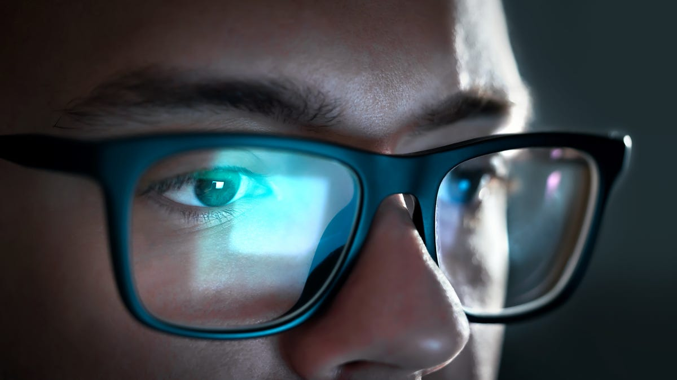
Illusion and the technology behind it
Brain image processing
Brain image processing

Slide 7
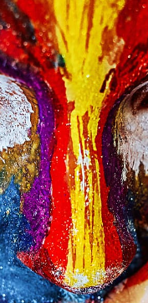
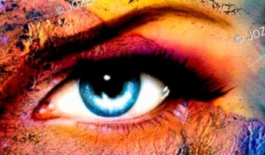
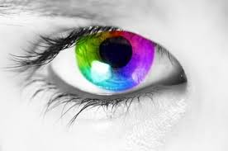
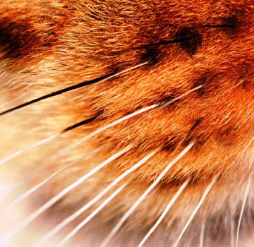
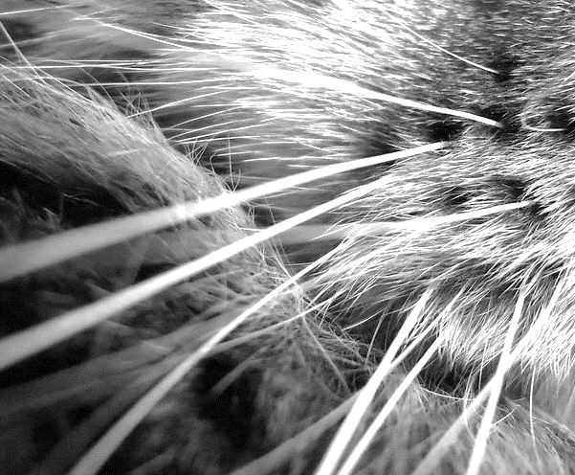
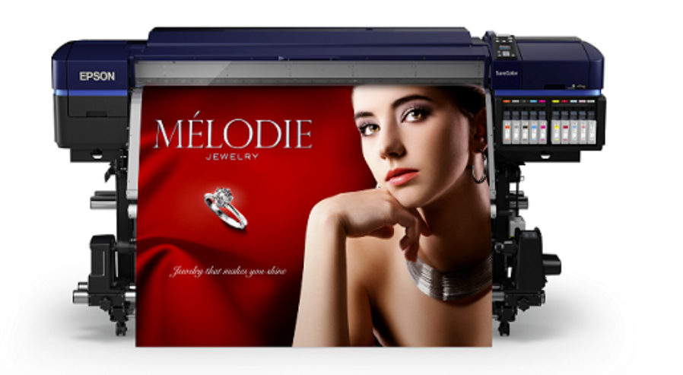
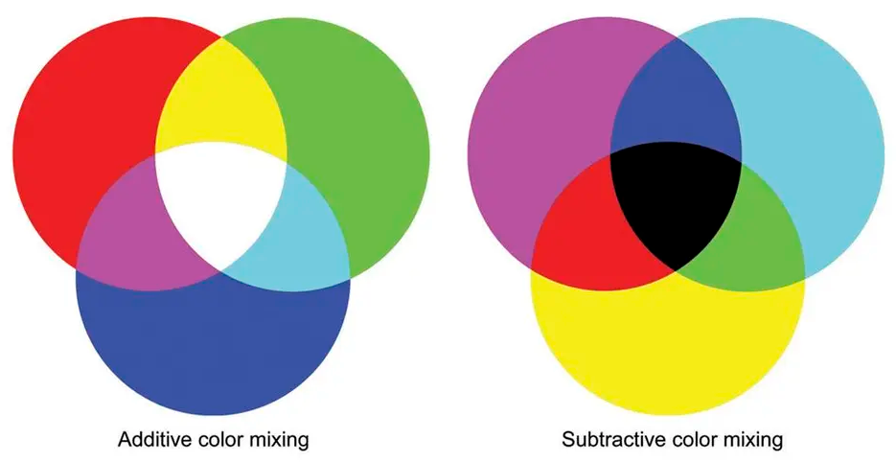
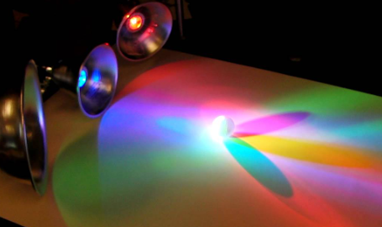
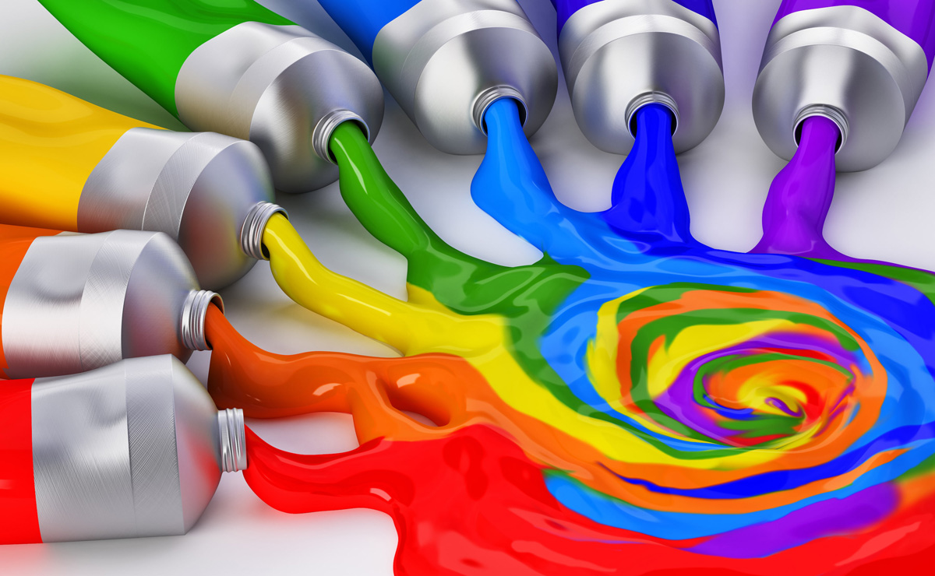
Illusion and the technology behind it
Additive / Subtractive color mixing
Color mixing
RGB
CMYK
Red, Green, Blue colors
Cyan, Magenta, Yellow and Key (Black) colors

Slide 8
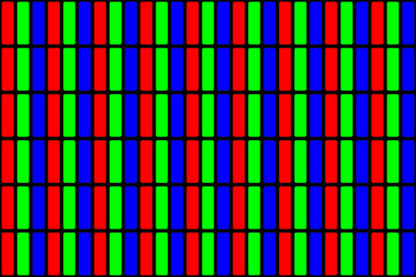
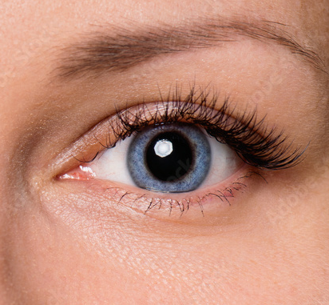
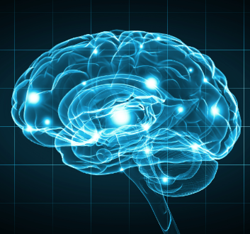
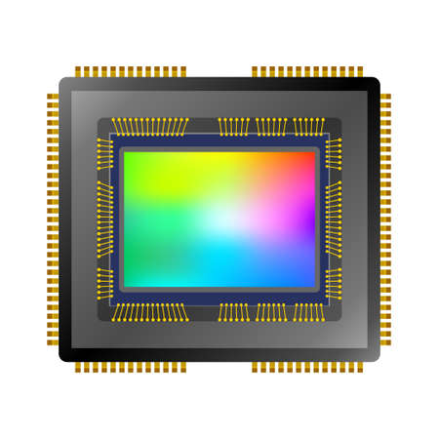
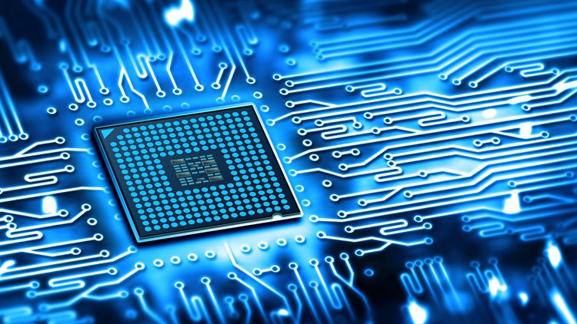
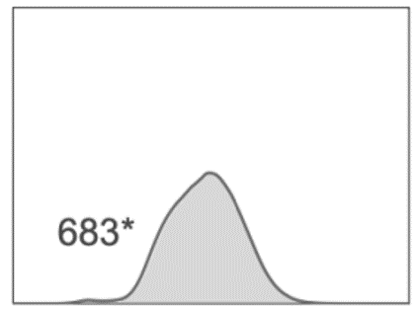
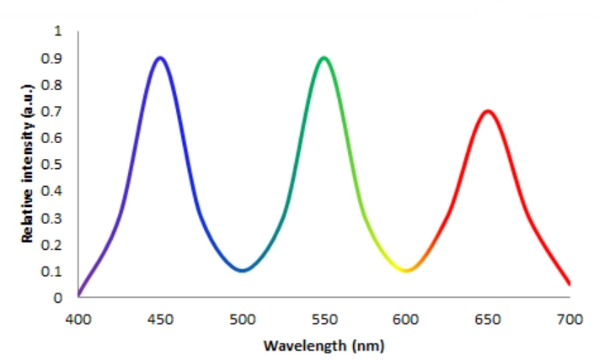
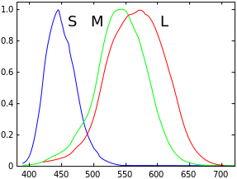
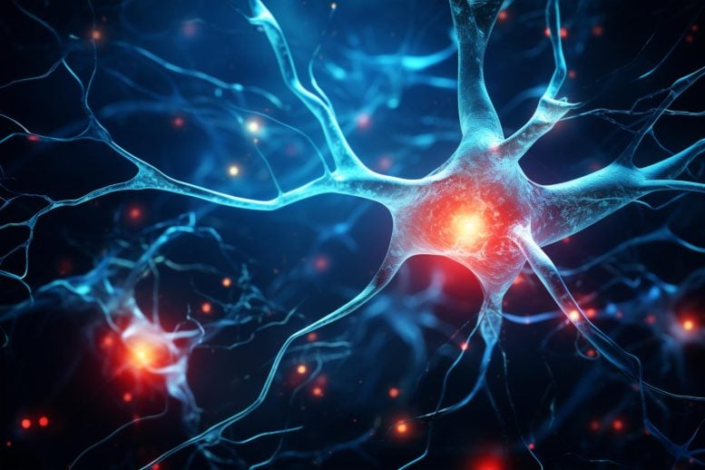
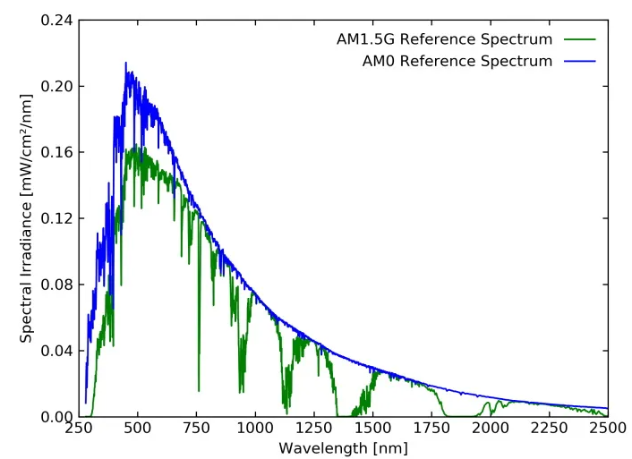
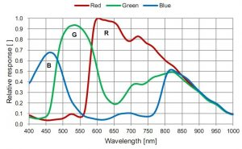
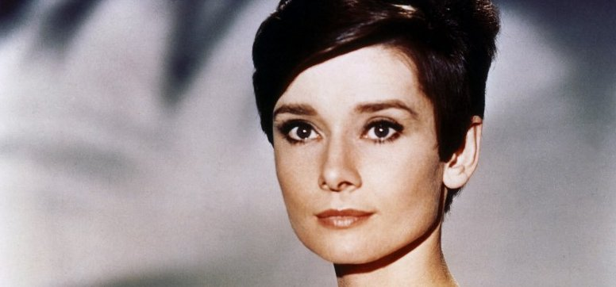
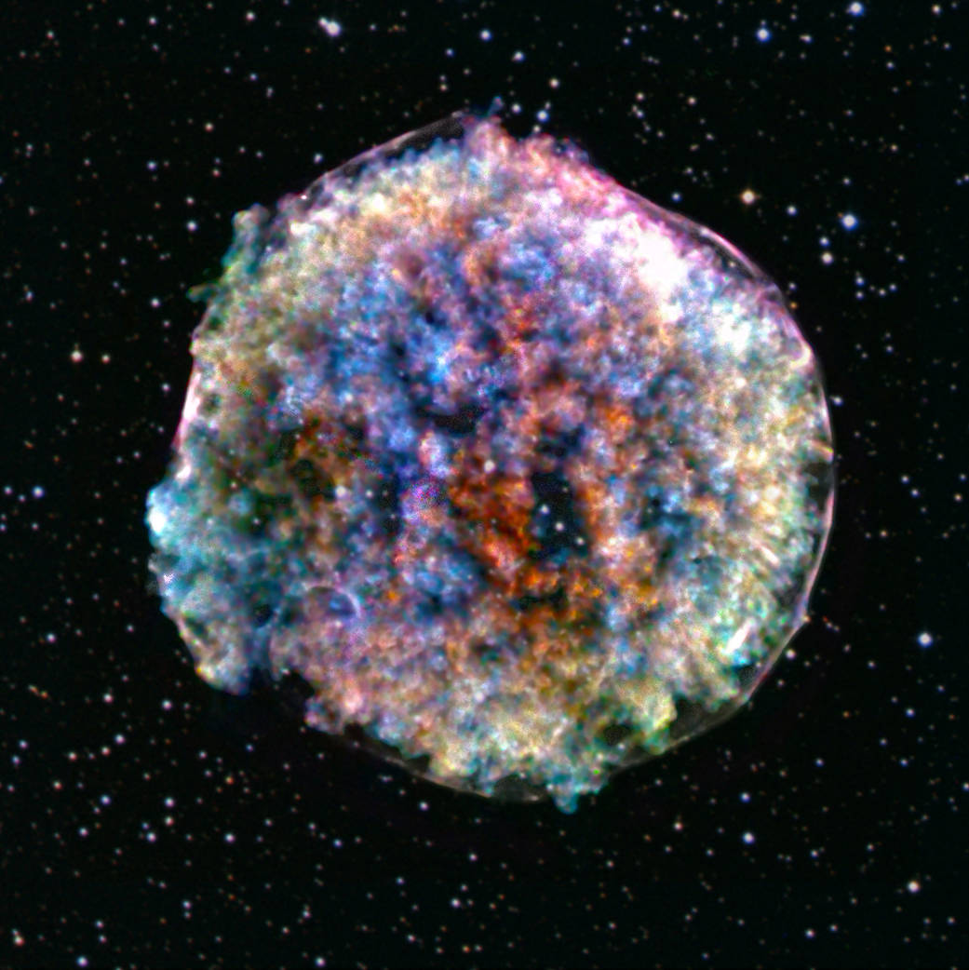
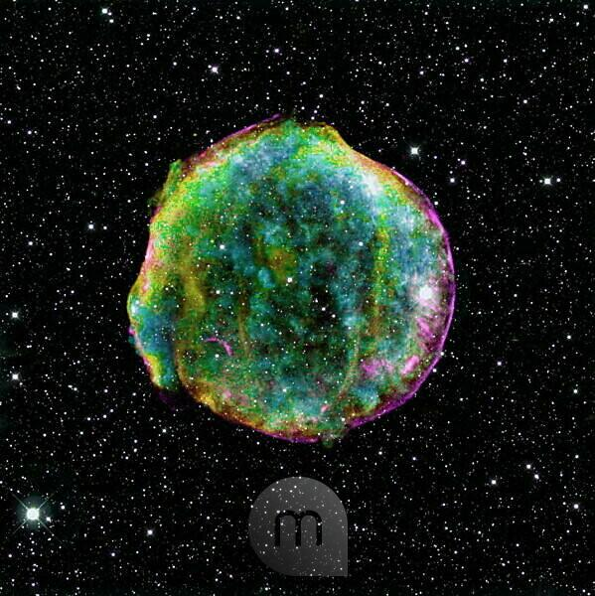
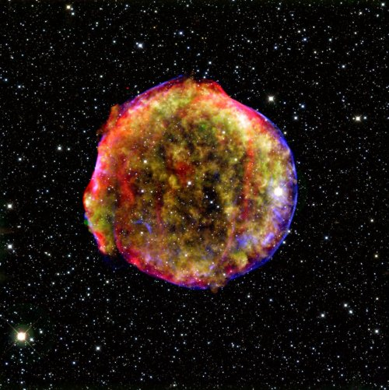
Illusion and the technology behind it
Light source, ligth sensor, display, seeing
White balance
→
X
=
X
=
Display light sources
spectrum
Human eye spectral sensitivity
Light source
spectrum
Light sensors
spectral sensitivity
„stimulus”
stimulus

Slide 9
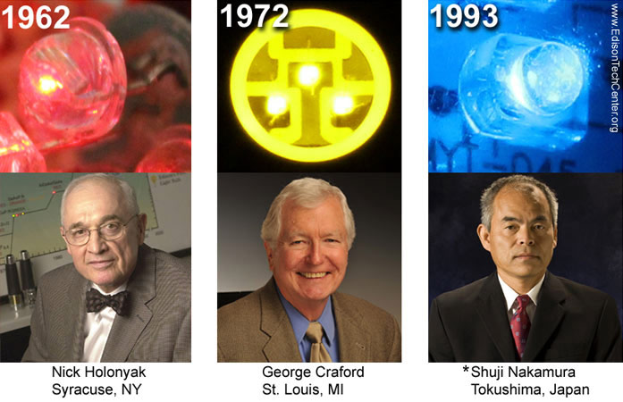
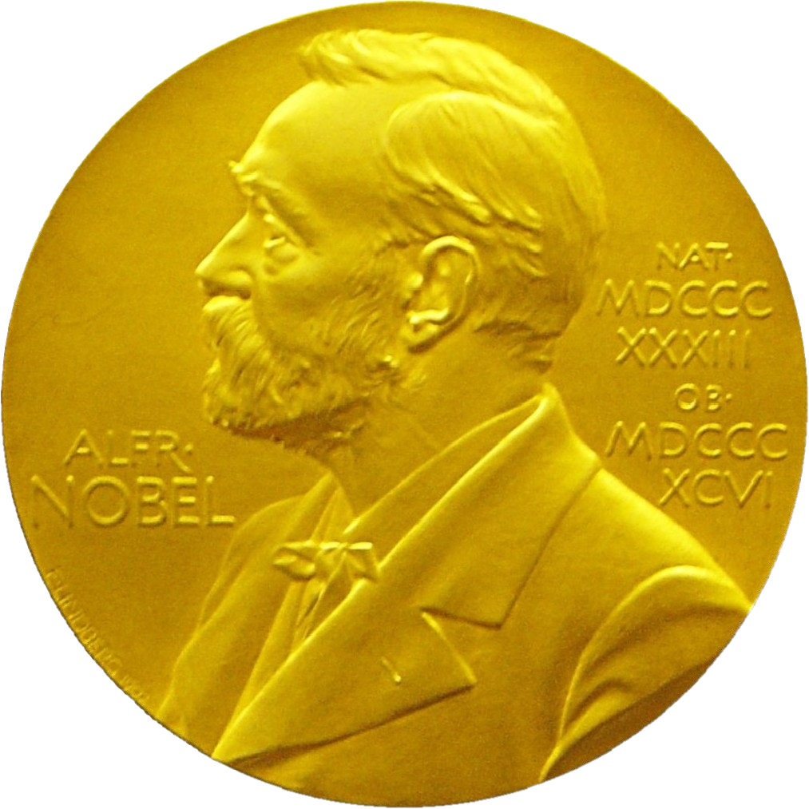
Illusion and the technology behind it Milesstones
„History”
Shuji Nakamura The Nobel Prize in Physics 2014
Prize share: 1/3
Prize motivation: “for the invention of efficient blue light-emitting diodes which has enabled bright and energy-saving white light sources”

Slide 10
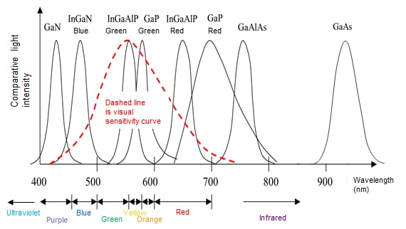
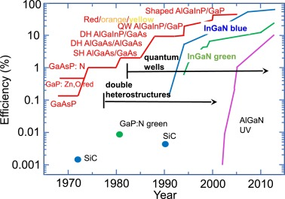
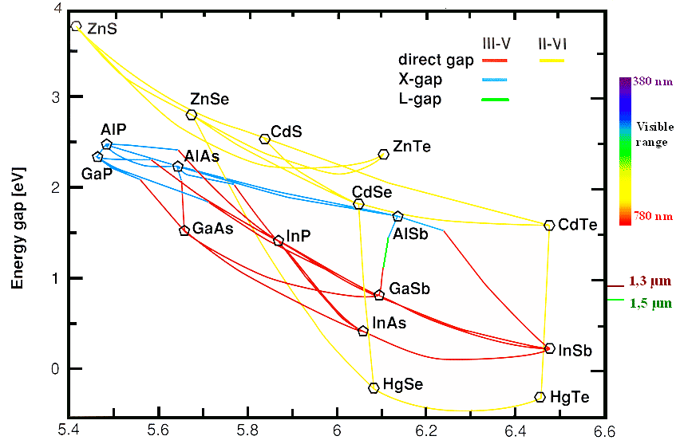
Illusion and the technology behind it
Semiconductor materials and LED spectrum
Developing
Years
Content
Material | Energy Band gap Eg ＠300K (eV) | Wavelength (λ） | Color
GaAs | 1.4 | 885 nm | Infrared
GaP | 1.8 to 2.26 | 549 to 700 nm | Green to red
InGaAlP | 1.9 to 2.3 | 539 to 653 nm | Green to red
InGaN | 2.1 to 3.2 | 388 to 590 nm | Ultraviolet to green
GaN | 3.4 | 365 nm | Ultraviolet to blue
Lattice constant [Å]

Slide 11
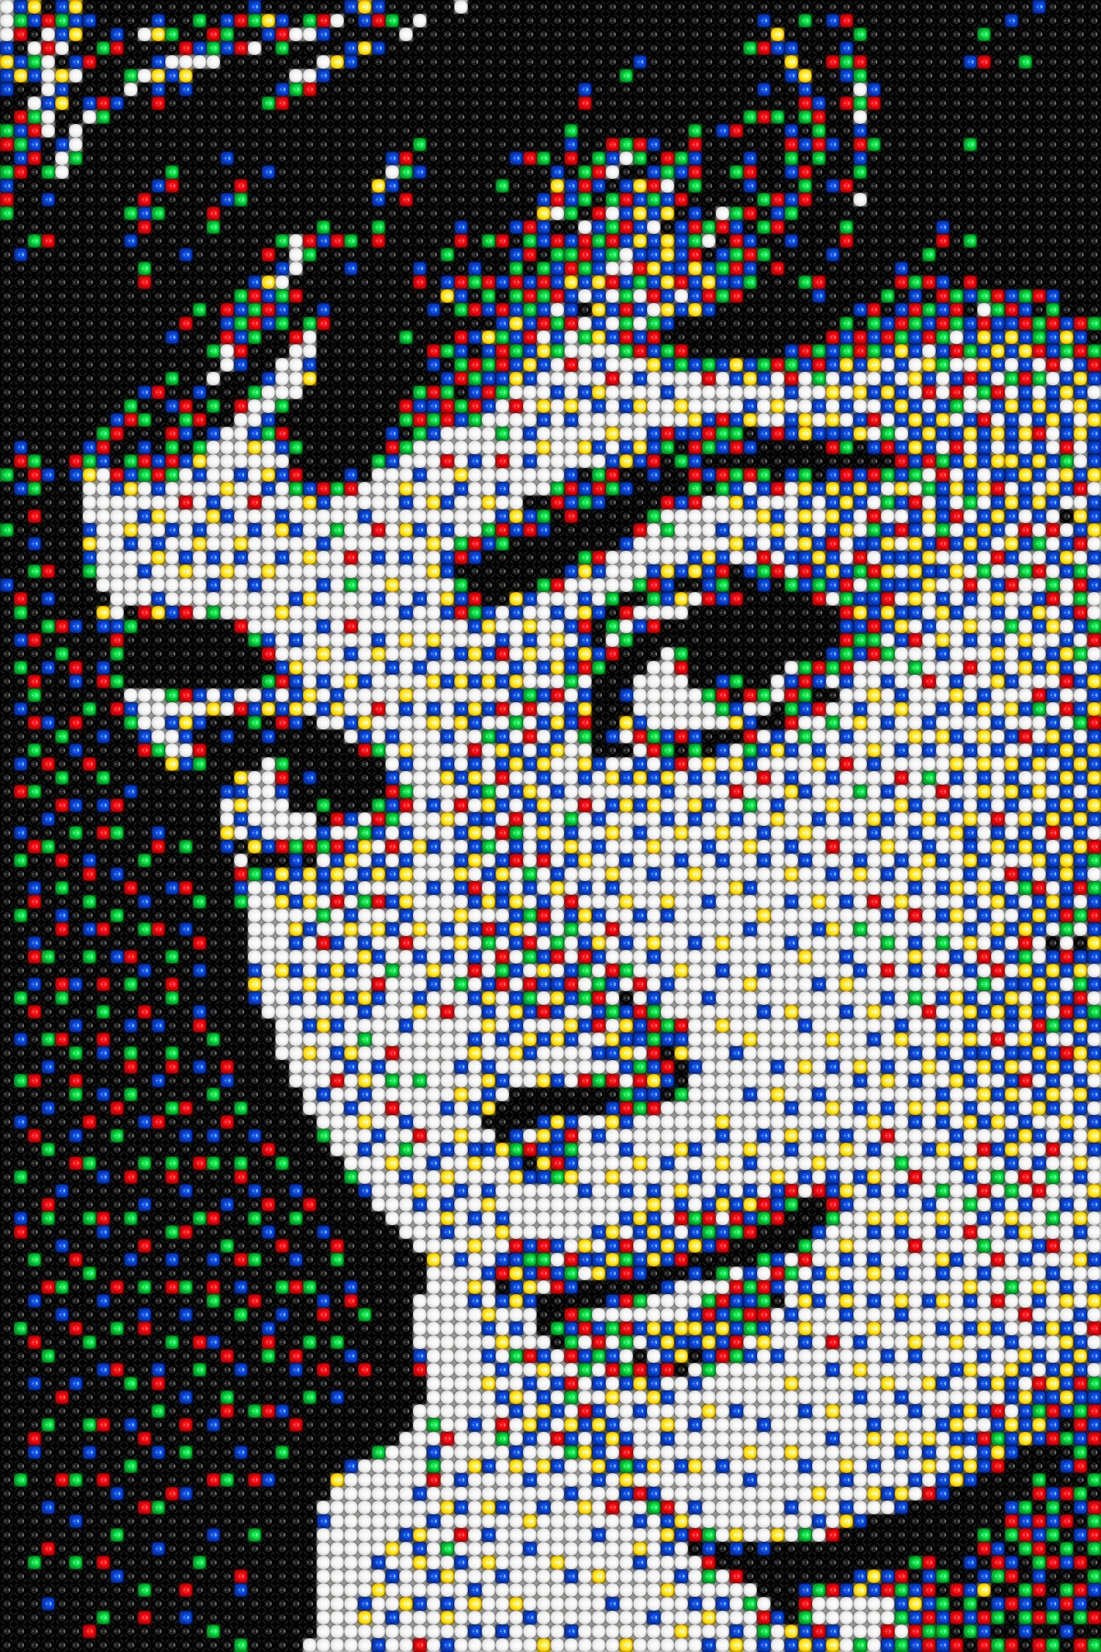
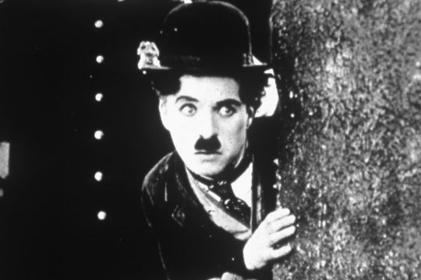
Illusion and the technology behind it
From Roll and Flip to TV Broadcast
Roll&Flip, Movie, TV Broadcast

Slide 12
Illusion and the technology behind it
Back to the old cinema
Slide per second and blincking

Slide 13
Illusion and the technology behind it
Back to the Cathode Ray Tube I
Scanning electron beam, interlaced, dot pitch
4 x 3
833 x 625
(800 x 600)
25 frame/sec
Dot pitch
0.25 mm 1,600 pixels/cm² or 10,000 pixels/in²
0.26 mm 1,444 pixels/cm² or 9,025 pixels/in²
0.27 mm 1,369 pixels/cm² or 8,556 pixels/in²
0.28 mm 1,225 pixels/cm² or 7,656 pixels/in²
0.31 mm 1,024 pixels/cm² or 6,400 pixels/in²
0.51 mm 361 pixels/cm² or 2,256 pixels/in²
1.00 mm 100 pixels/cm² or 625 pixels/in²

Slide 14
Illusion and the technology behind it
Back to the Cathode Ray Tube II
CRT 4k? - Phosphorescence, Refresh, Dynamic Contrast
4 k
4096 x 2160
60 frame/sec
531 MHz BandWidth
1/BW → Pixel Time = 1.88 nsec
1 frame = 2 fields
50 field/sec
625 row x 50 Hz →
15.625 kHz Horizontal Frequency
625 row x 825 col x (25 frame / 2) →
6.5 MHz BandWidth
1/BW → Pixel Time = 153 nsec
1 / (50 Hz / 2) = 40 msec

Slide 15
Illusion and the technology behind it
Color Space
CIE-1931

Slide 16
Illusion and the technology behind it
CIE 1931 - Old habits die hard
CIE-1976

Slide 17
Illusion and the technology behind it
LED package constructions I
Wire bond LED
DBRs,
Distributed Bragg Reflectors
p-electrode
Light
ITO
p-GaN (Wizard) EBL, pGaN
MQWs (~ 5x [In_{x}Ga_{(1-x)}N QW /
GaN barrier]) (Wizard)
n-electrode
n-GaN (Wizard) 2um
Sapphire (0001)
uGaN – Buffer Layer
Metal reflector (Ag)

Slide 18
Illusion and the technology behind it
LED package constructions II
Flip Chip LED

Slide 19
Illusion and the technology behind it
LED package constructions III
Flip Chip LED + Thermal Pad

Slide 20
Illusion and the technology behind it
LED size
Traditional, mini, micro, nano, pico?
< 100 μm

Slide 21
Illusion and the technology behind it
Multiplex driving techniques I
Spatial mutiplex LED driving
(passive matrix)
190 μm × 190 μm
Column
wire
Micro-LED
Row
wire
1 … 1080 … 2160
Via
10 μm × 10 μm
2160 x 1 row wire
3 x 4096 col wire
60 Hz
4 k (4096 x 2160)
60 frame/sec

Slide 22
Illusion and the technology behind it
Multiplex driving techniques II
Color multiplexing
(passive matrix)
3 x 2160 row wire
2160 x 4096 col wire
„passive” sequential
4 k (4096 x 2160)
60 frame/sec

Slide 23
Illusion and the technology behind it
Multiplex driving techniques III
Color multiplexing
(passive matrix, active matrix)
3 x 2160 row wire
3 x 4096 col wire
4 k (4096 x 2160)
60 frame/sec

Slide 24
Illusion and the technology behind it
Panel size / Pixel Per Inch
LED size ←→ PPI, LED only light soure

Slide 25
Illusion and the technology behind it
Take Home Message
Take Home Message
Eye is more than a sensor array (100.000.000+ receptors, 40% brain)
Brain image processing
(Data compression, data server room, learning, psychology, evolution, optical illusions…)
Cinema, TV Broadcasting, Displays etc.
technology builds on the human brain
Limitation of Cathode Ray Tube (CRT), phosphorescence, 4k CRT
Color mixing, white balance, CIE
LED structures, size isn’t everything
Challange: uLED connections and controll
Kurtoskalacs is OK
SAM2 is loaded
Wafer treatment is OK
99.8% ethylalcohol was found in vegyilabor…
ACV-3000 100%
Welcome to Semilab
Photoluminescence
is cool.
I♥MA
Particles not found.
Aki megeszi az ebédemet…
Chuck is OK. MÜ is OK.
For All Your Metrology Needs
Notes:
For All Your Metrology Needs

