Slide 1
From „Horror vacui” to the Computerized Tomography (CT)
Ernő KOLLÁR
19 October 2024
Ernő KOLLÁR, PhD

Slide 2
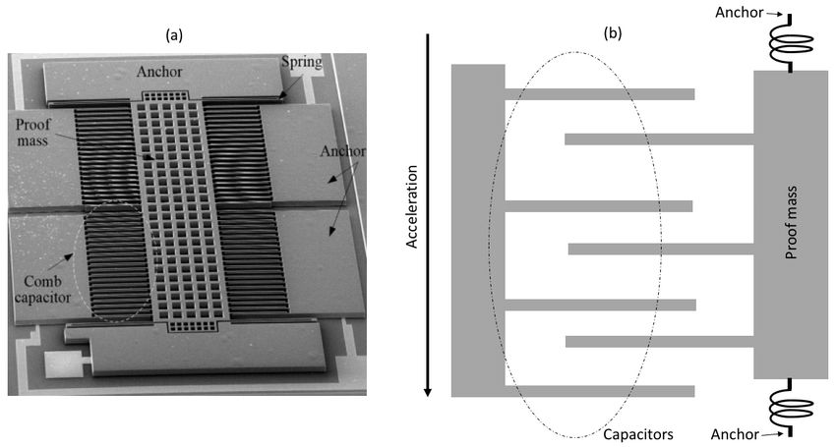
From „Horror vacui” to the Computerized Tomography (CT)
...

Slide 3
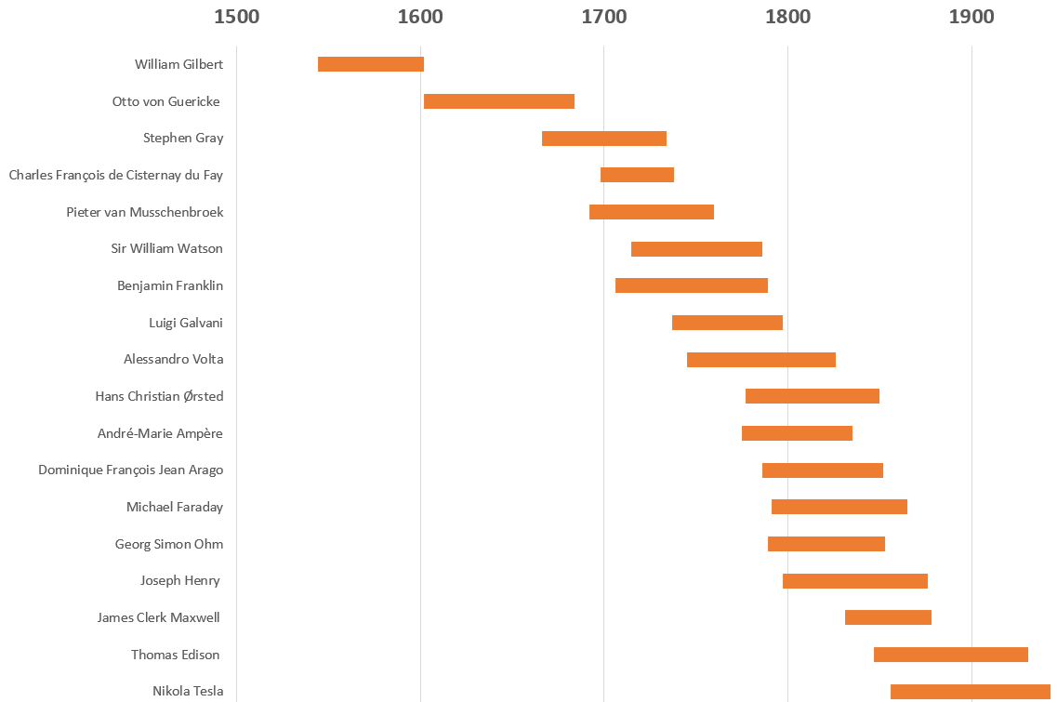
From „Horror vacui” to the Computerized Tomography (CT)

Slide 4
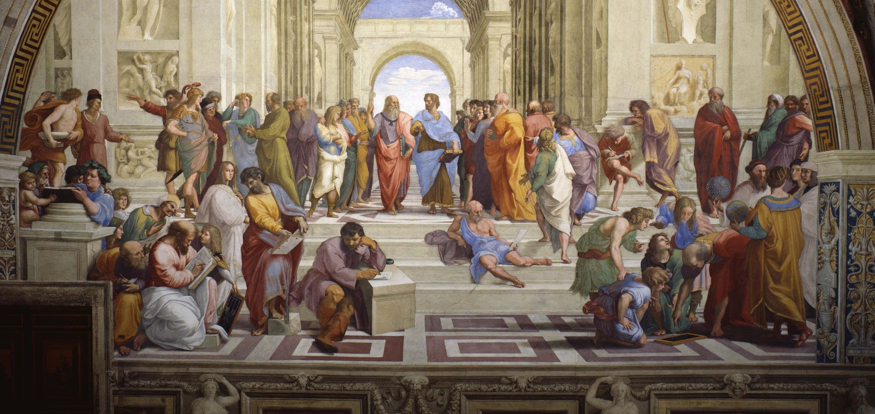
From „Horror vacui” to the Computerized Tomography (CT)
Ancient world - „horror vacui”
Parmenides
Raffaello Santi (1483-1520) The School of Athens (1509-1511)
Apostolic Palace, Vatican City

Slide 5
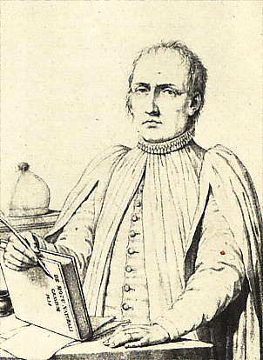
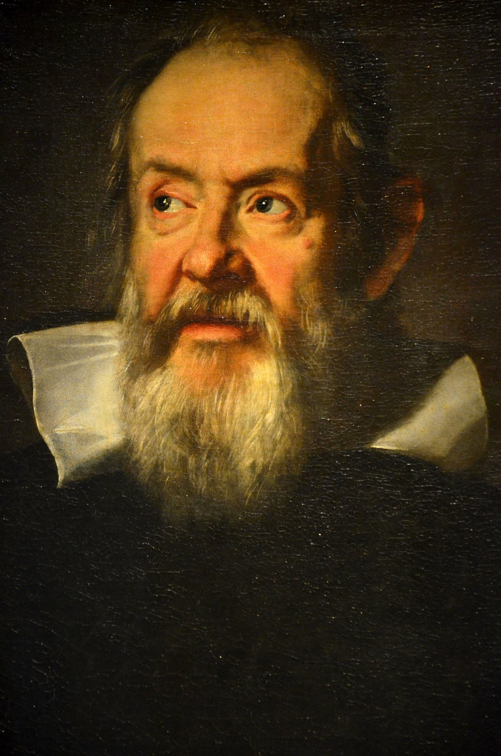
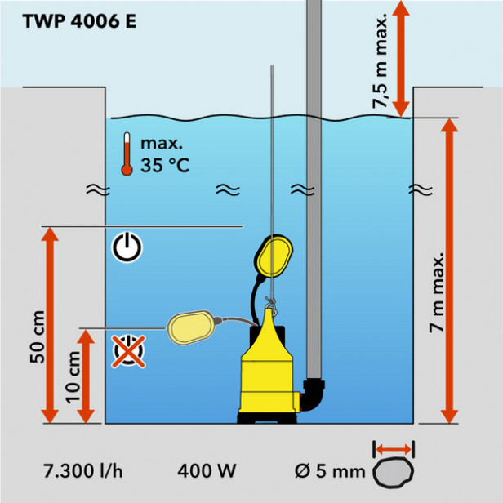
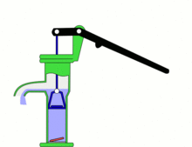
From „Horror vacui” to the Computerized Tomography (CT)
Water siphon problem
Water pump and the mysterious 10 meters limit - I
1630 Baliani's siphon experiment
Baliani wrote a letter to Galileo explaining an experiment he had made in which a siphon, led over a hill about 21 m high, failed to work. When the end of the siphon was opened in a reservoir, the water level in that limb would sink to about 10 m above the reservoir.[2] Galileo responded with an explanation of the phenomenon: he proposed that it was the power of a vacuum that held the water up, and at a certain height the amount of water simply became too much and the force could not hold any more, like a cord that can support only so much weight.
Giovanni Battista Baliani (1582–1666)
Italian mathematician, physicist and astronomer.
De motu naturali gravium solidorum (Genova, 1638)
De gravium solidorum et liquidorum (Genova, 1646)
Galileo Galilei
(1564 – 1642)

Slide 6
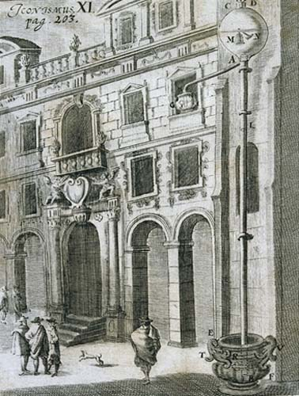
From „Horror vacui” to the Computerized Tomography (CT)
Water siphon problem
Water pump and the mysterious 10 meters limit - II
Berti built an 11 m lead tube, filled it with water, and sealed both ends. He submerged one end in a basin of water and unsealed it. Although some of the water flowed out, much of it remained, filling the tube to about 10 m (34 feet) above the water level in the basin, the same height as in Baliani's siphon.
Berti died a few months after his experiment and into the discussion stepped Evangelista Torricelli.
Gasparo Berti
(ca. 1600–1643)
Italian mathematician, physicist and astronomer

Slide 7
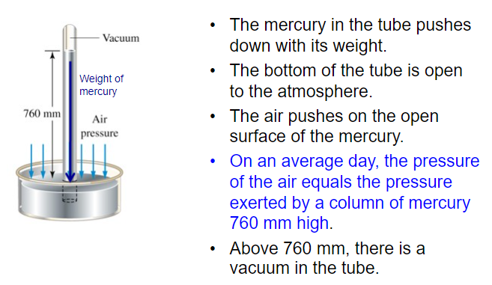
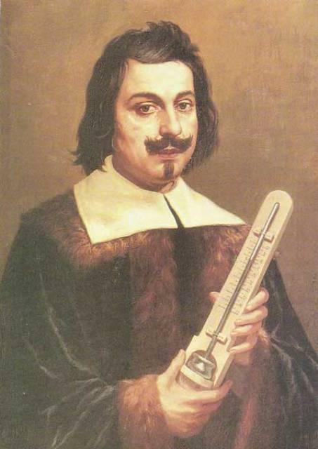
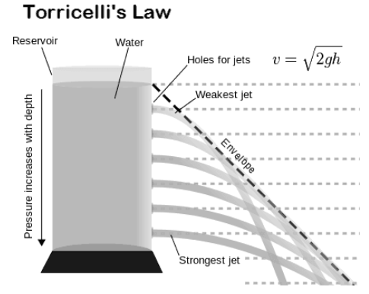
From „Horror vacui” to the Computerized Tomography (CT)
Th first barometer and the vacuum
Evangelista Torricelli
(1608-1647)
760 [mmHg] = 760 [torr] =
= 101 325 [Pa] = 1 [atm]

Slide 8
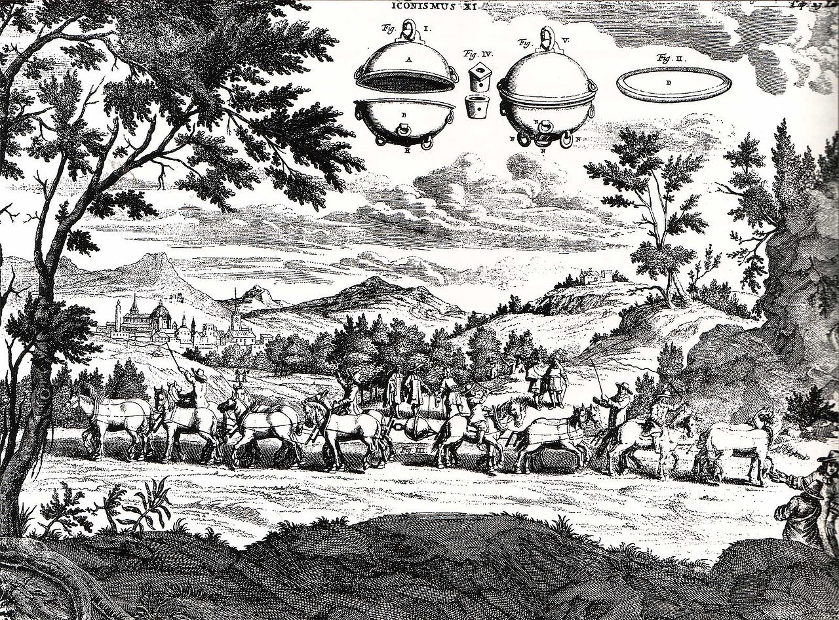
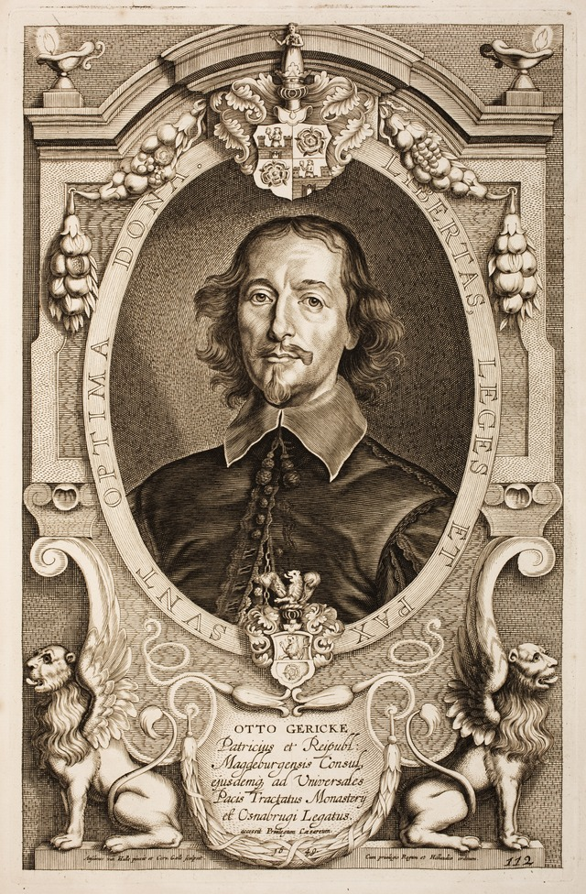
From „Horror vacui” to the Computerized Tomography (CT)
First vacuum pump
1654 - Magdeburg hemispheres
Otto von Guericke
(1602-1686)

Slide 9
From „Horror vacui” to the Computerized Tomography (CT)
Magdeburg ☺

Slide 10
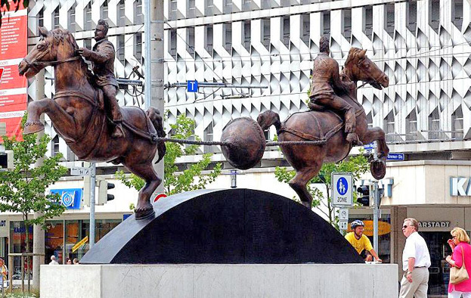
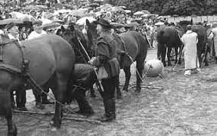
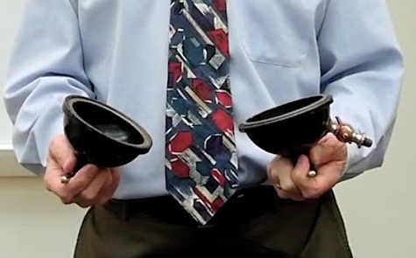
From „Horror vacui” to the Computerized Tomography (CT)
Magdeburg semispheres - today

Slide 11
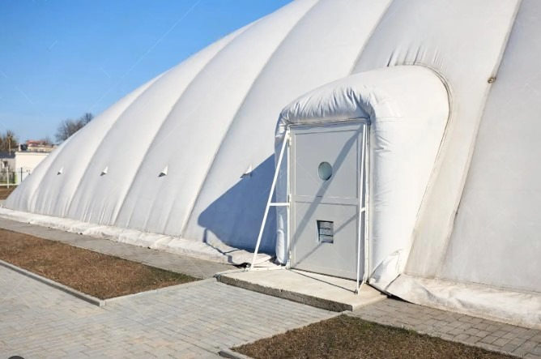
From „Horror vacui” to the Computerized Tomography (CT)
Magdeburg semispheres - at home
1 [Pa] = 1 [N/m²]
10 [Pa] ???
F = m*g → 1 kg * 9.81 m/sec²
~ 10 N

Slide 12
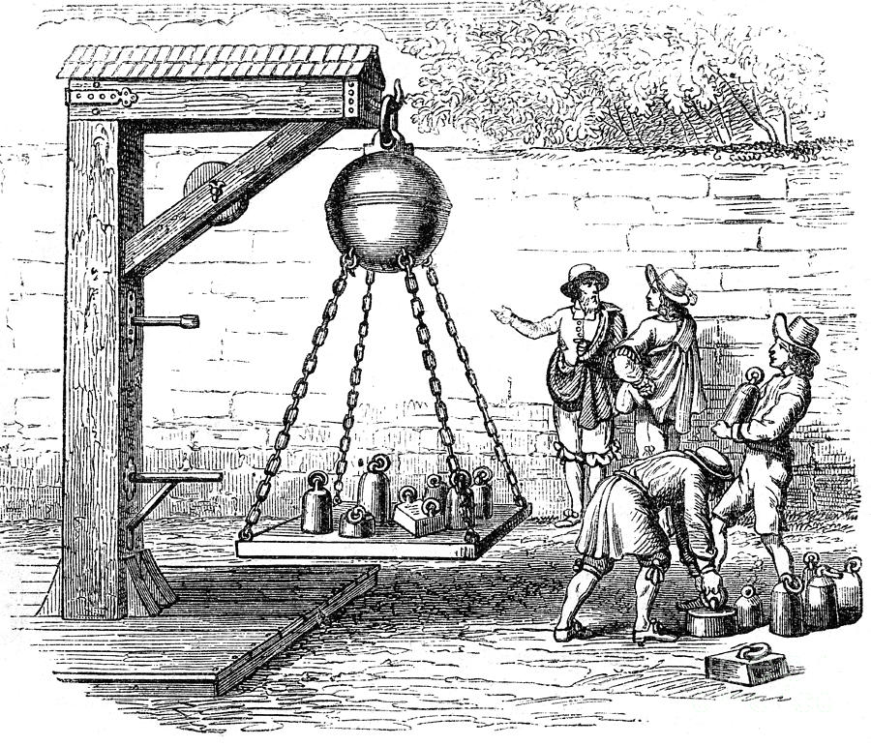
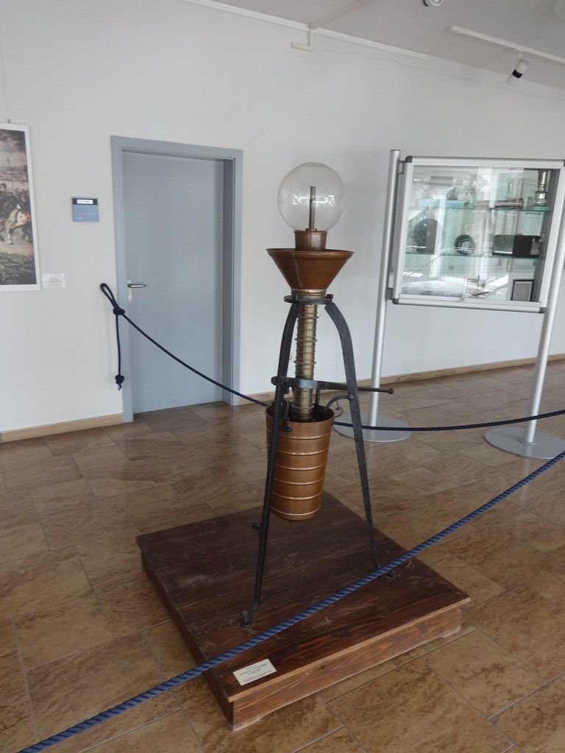
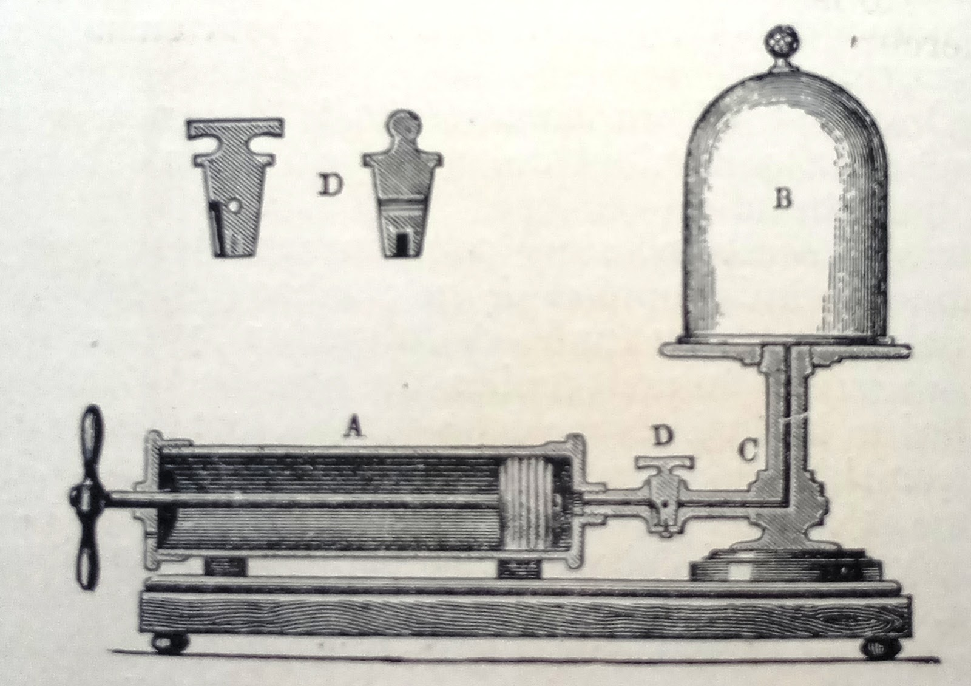
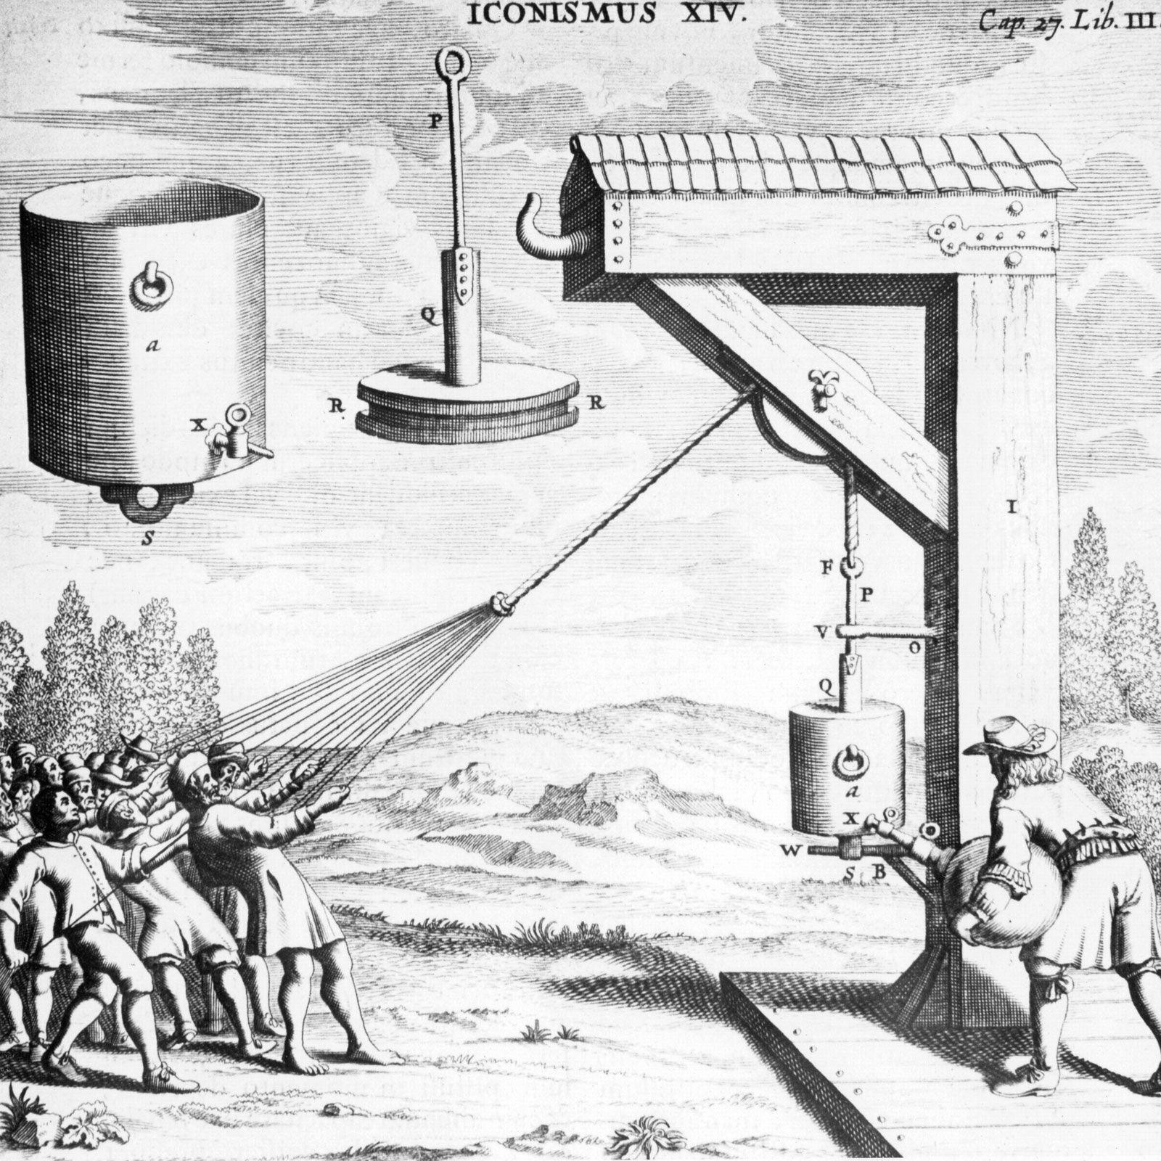
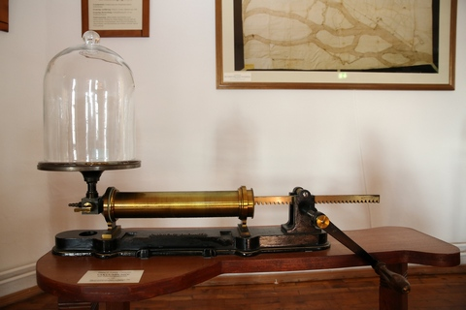
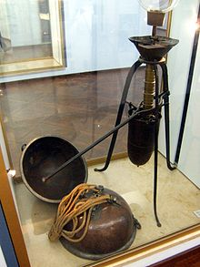
From „Horror vacui” to the Computerized Tomography (CT)
First vacuum pump - Construction question
First vacuum pump - 1654 ???

Slide 13
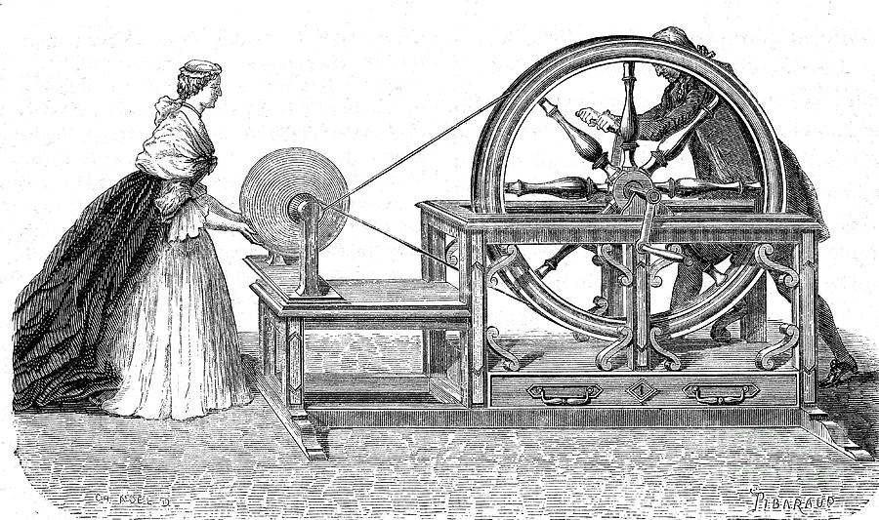
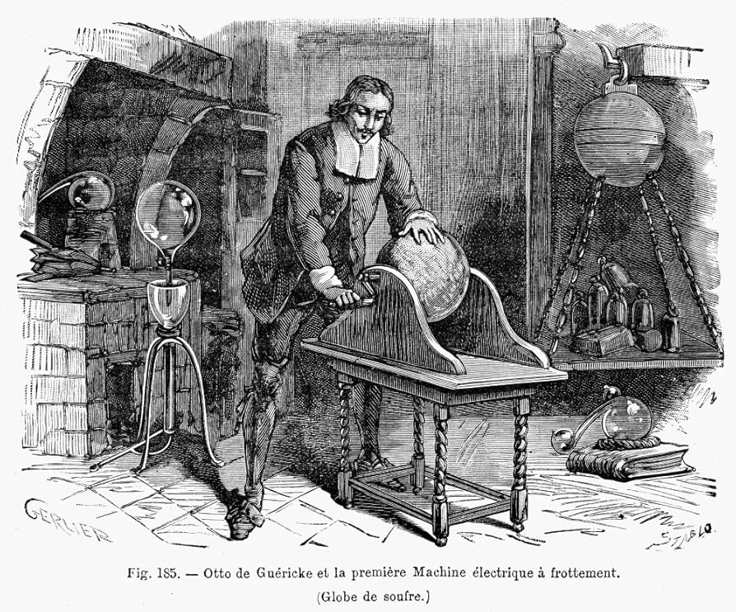
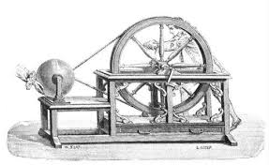
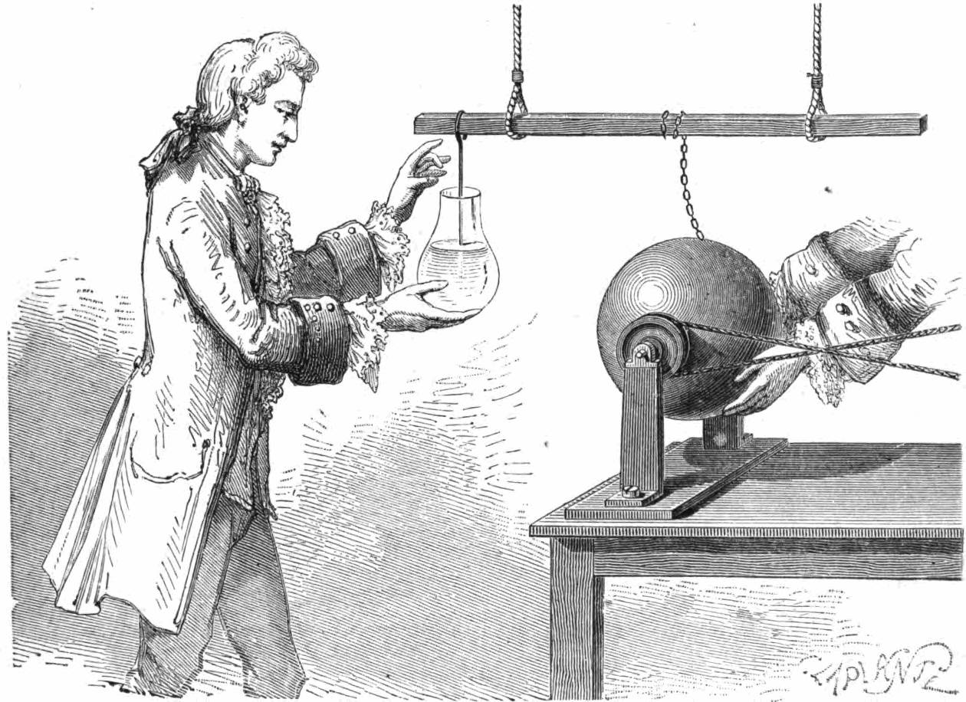
From „Horror vacui” to the Computerized Tomography (CT)
1663- First electrostatic generator
Otto von Guericke
(1602-1686)
https://www.youtube.com/watch?v=lWjisCgS_hE

Slide 14
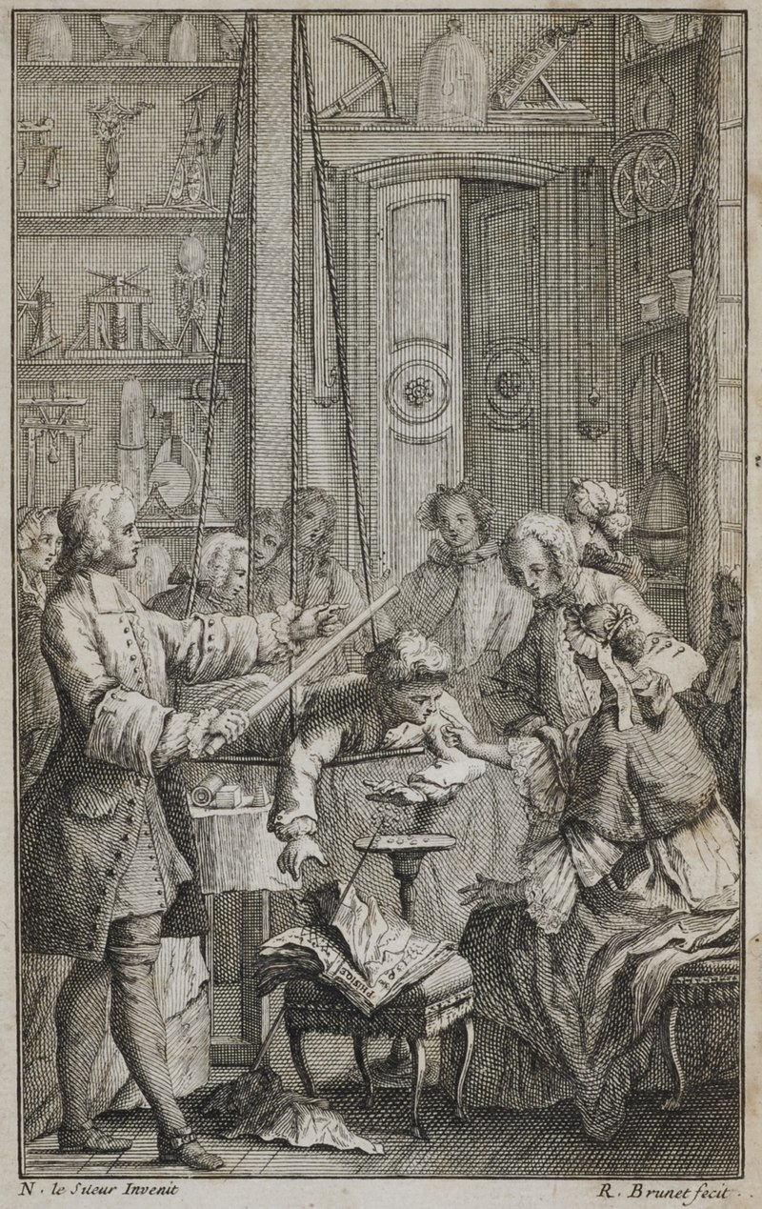
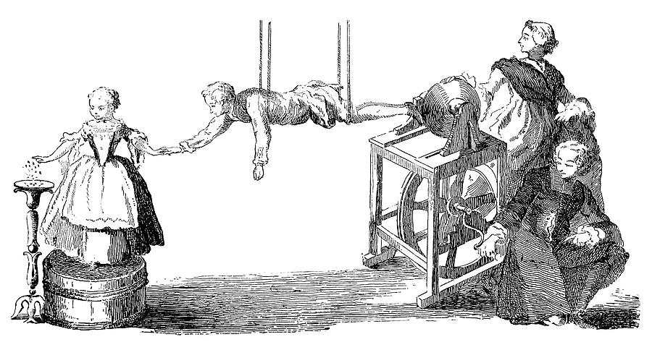
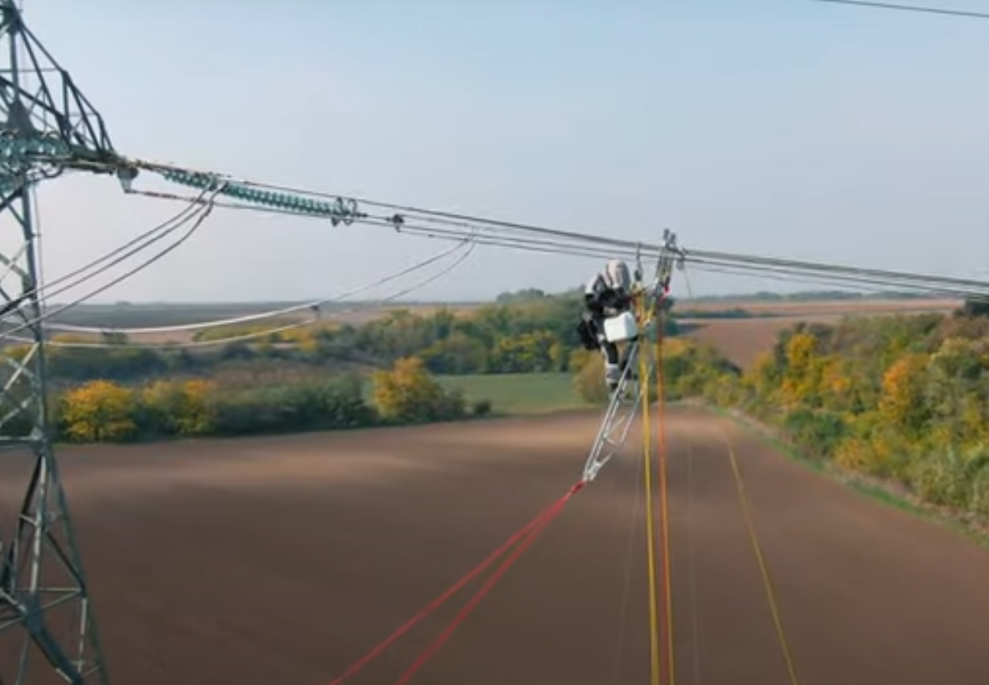
From „Horror vacui” to the Computerized Tomography (CT)
ElectroStatic generator - ElectroStatic Separation
1654 - Magdeburg
https://www.youtube.com/watch?v=x_7h0mzK-rw

Slide 15
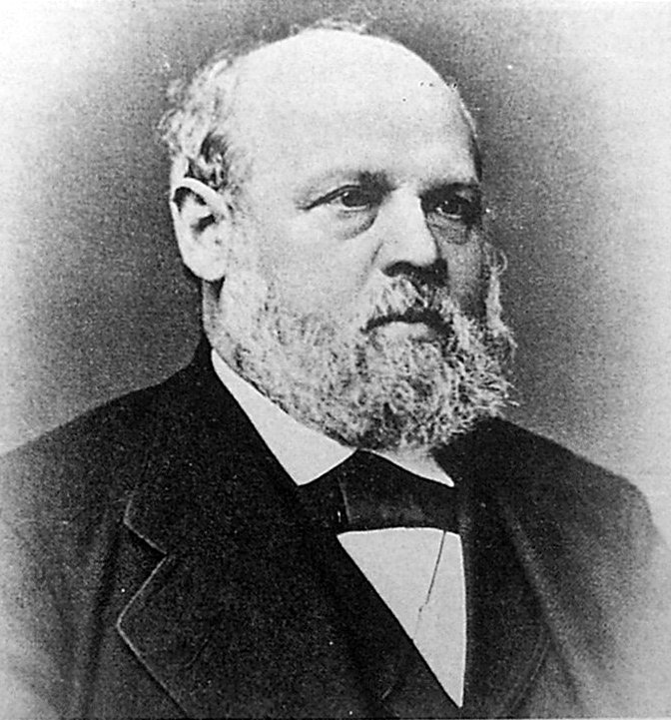
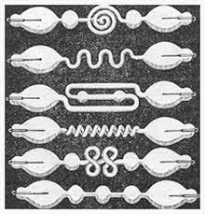
From „Horror vacui” to the Computerized Tomography (CT)
Mercury air pump (~2 Torr) ,
1855
760 [mmHg] = 760 [torr] = 101 325 [Pa] = 1 [atm]
1 [mmHg] = 1 [torr] = 133,322 [Pa]
Geißler,
Johann Heinrich Wilhelm
(1814-1879)
https://www.youtube.com/watch?v=gTRVtDXMs4s
https://www.youtube.com/watch?v=NYvEnAvouVA
https://www.youtube.com/watch?v=bdb1x2vQ2Z0
https://www.youtube.com/watch?v=bXggqlIaJeU

Slide 16
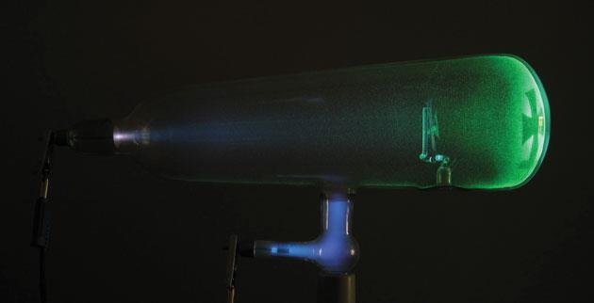
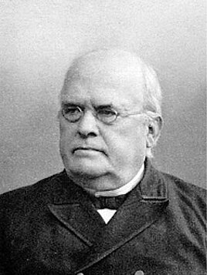
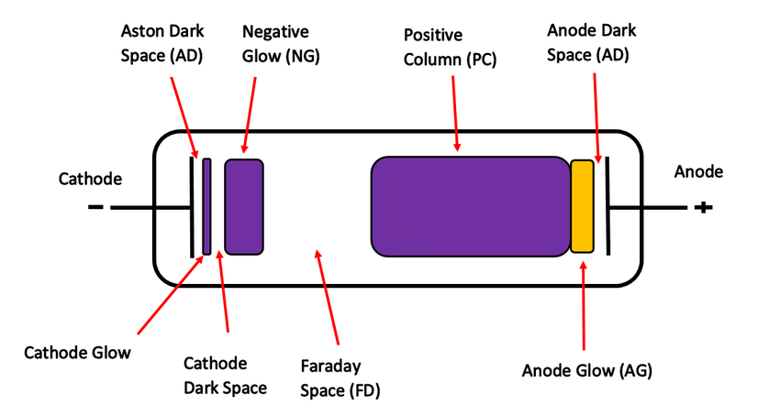
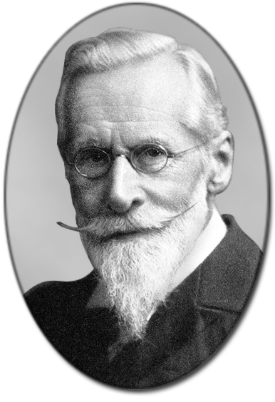
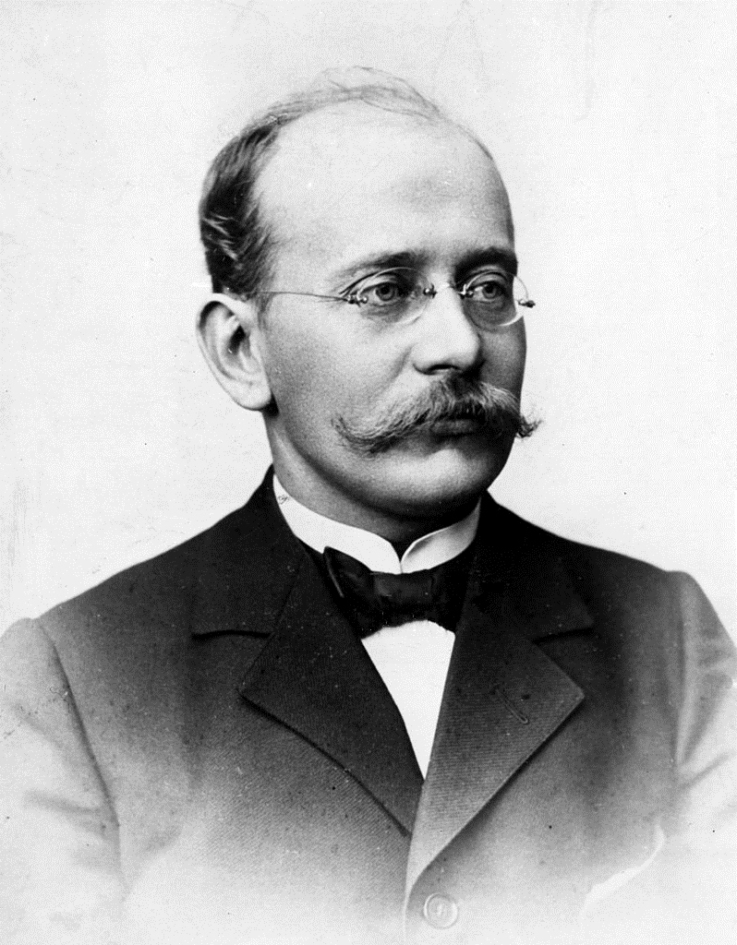
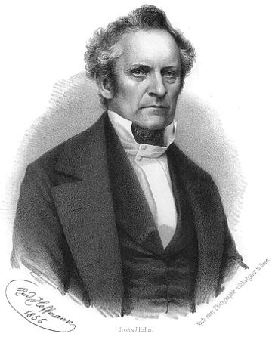
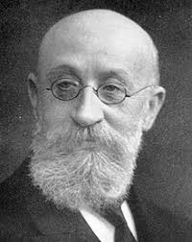
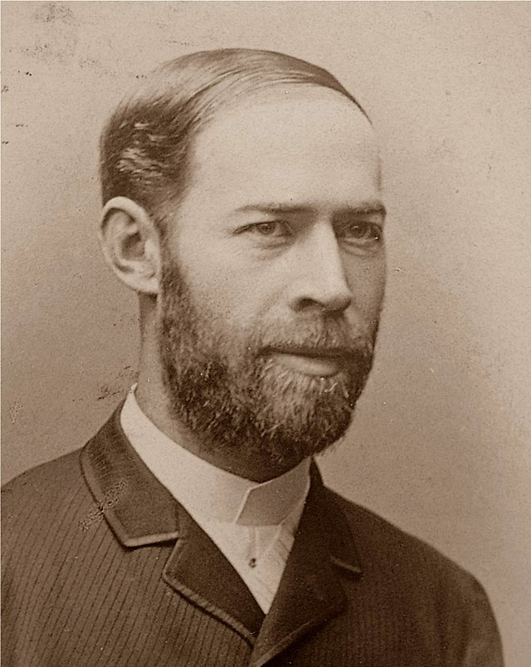
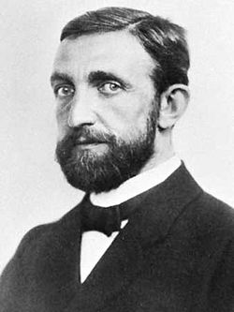
From „Horror vacui” to the Computerized Tomography (CT)
Crookes tube
https://www.youtube.com/watch?v=RwQbID53f5o
2:00
Sir William Crookes
(1832-1919)
Johann Wilhelm Hittorf
(1824 - 1914)
https://www.youtube.com/watch?v=FNiHCnqPAH4
Kristian Birkeland (1867-1917)
Julius Plücker
(1801 – 1868)
Eugen Goldstein
(1850-1930)
Heinrich Hertz
(1857-1894)
Lénárd Fülöp
(1862-1947)
https://www.youtube.com/watch?v=Ka3v5dIQGOI, 1:50- 2:15, 2:40-

Slide 17
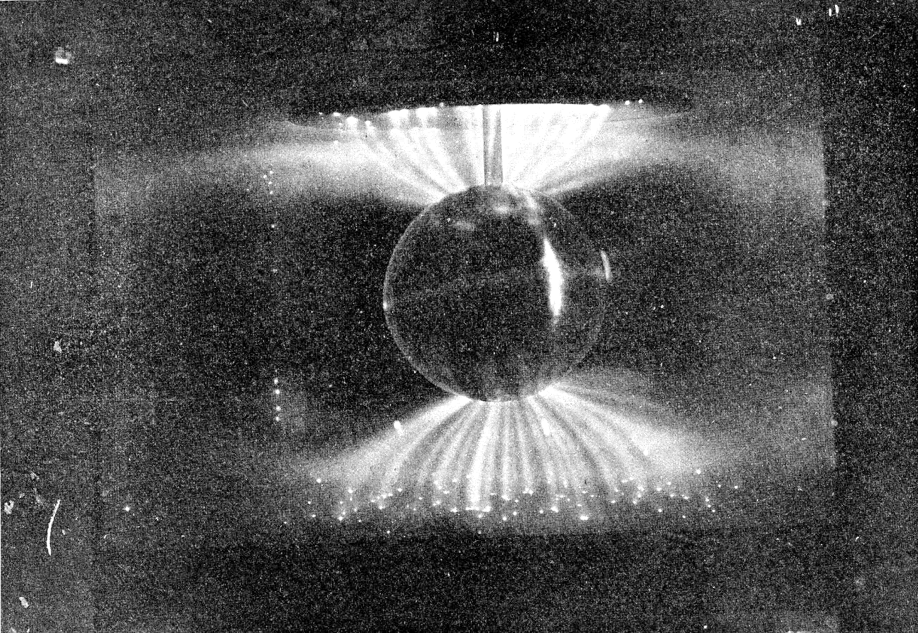
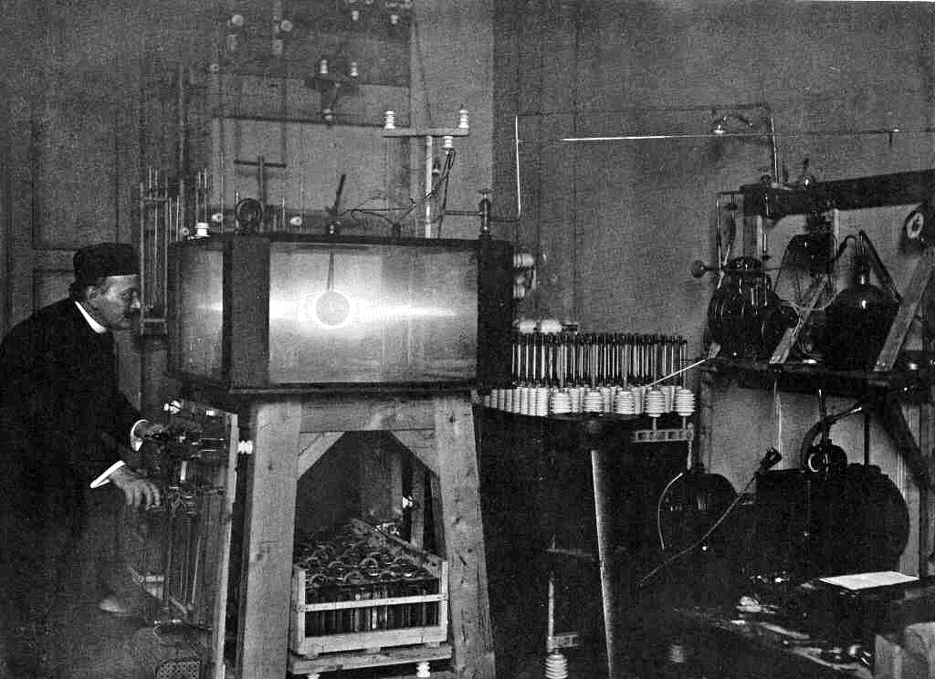
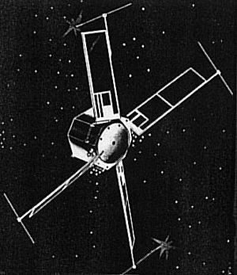
From „Horror vacui” to the Computerized Tomography (CT)
Terrella - Earth model
1963 U.S. Navy satellite 1963-38C

Slide 18
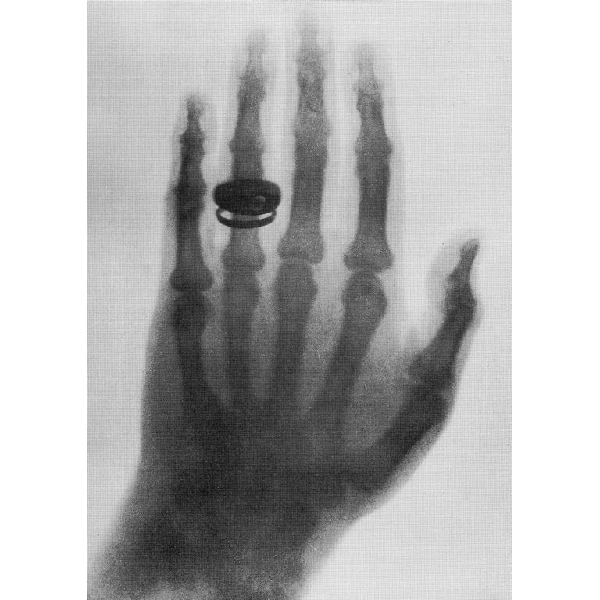
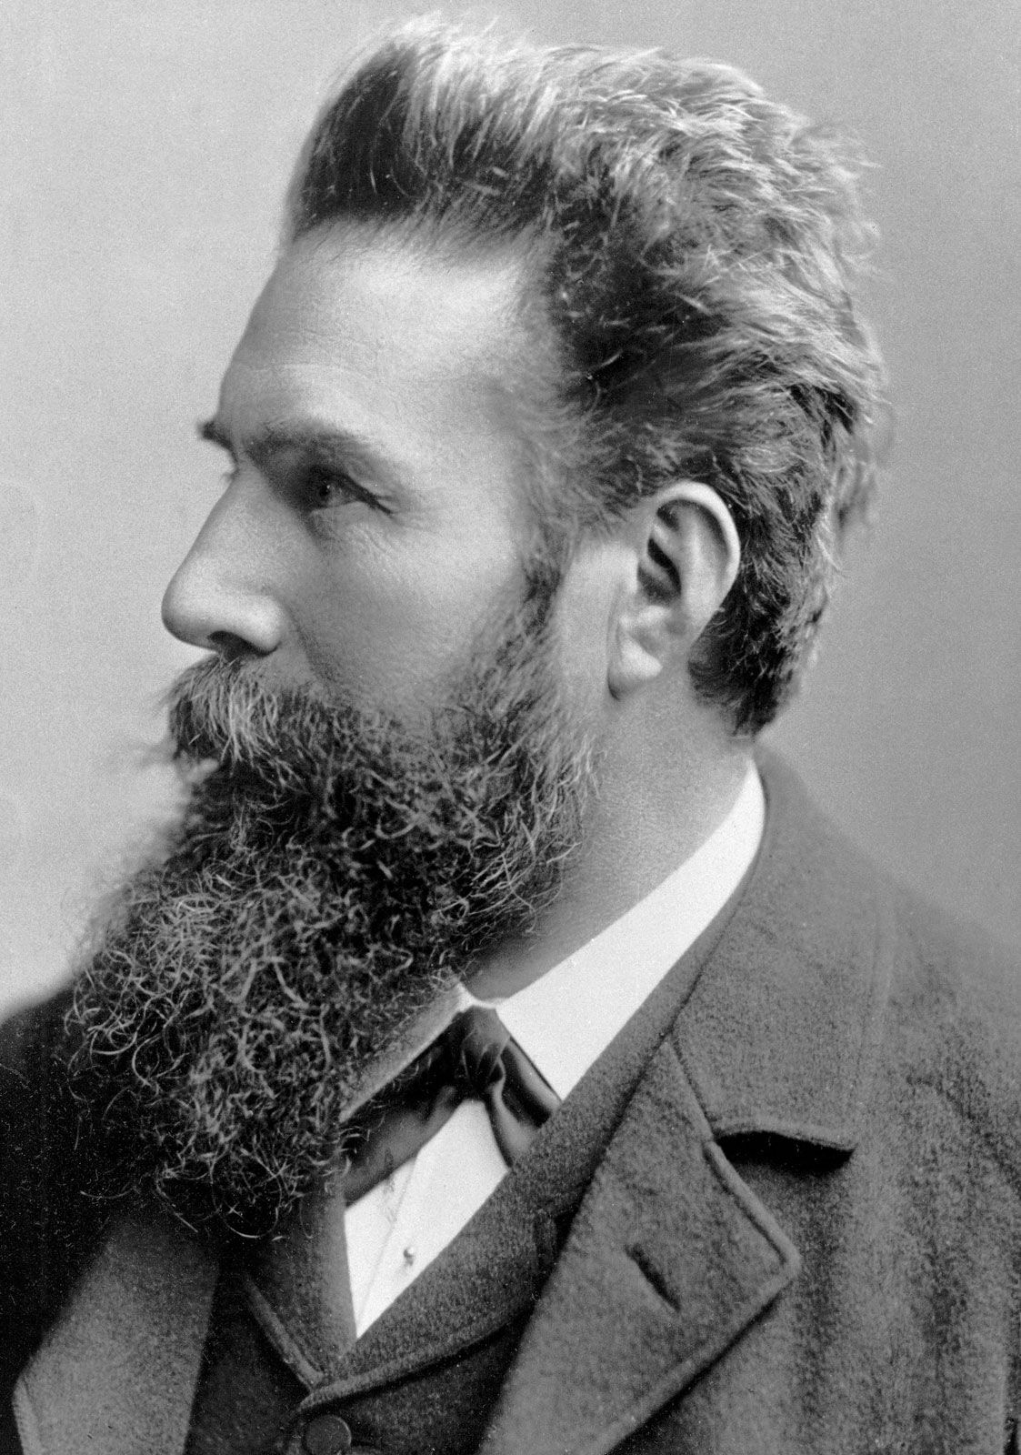
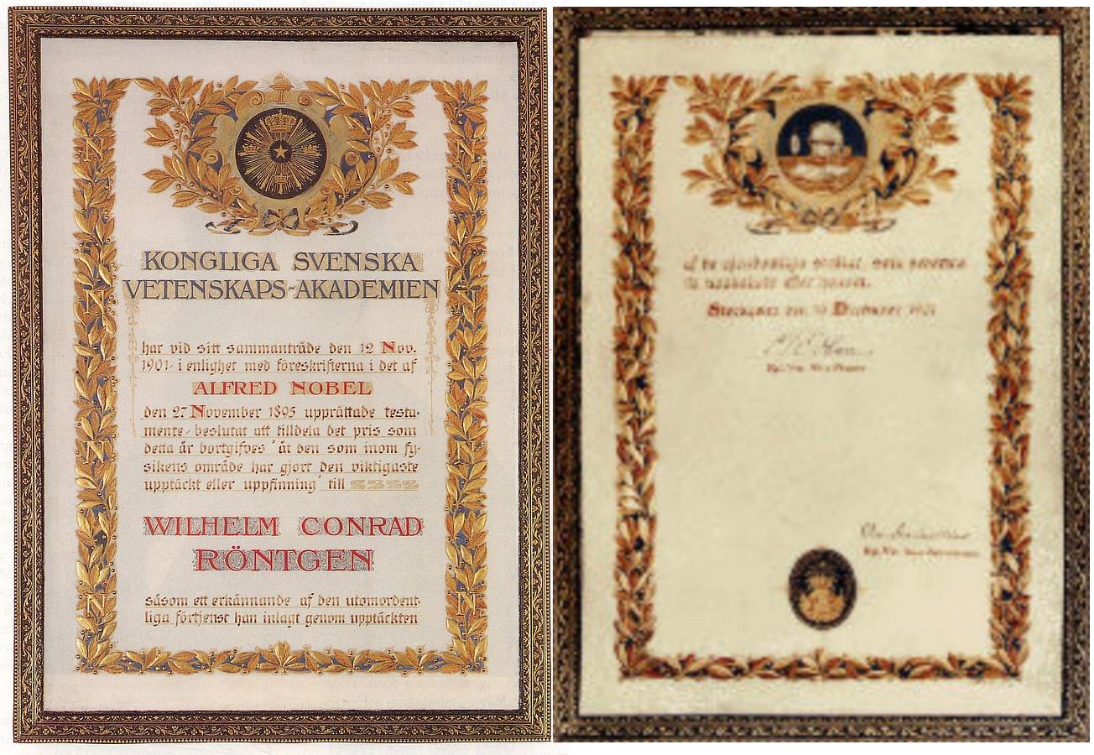
From „Horror vacui” to the Computerized Tomography (CT)
X-Ray tube (1895)
Wilhelm Conrad Röntgen (1845 – 1923)
The Nobel Prize in Physics 1901

Slide 19
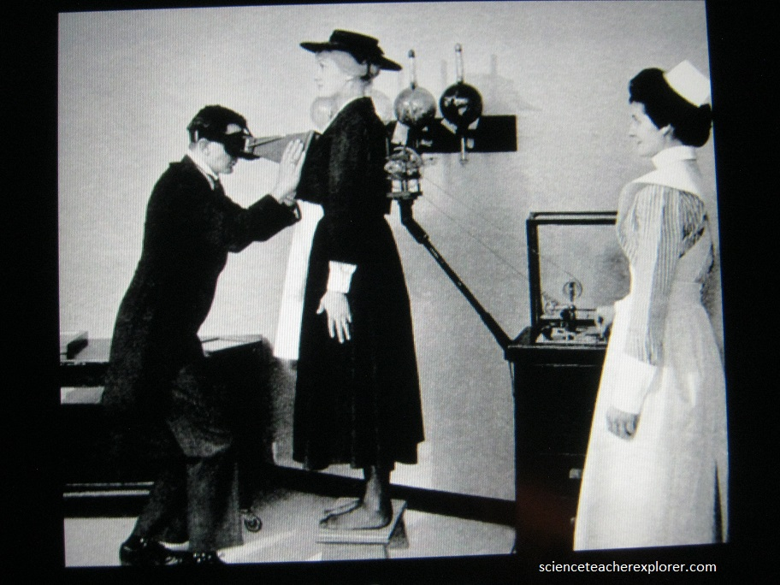
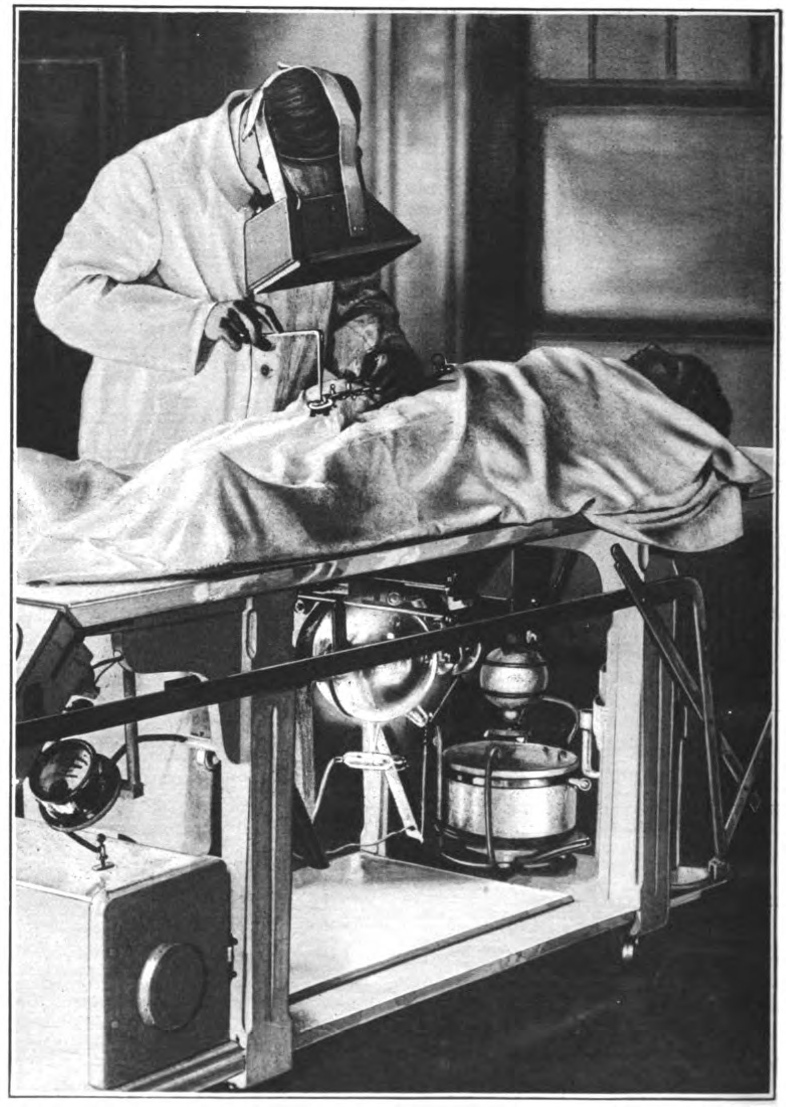
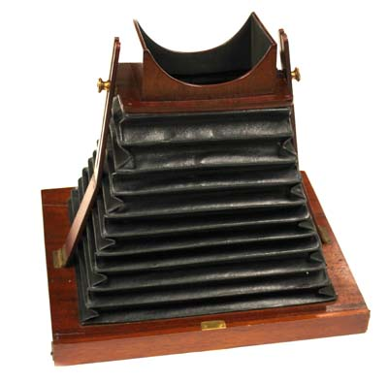
From „Horror vacui” to the Computerized Tomography (CT)
Fluoroscopy around 1900

Slide 20
From „Horror vacui” to the Computerized Tomography (CT)
Fluoroscope in civilian life (around 1900), X-ray: Magic
The First Attempt to Treat Cancer with X Rays by Doctor Chicotot, 1907 (oil on canvas) by Chicotot,

Slide 21
From „Horror vacui” to the Computerized Tomography (CT)
Fluoroscopy 1910-1920
1914.
Circa 1910.

Slide 22
From „Horror vacui” to the Computerized Tomography (CT)
X-ray treatment circa 1920

Slide 23
From „Horror vacui” to the Computerized Tomography (CT)
Fluoroscopy 1929

Slide 24
From „Horror vacui” to the Computerized Tomography (CT)
Filmstar Judith Allen with the radiograph of her back, 1930
Actress Judith Allen 1938 Vintage

Slide 25
From „Horror vacui” to the Computerized Tomography (CT)
Fluoroscope exams in 1940
An x-ray technician with the US Medical Corps tending to a wounded soldier during World War Two, circa 1941-1945

Slide 26
From „Horror vacui” to the Computerized Tomography (CT)
Adrian Shoe-Fitting Fluoroscope 1940s
Notes:
https://www.sparkmuseum.org/bad-to-the-bone/

Slide 27
From „Horror vacui” to the Computerized Tomography (CT)
Chest x-ray (1946)

Slide 28
From „Horror vacui” to the Computerized Tomography (CT)
1960s
X-ray machine which circles head to take panoramic picture of teeth, eliminating usual mouthful of film, 1960

Slide 29
From „Horror vacui” to the Computerized Tomography (CT)
1960-1970
https://www.youtube.com/watch?v=M6vsBcxHPZU

Slide 30
From „Horror vacui” to the Computerized Tomography (CT)
1970s

Slide 31
From „Horror vacui” to the Computerized Tomography (CT)
1980s

Slide 32
From „Horror vacui” to the Computerized Tomography (CT)

Slide 33
From „Horror vacui” to the Computerized Tomography (CT)
1980s

Slide 34
From „Horror vacui” to the Computerized Tomography (CT)
2000s

Slide 35
From „Horror vacui” to the Computerized Tomography (CT)
1995-2008

Slide 36
From „Horror vacui” to the Computerized Tomography (CT)
2010s

Slide 37
From „Horror vacui” to the Computerized Tomography (CT)
2010s

Slide 38
From „Horror vacui” to the Computerized Tomography (CT)
Detectors

Slide 39
From „Horror vacui” to the Computerized Tomography (CT)
Today
https://www.youtube.com/watch?v=08udju-MnpM

Slide 40
From „Horror vacui” to the Computerized Tomography (CT)
Today
What technology has reduced dose?
Dose reduction technology
• Beam filtration
More powerful x-ray tubes (e.g. Straton, Vectron) allow increased beam filtration, which reduces dose
Current example - 100kV Sn and 150 kV Sn modes on Force
• Beam shaping
"Bow-tie" filters used to reduce unneeded surface dose
Research into "adaptive" beam shaping is ongoing
Dose reduction technology
• Collimation
Early scanners had post-patient collimation to define slice width, reduce scatter, and improve spatial resolution
Current scanners rarely use post-patient collimation (UHR mode is one exception)
• Multi-slice CT
4 slice MSCT scanners use of narrow z collimations (e.g. 4 x 1 mm) required a larger penumbral region and "wasted" more dose
Adaptive z collimation addresses spiral overranging
Dose reduction technology
• Patient specific dose utilization
• Global size adaptation (e.g. child vs. adult) Image Gently campaign has helped to make "right-sizing" the dose the standard of care (e.g. protocols for children)
https://www.youtube.com/watch?v=08udju-MnpM

Slide 41
From „Horror vacui” to the Computerized Tomography (CT)
Today
Tube current modulation (TCM)
Until early 2000s, one tube current was used everywhere Overdosed thin areas, underdosed thick areas TCM (e.g. Care Dose) is now standard of care Included organ specific (e.g. lens of eye) TCM
Tube potential optimization
Early scanners offered very few tube potentials, 120 kVp imaging was ubiquitous, now 70 to 150 kV options exist Automatically adjust to task and patient (e.g. Care kV)
Detectors
Originally used scintillators (e.g. Nal, CsI, BGO) and photomultiplier tubes
• High pressure gas (e.g. Xenon) detectors were used in early 3rd generation scanners, but were less dose efficient (about 60% vs. 98%)
• Now use more efficient scintillators and photodiodes
• Detector electronics
• Poor stability in earlier systems caused artifacts like rings
• Also introduced noise
Newer detectors, like Stellar detectors, have extremely low electronic noise
Dose reduction technology
• Image reconstruction
• Edge preserving image filtering
• Iterative reconstruction (e.g. Safire, Admire, ASIR, MBIR)
• Machine learning, deep learning, CNN
https://www.youtube.com/watch?v=08udju-MnpM

