Slide 1
The vacuum tubes
Ernő KOLLÁR
03 October 2024
Ernő KOLLÁR, PhD

Slide 2
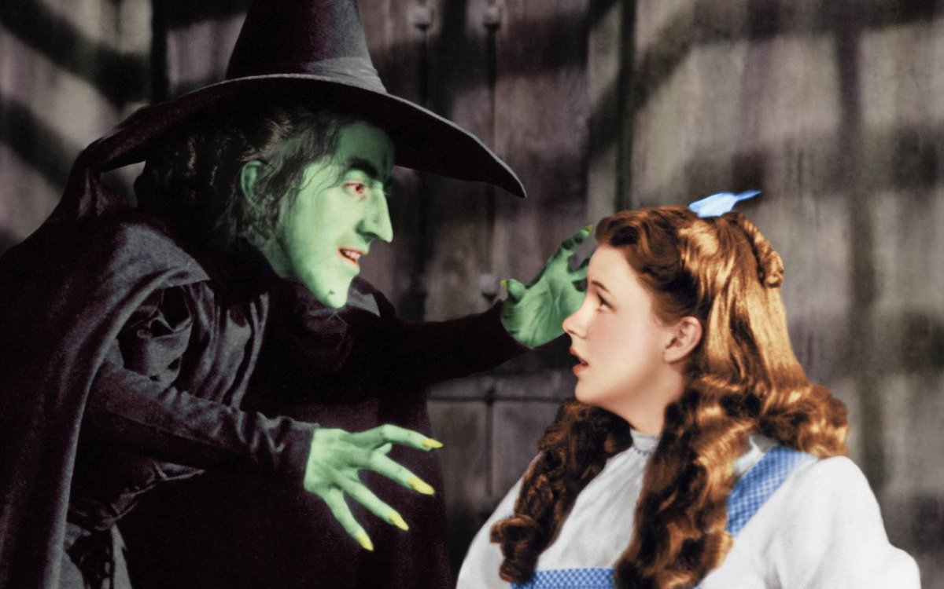
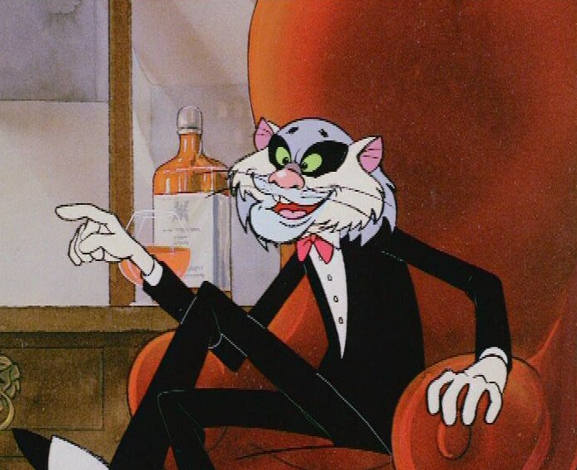
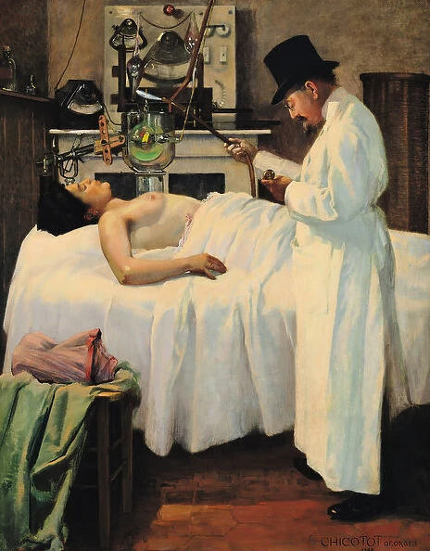
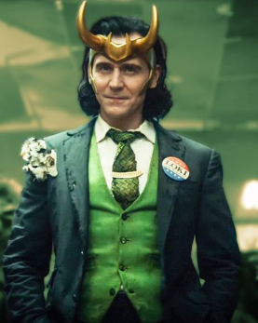
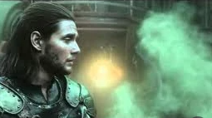
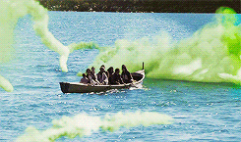
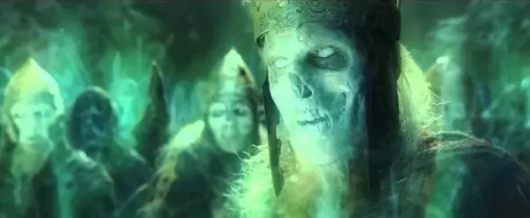
The vacuum tubes
The First Attempt to Treat Cancer with X Rays by Doctor Chicotot, 1907 (oil on canvas) by Chicotot,

Slide 3
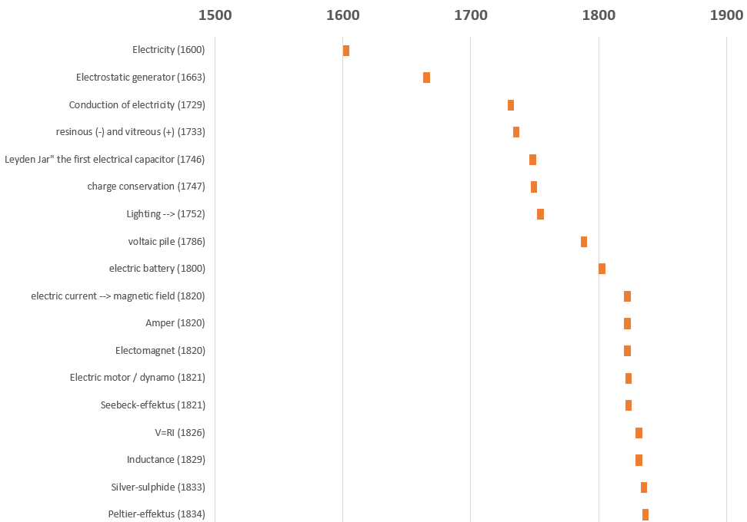
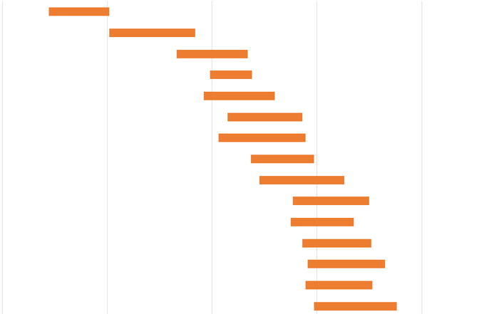
The vacuum tubes

Slide 4
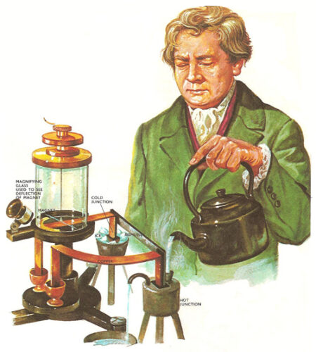
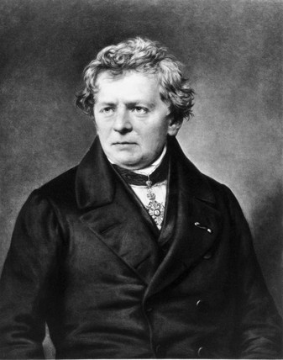
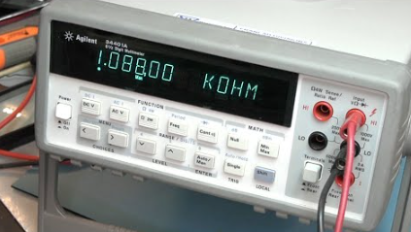
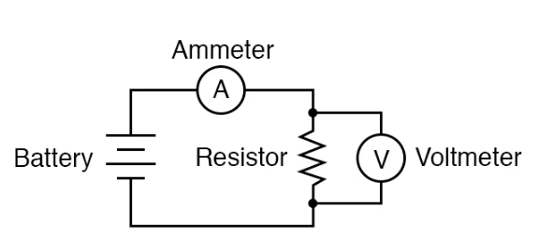
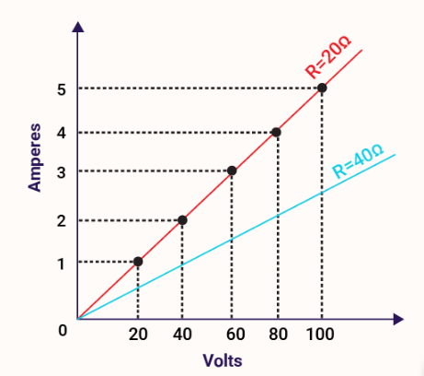
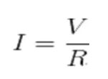
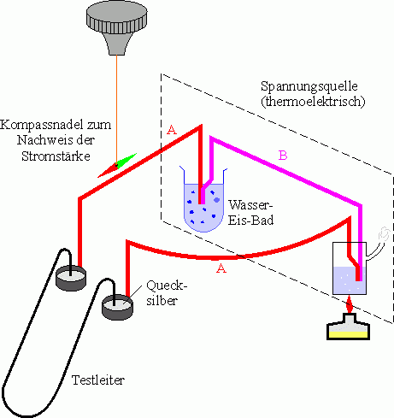
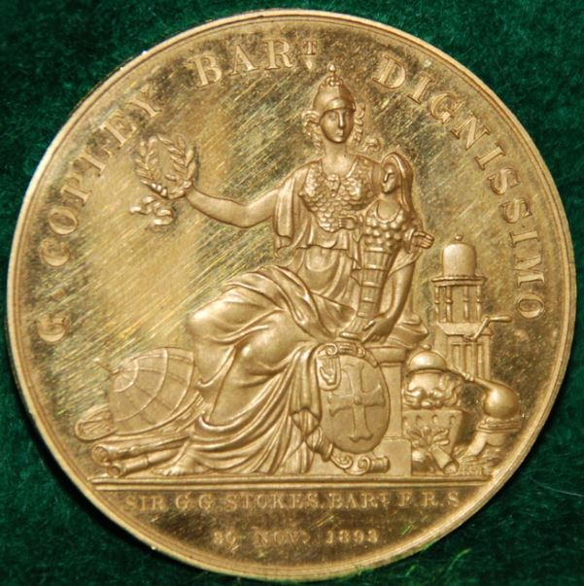
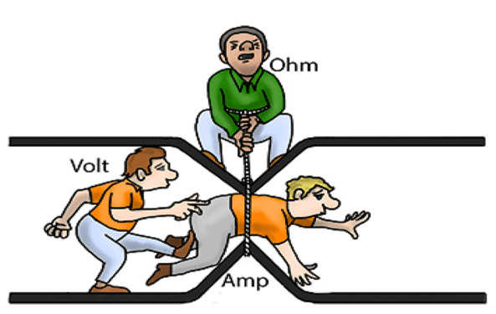
The vacuum tubes
1826 - Ohm rule
1826
Georg Simon Ohm
(1787-1854)
Copley Medal (1841)
"For his researches into the laws of electric currents contained in various memoirs published in Schweiggers Journal, Poggendorffs Annalen and in a separate work entitled Die galvanische Kette mathematisch bearbeitet"

Slide 5
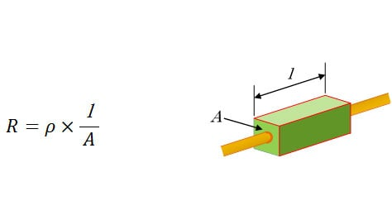
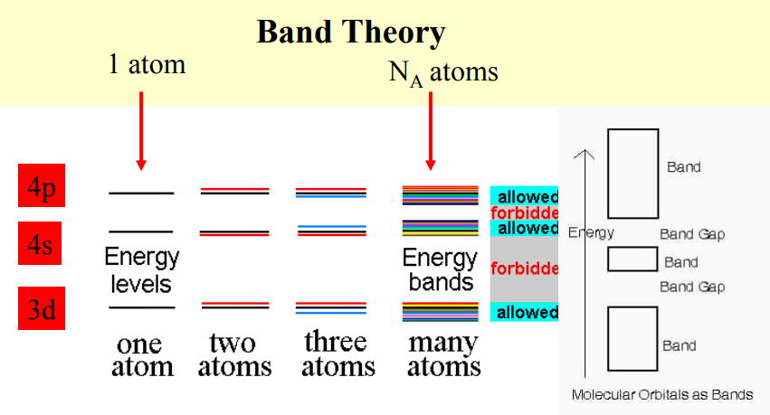
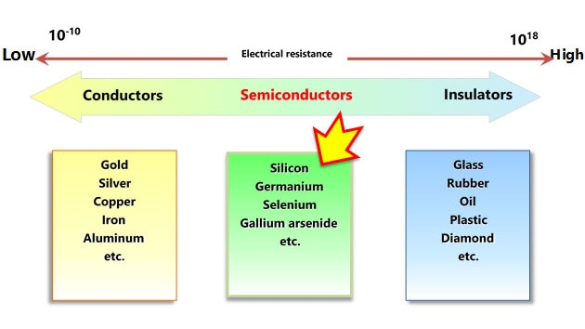
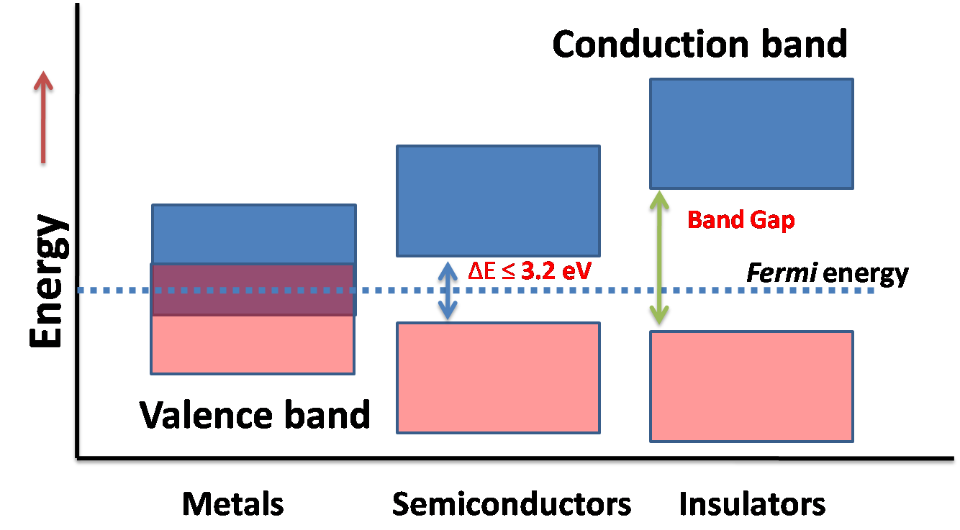
The vacuum tubes
Electrical resistivity of the materials
Macroscopic aspect
Band structure aspect
Electrical resistivity: Conductors: 10⁻⁸ to 10⁻⁴ Ωcm
Semiconductors: 10⁻⁴ to 10⁸ Ωcm
Insulators: 10⁸ to 10¹⁸ Ωcm

Slide 6
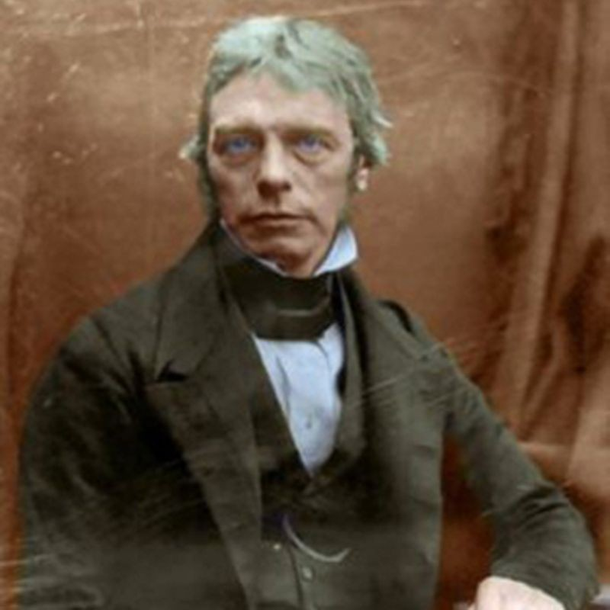
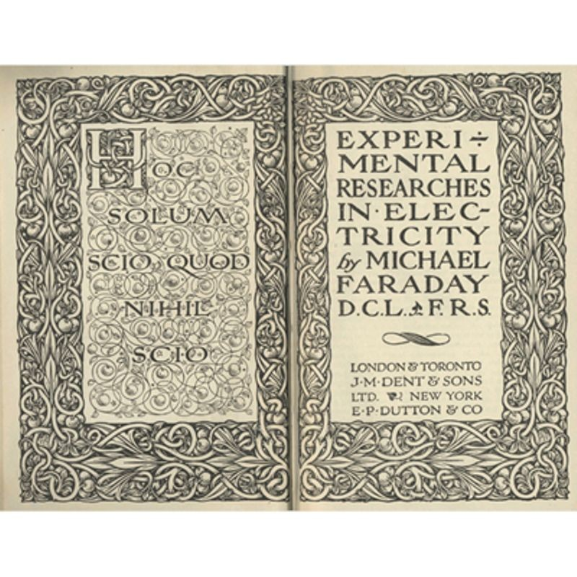
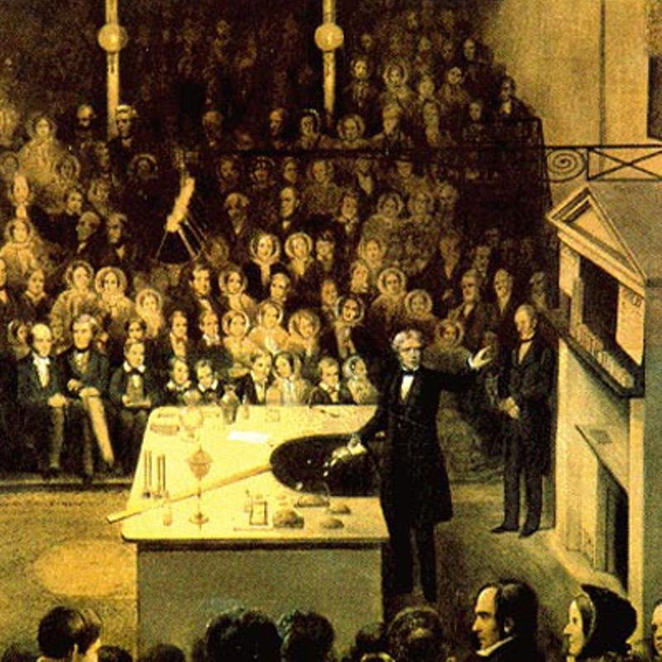
The vacuum tubes
Crookes tube
1833 - Silver sulfide: An extraordinary case
Michael Faraday
(1791-1867)
In a chapter entitled "On Conducting Power Generally" in his book Experimental Researches in Electricity Faraday writes "I have lately met with an extraordinary case ... which is in direct contrast with the influence of heat upon metallic bodies ... On applying a lamp ... the conducting power rose rapidly with the heat ... On removing the lamp and allowing the heat to fall, the effects were reversed."

Slide 7
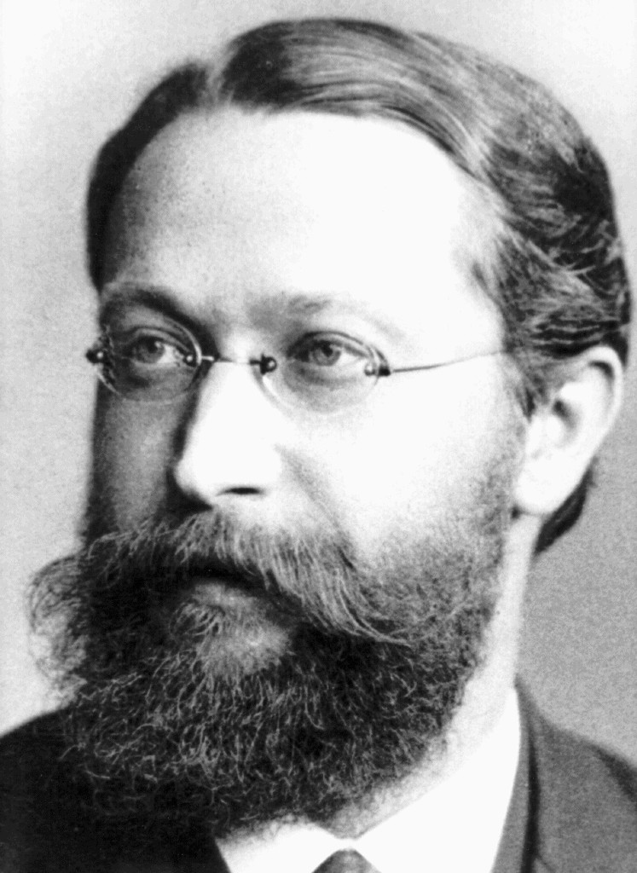
The vacuum tubes
1874 - The first point-contact rectifier (PbS)
Karl Ferdinand Braun (1850-1918)
Galena, lead glance, lead(II)sulfide, Crystals that required a light pressure „cat whisker detector” - a crude unstable point-contact metal–semiconductor junction, forming a Schottky barrier diode (0.25 mm diam. phosphor bronze wire) The Nobel Prize in Physics 1909 was awarded jointly to Guglielmo Marconi and Karl Ferdinand Braun "in recognition of their contributions to the development of wireless telegraphy."

Slide 8
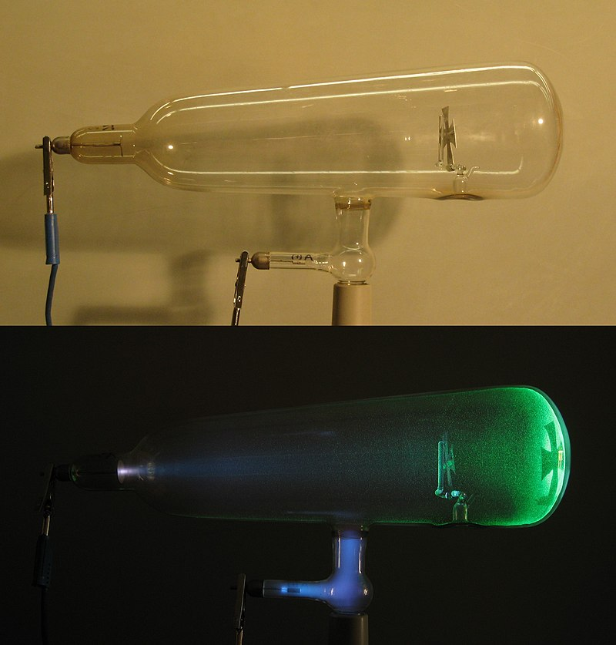
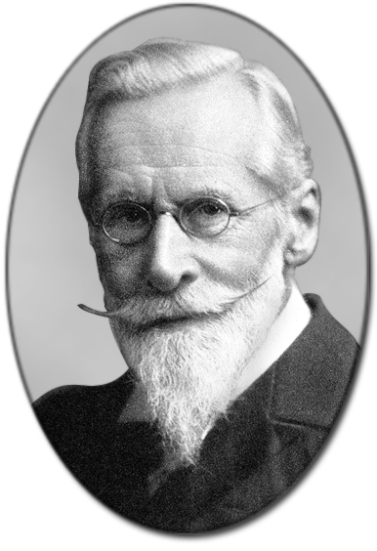
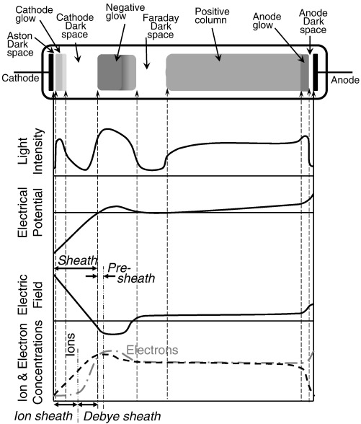
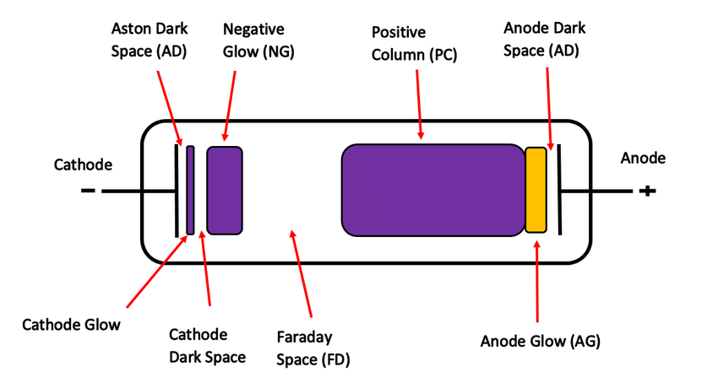
The vacuum tubes
Crookes tube
1878 -
Sir William Crookes
(1832-1919)

Slide 9
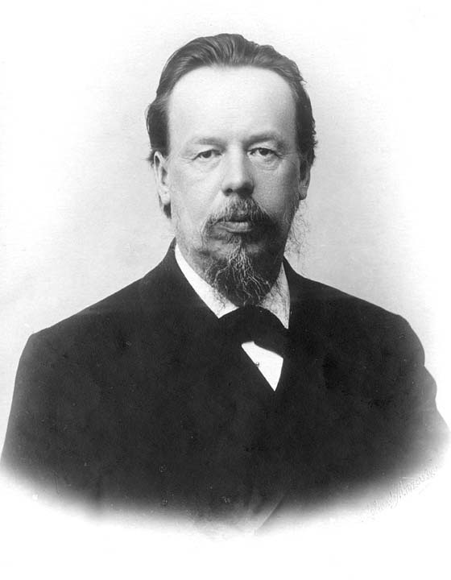
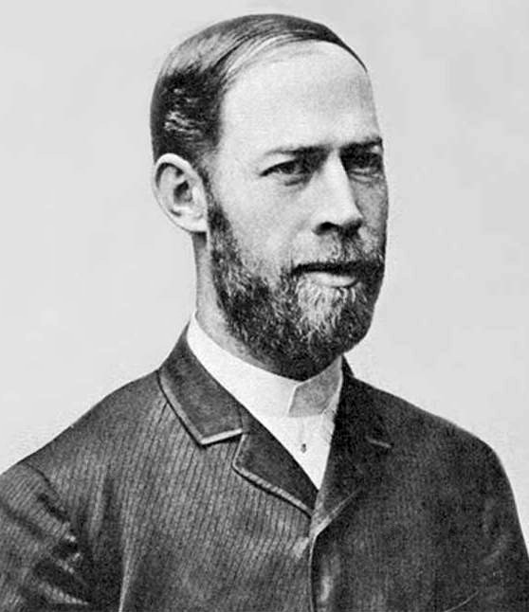
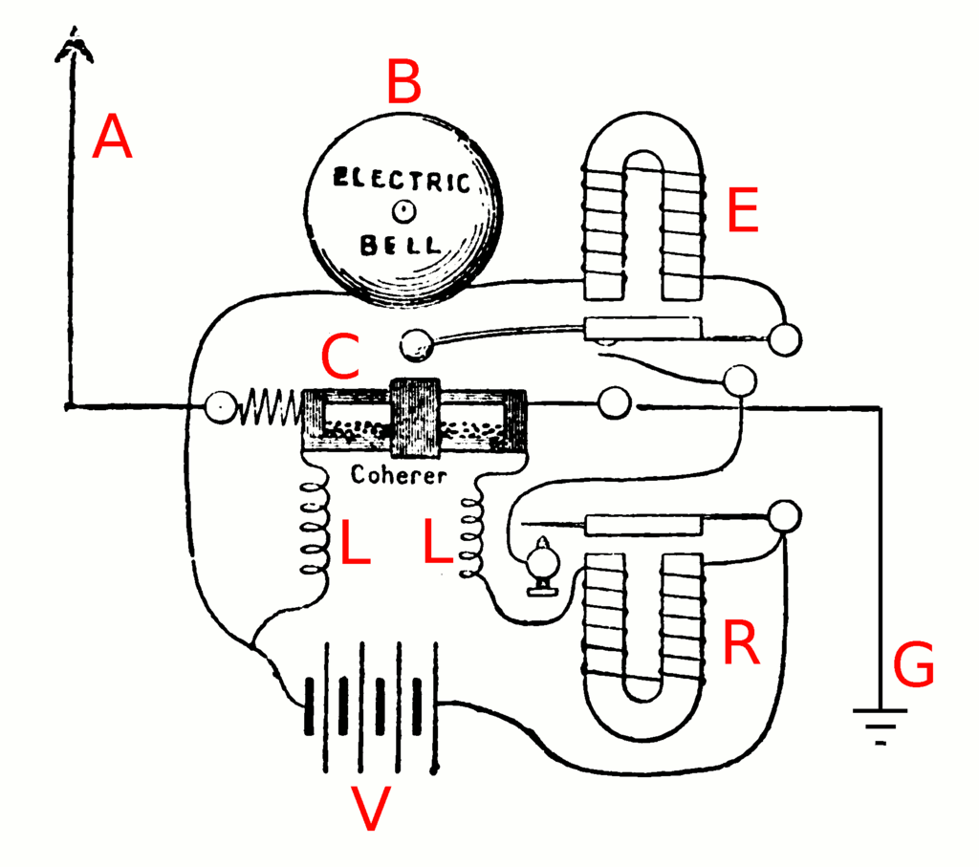
The vacuum tubes
1880? - 1886? - Electromagnetic waves
Heinrich Rudolf Hertz
(1857 – 1894)
Alexander Stepanovich Popov
(1859 –1906)
He transmitted radio signals 250 meters between different campus buildings in St. Petersburg.
Circuit of Popov's lightning detector

Slide 10
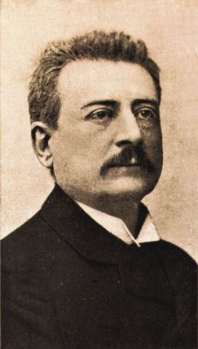
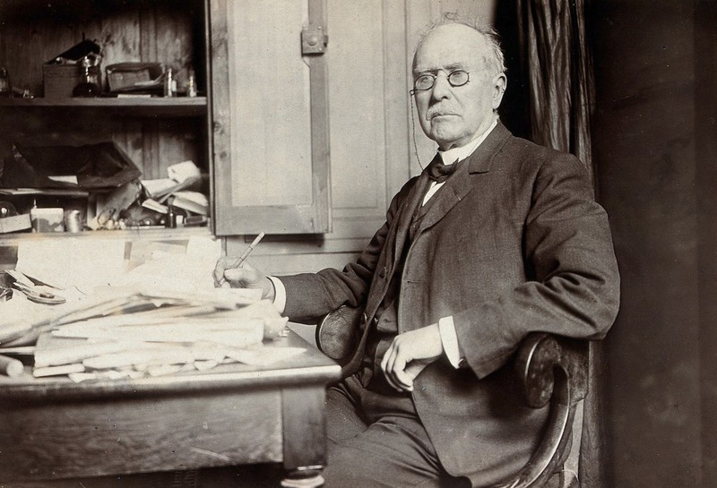
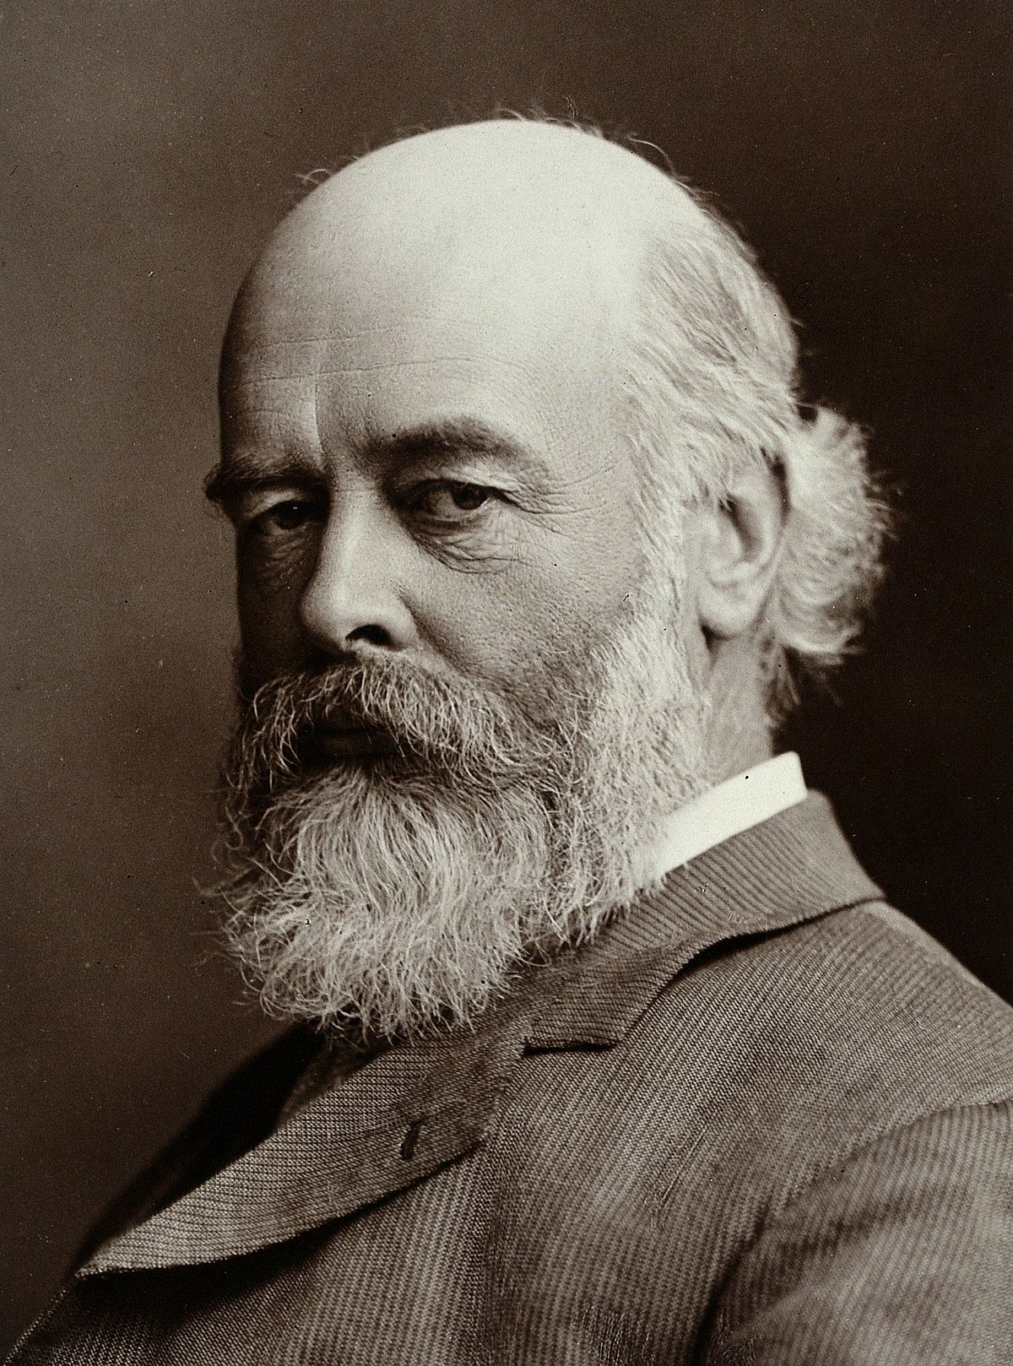
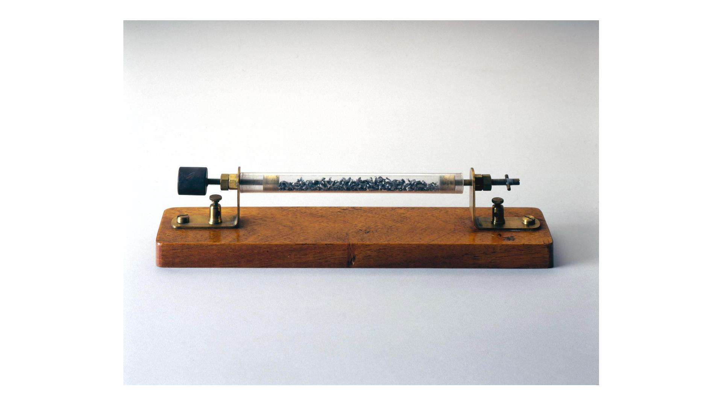
The vacuum tubes 1890 - Wireless telegraphy or radiotelegraphy
Édouard Eugène Désiré Branly
(1844 – 1940)
Sir Oliver Joseph Lodge
(1851 – 1940)
Temistocle Calzecchi Onesti
(1853 – 1922)
Lodge named the device "coherer"

Slide 11
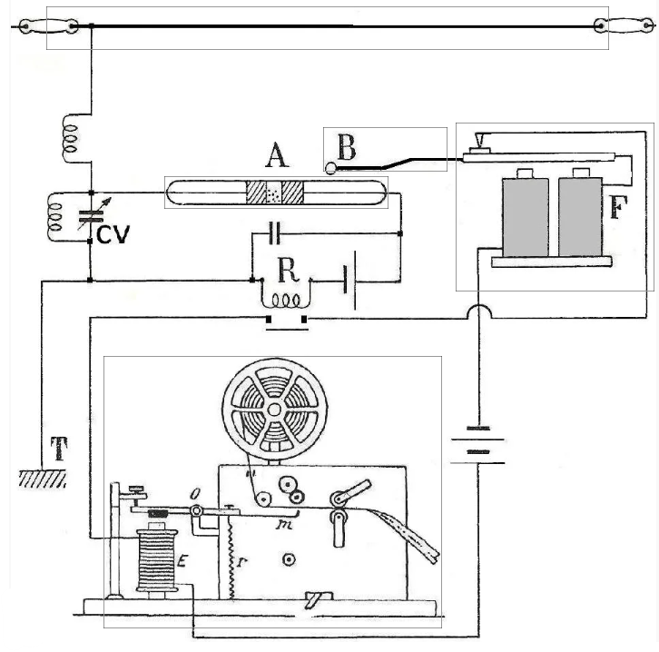
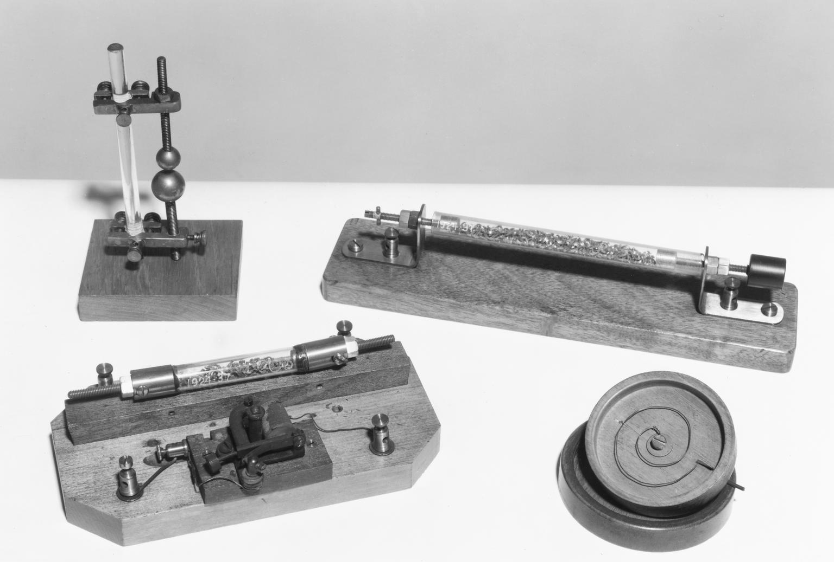
The vacuum tubes
1890 - Iron borings coherer (Branly type)

Slide 12
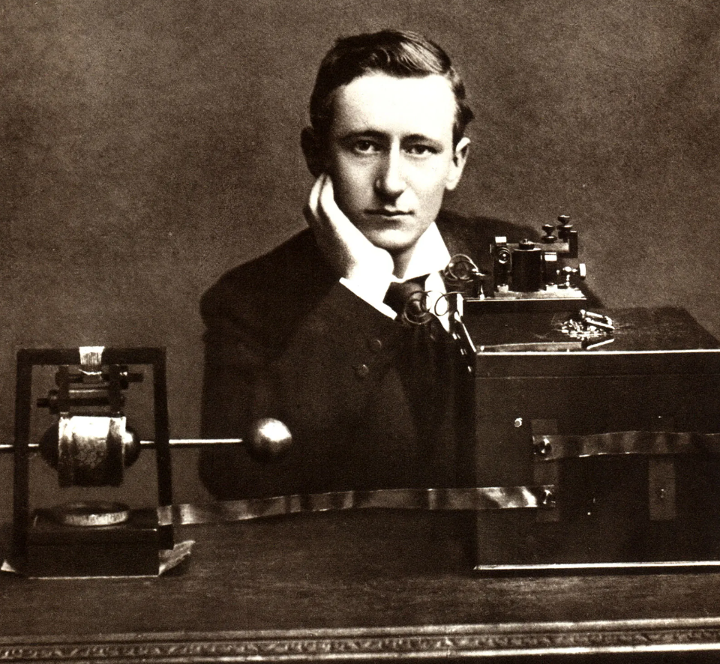
The vacuum tubes
1899-1901 Wireless telegraph
In 1897 he formed a wireless telegraph business in England. It made him rich.
1899 - La Manche
In 1901 Marconi sent radio signals across the Atlantic Ocean for the first time (3500 km). Some scientists had thought this could not be done. They believed that radio waves traveled in straight lines. As Earth’s surface curved, they said, the waves would go out into space. Marconi believed that the long waves he used would follow Earth’s curve. He was right.
1904 - Ships
1907 – Permanent Transatlantic wireless communication
Marconi was awarded a share of the Nobel prize in physics in 1909.
Guglielmo Marconi
(1874 – 1937)

Slide 13
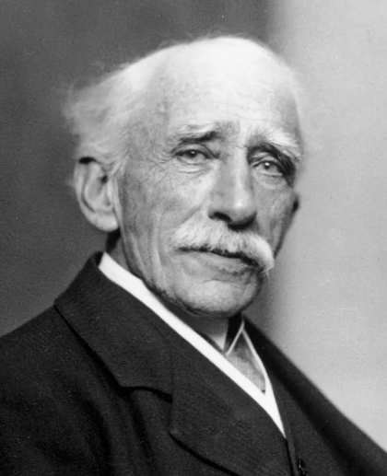
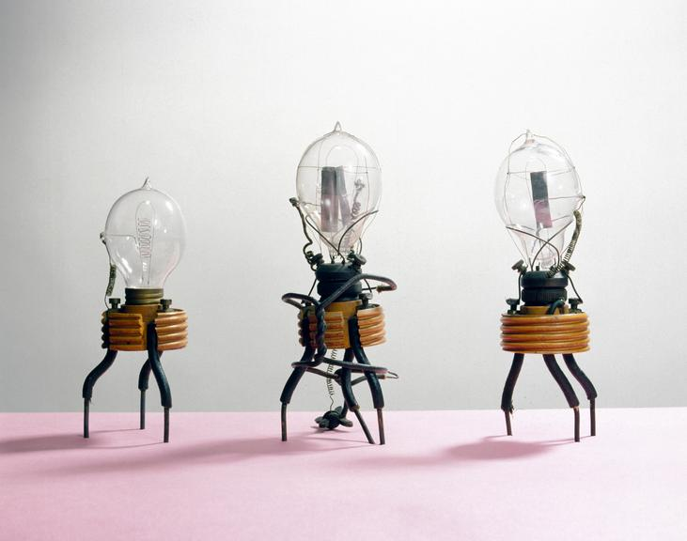
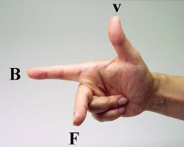
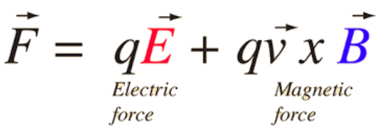
The vacuum tubes
The first electronic rectifier
1904 -
Sir John Ambrose Fleming (1849–1945)
John Ambrose Fleming invented the first practical electron tube called the 'Fleming Valve’. Fleming invents the vacuum tube diode.

Slide 14
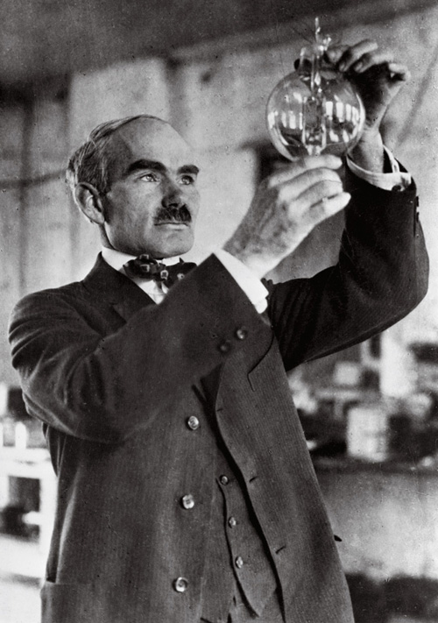
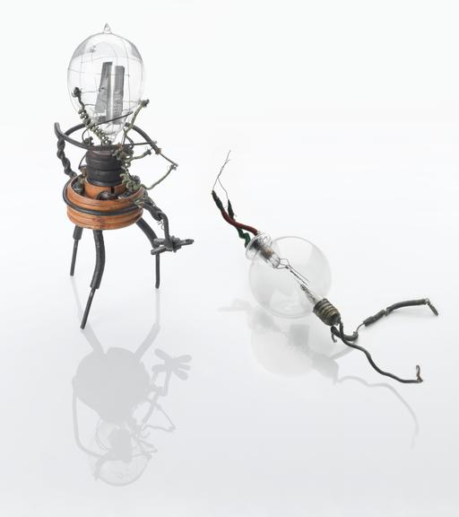
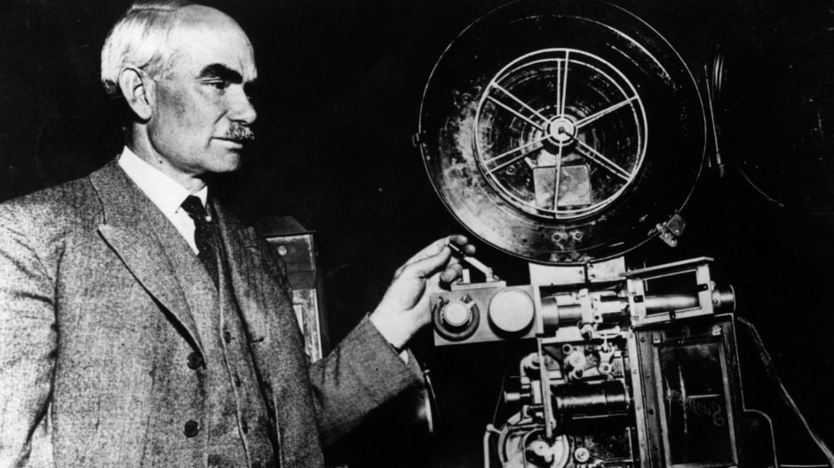
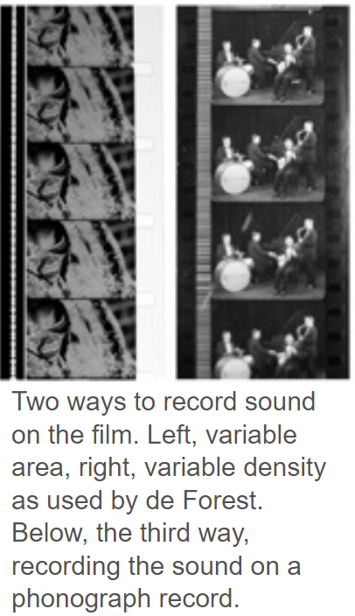
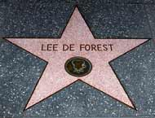
The vacuum tubes
‚”Audion” is the first triode
1906 - The first effective device for electrical amplification
Phonofilm 1918
Lee De Forest
(1873–1961)
Hollywood
Walk of Fame

Slide 15
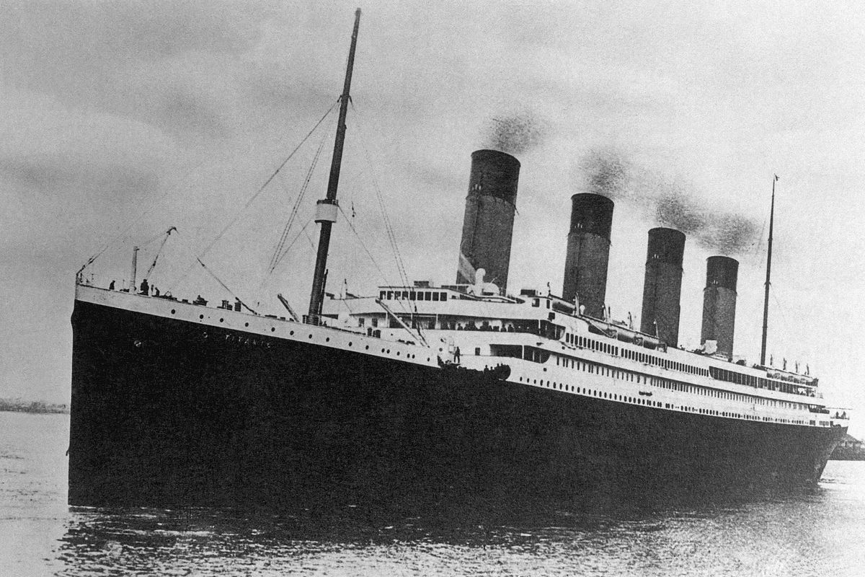
The vacuum tubes
‚1912 - Titanic
CQD CQD SOS Titanic Position 41.44 N 50.24 W.
Require immediate assistance.
Come at once.We struck an iceberg. Sinking’
(12.17am 15.April.1912)

Slide 16
The vacuum tubes
Tetrode
1916 / 1919
Walter Hans Schottky
(1886 – 1976)
Walter Schottky invented the first double-grid tube in 1916

Slide 17
The vacuum tubes
qqq
a

Slide 18
The vacuum tubes
qqq
a

Slide 19
The vacuum tubes
qqq
a

Slide 20
The vacuum tubes
qqq
a

