Slide 1
Temperature dependent timing in standard cell designs
A. Timár, M. Rencz

Slide 2
Problem description
Calculating temperature dependent timing in standard cell designs is necessary
Failing to take temperature dependent delays into account can fail timing closure and integrity
Device temperature and self-heating during operation can offset cell delays resulting in timing failures
E.g. clock skew, propagation delay changes
Correct functional operation may fail

Slide 3
Delay versus temperature data needed
How to make connection between timing and temperature data?
PVT variation data is available (Process, Voltage, Temperature)
Standard cell libraries are characterized for a few PVT corners
E.g. Supply voltage VDD = 4.5V…5V…5.5V Process mask variation = 0.9…1.0…1.1 Temperature = -40°C…27°C…125°C
Intermediate points are calculated by linear interpolation

Slide 4
Timing and delay data
Standard cell libraries usually provide timing, noise and power data for PVT corners
Liberty format (by Synopsys)
Timing Library Format (TLF, by Cadence)
Both contain the same data in different format
Timing data for each cell and each corner can be extracted
Delays should be modified according to temperature changes during logic simulation

Slide 5
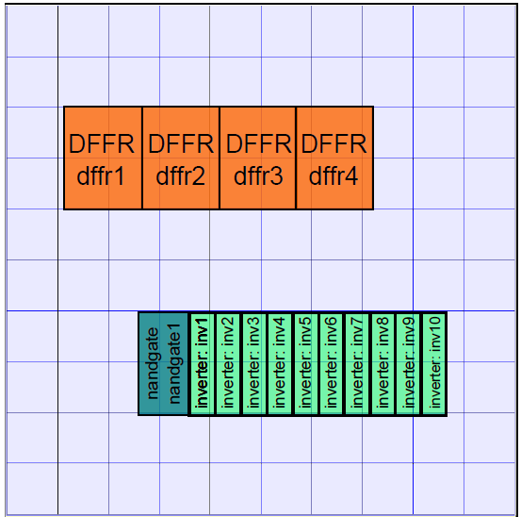
CellTherm logi-thermal simulator
Latest enhancements of the CellTherm* logi-thermal simulator include:
Temperature dependent delay calculation
Delay back-annotation during simulation
Partitioning and data serialization for simulation speedup
* CellTherm is researched and developed in the Department of Electron Devices, BME

Slide 6
Delay annotation from SDF
CellTherm connects a logic simulator and a thermal simulator and conveys data between them
The delay data for actual corners are extracted from SDF (Standard Delay Format) files
SDF files can be generated from the synthesis software
Pre- and post-layout SDFs can be extracted
Synthesis softwares calculate SDF data from the actual placement and (optional) routing of the standard cell design
SDF data is derived from the Liberty database according to the PVT corners
Result: SDF contains valid delay data for the specific design and corners

Slide 7
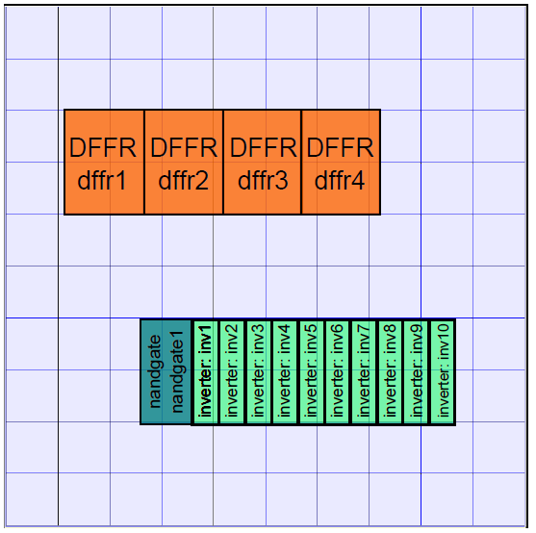
Demonstration
To demonstrate the necessity of temperature-aware timing simulation
Simple demonstration circuit: ring oscillator
Fictional standard cell library
Enlarged cell sizes
Increased power dissipations
Reduced temperature corner span
To emphasize temperature dependent timing
Ring oscillator

Slide 8
Ring oscillator demonstration
START
NAND
INV
INV
INV
INV
INV
INV
INV
INV
INV
INV
OSC_OUT

Slide 9
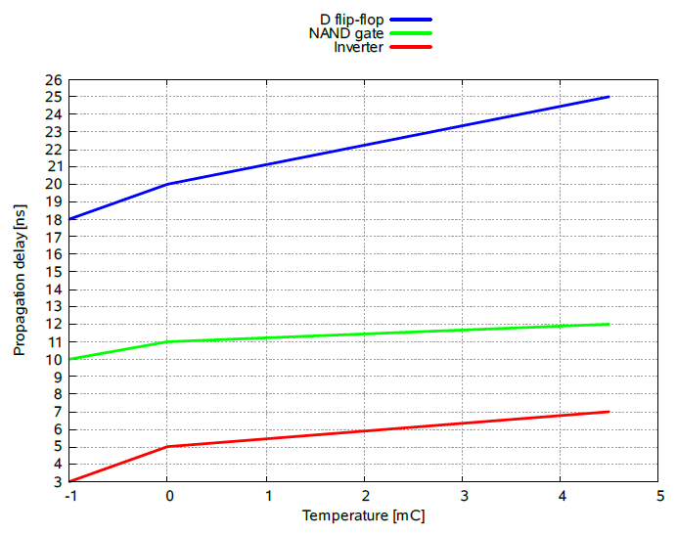
Delay vs Temperature functions
Demonstrational SDF
Temperature corners span reduced to visibly demonstrate temperature dependent delays

Slide 10
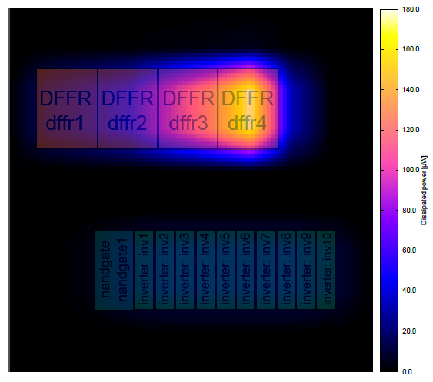
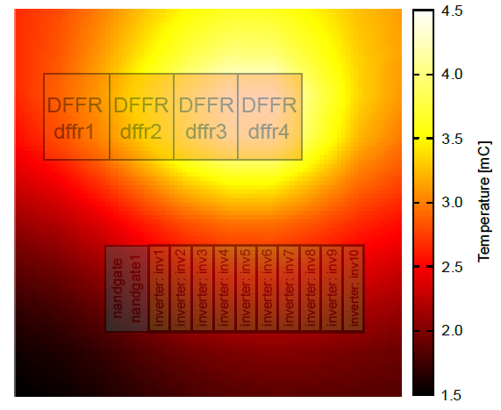
Thermal and power maps
Bi-linear interpolation of partition temperatures and dissipations result in smoother maps (like a 100x100 mesh)

Slide 11
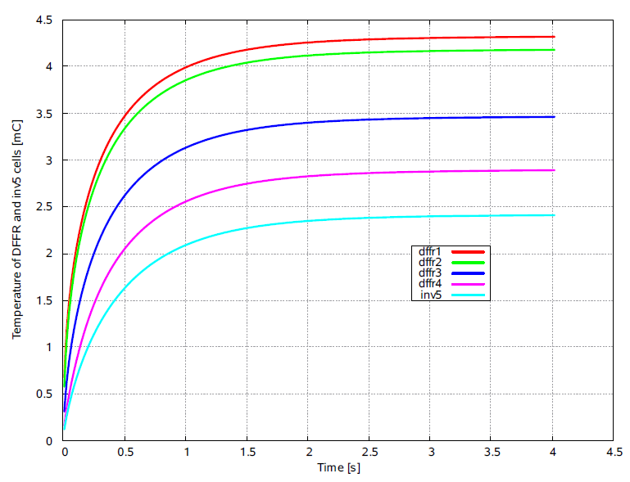
Cell temperatures over time

Slide 12
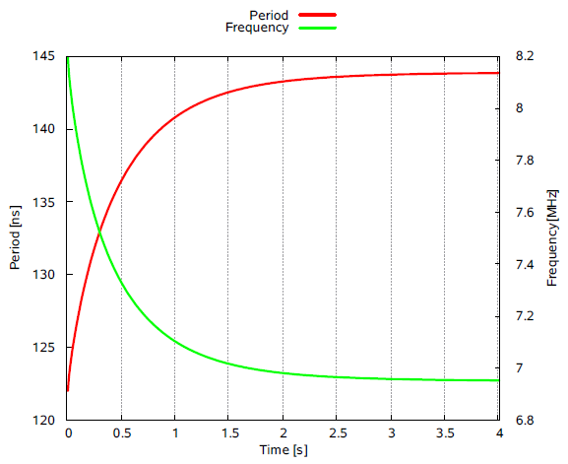
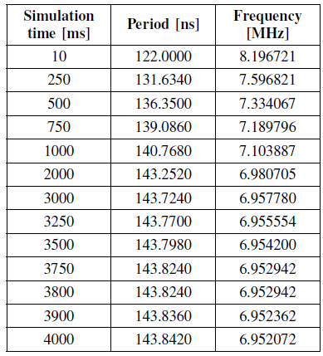
Frequency of ring oscillator

Slide 13
Summary
The latest improvements and enhancements were introduced in the CellTherm logi-thermal simulator
Temperature dependent delays can be calculated
The delays can be back-annotated into the logic simulation during runtime
A simple standard cell circuit has been made to demonstrate temperature-aware delay calculation
The demonstration ring oscillator’s frequency changes with the self-heating of the circuit
Delay-temperature curves are extracted from SDF files produced by synthesis software

Slide 14
Possible further improvements
Interpolating PVT corners results in rough delay calculations
More accurate and precise timing and power characterization in function of temperature is needed to calculate self-heating induced timing variation
Open source Liberty format can be extended to contain arbitrary number of temperature data points
This would allow simulation of sub-nanometer process effects like inverse temperature dependency (ITD) during a logi-thermal simulation
“Worst-case scenario is at maximum temperature” may not be true when ITD takes place

Slide 15
Acknowledgement
The work reported in this presentation was supported by
The THERMINATOR Project of the FW7 program of the EU
The Hungarian Government through the TÁMOP-4.2.1/B-09/1/KMR-2010-0002 project at the Budapest University of Technology and Economics

